Slide 1
Using this PowerPoint
Welcome to the ESCO 608 PowerPoint!
Items listed in RED are important items that may appear on the exam – pay close attention to these areas.
There are instructor notes written for each slide as well as the reference to the page in the ESCO preparatory manual the information can be found on.

Slide 2
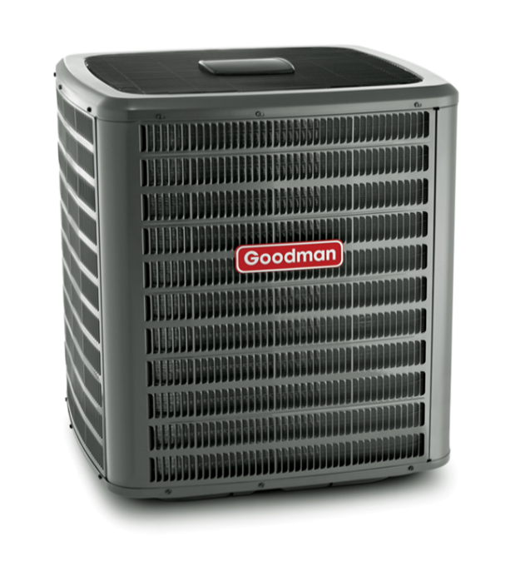
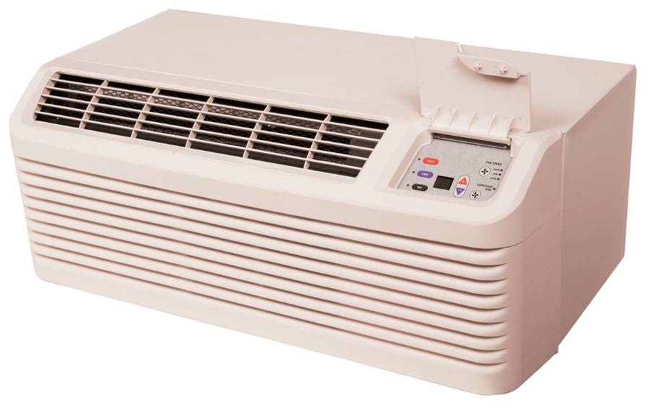

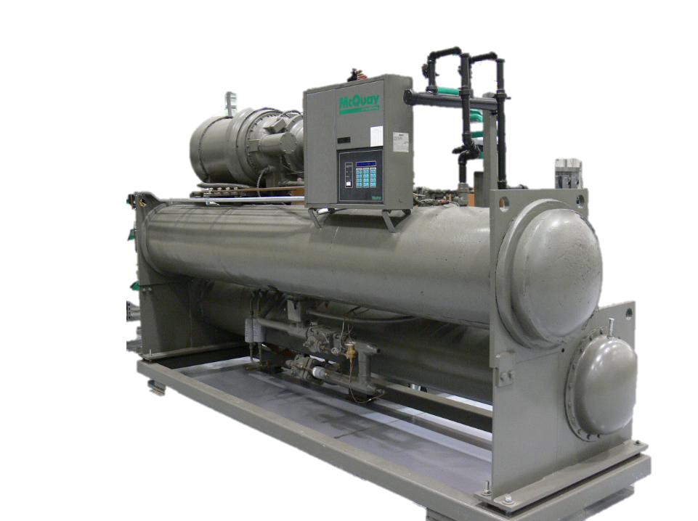
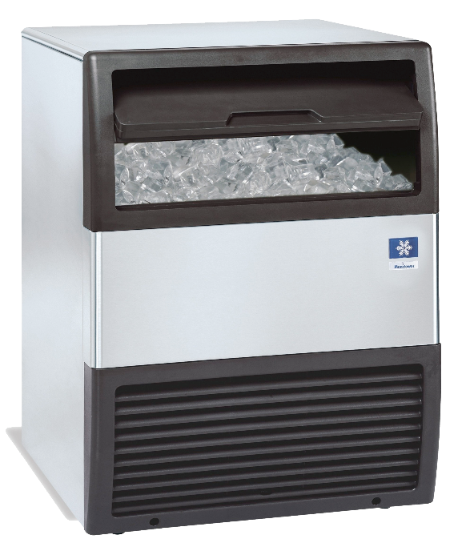
EPA Section 608 Preparatory Class
Notes:
ESCO EPA Section 608 Preparatory Manual 9th Edition V2 Page1
This power point is intended to prepare technicians for the Environmental Protection Agency’s (EPA) Section 608 Certification examination and contains information a technician will require to successfully complete the exam. This power point is meant to serve as a guide for reviewing material related to Section 608 of the Clean Air Act Amendment and is not intended as a formal refrigeration training course. Technicians preparing for this examination should be familiar with the basic vapor-compression refrigeration cycle, common service equipment, and procedures.
This power point has been developed with the most current information available at the time of this edition. Should EPA regulations change after a technician becomes certified, it is the responsibility of the technician to comply with any future changes. The EPA also reserves the right to modify the test questions and/or require new certification or recertification based on advancements in technology. The ESCO Institute will update this manual as necessary to reflect current EPA regulations and testing requirements

Slide 3
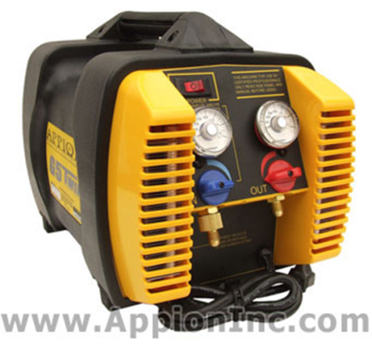
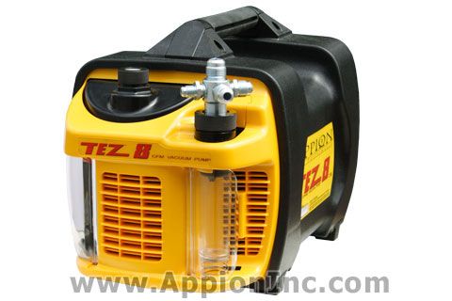
INTRODUCTION
This manual is intended to prepare technicians for the Environmental Protection Agency’s (EPA) Section 608 Certification examination and contains the information required to successfully complete the exam.
Notes:
ESCO EPA Section 608 Preparatory Manual 9th Edition V2 Page 1
This manual is intended to prepare technicians for the Environmental Protection Agency’s (EPA) Section 608 Certification examination and contains the information required to successfully complete the exam.

Slide 4
INTRODUCTION
This book serves as a guide for reviewing material related to Section 608 of the Clean Air Act and is not a formal refrigeration training course.
Technicians preparing for this examination should be familiar with the basic vapor-compression refrigeration cycle, as well as common service principles, practices, and procedures.
Notes:
ESCO EPA Section 608 Preparatory Manual 9th Edition V2 Page 1
This book serves as a guide for reviewing material related to Section 608 of the Clean Air Act and is not a formal refrigeration training course. Technicians preparing for this examination should be familiar with the basic vapor-compression refrigeration cycle, as well as common service principles, practices, and procedures.

Slide 5
INTRODUCTION
This manual has been developed with the most current information available at the time of publication.
Should EPA regulations change after a technician becomes certified, it is the responsibility of the technician to comply with these changes.
The EPA reserves the right to modify the test questions and/or require new certification or recertification based on advancements in technology.
The ESCO Institute will update this manual, as necessary, to reflect current EPA regulations and testing requirements.
Notes:
ESCO EPA Section 608 Preparatory Manual 9th Edition V2 Page 1
This manual has been developed with the most current information available at the time of publication. Should EPA regulations change after a technician becomes certified, it is the responsibility of the technician to comply with these changes. The EPA also reserves the right to modify the test questions and/or require new certification or recertification based on advancements in technology. The ESCO Institute will update this manual, as necessary, to reflect current EPA regulations and testing requirements.

Slide 6
FEDERAL REGULATIONS
Section 608 of the Clean Air Act requires all persons who maintain, service, repair, or dispose of appliances containing regulated refrigerants, be certified in proper refrigerant handling techniques as required by the National Recycling and Emission Reduction Program.
Regulated refrigerants currently include: CFC, HCFC, HFC, and HFO refrigerants.
Notes:
ESCO EPA Section 608 Preparatory Manual 9th Edition V2 Page 1
Section 608 of the Clean Air Act requires all persons who maintain, service, repair, or dispose of appliances containing regulated refrigerants, be certified in proper refrigerant handling techniques as required by the National Recycling and Emission Reduction Program. Regulated refrigerants currently include: CFC, HCFC, HFC, and HFO refrigerants.

Slide 7
FEDERAL REGULATIONS
If you maintain, service, repair, or dispose of appliances containing a regulated refrigerant, you must be certified.
This Means: YOU CANNOT WORK UNDER ANOTHER PERSON’S CERTIFICATION.
Notes:
ESCO EPA Section 608 Preparatory Manual 9th Edition V2 Page 1
If you maintain, service, repair, or dispose of appliances containing a regulated refrigerant, you must be certified.
This means you cannot work under another person’s certification.

Slide 8
BEFORE YOU BEGIN
In addition to this preparatory manual, practice questions are available to help prepare you for the EPA Section 608 examination.
You can access these practice questions, free of charge, on the ESCO website at www.escogroup.org/practice.
Notes:
ESCO EPA Section 608 Preparatory Manual 9th Edition V2 Page 1

Slide 9
BEFORE YOU BEGIN
If your examination was administered through an ESCO-approved testing location, you will be able to login to the ESCO website at www.escogroup.org to access your examination results, order replacement certification cards, update your information (i.e., address), opt out of the public certification registry, order additional training materials, etc.
Notes:
ESCO EPA Section 608 Preparatory Manual 9th Edition V2 Page 1
If your examination was administered through an ESCO-approved testing location, you will be able to login to the ESCO website at www.escogroup.org to access your examination results, order replacement certification cards, update your information (i.e., address), opt out of the public certification registry, order additional training materials, etc.

Slide 10
BEFORE YOU BEGIN
You may also contact ESCO’s customer service team, Monday-Friday, 8:00 AM 5:00 PM, Central Time at 1-800-726-9696 if you have any questions related to your certification.
Please note: if you participate in an examination that is administered in paper format (i.e., Scantron answer sheet), please allow 5-7 business days for your examination to be received at the ESCO grading center for processing.
Notes:
ESCO EPA Section 608 Preparatory Manual 9th Edition V2 Page 1
You may also contact ESCO’s customer service team, Monday-Friday, 8:00 AM 5:00 PM, Central Time at 1-800-726-9696 if you have any questions related to your certification. Please note: if you participate in an examination that is administered in paper format (i.e., Scantron answer sheet), please allow 5-7 business days for your examination to be received at ESCO’s grading center for processing.

Slide 11
OVERVIEW OF THE EXAMINATION (Core)
Core: The core covers fundamental information of the clean air act and is required for any one of the four levels of certifications. Failure to pass the core means no level of certification will be issued no matter the score on Type I, II, III.
Notes:
ESCO EPA Section 608 Preparatory Manual 9th Edition V2 Page 1
Overview of the Examination
The core covers fundamental information of the clean air act and is required for any one of the four levels of certifications. Failure to pass the core means no level of certification will be issued no matter the score on Type I, II, III.

Slide 12
OVERVIEW OF THE EXAMINATION (Core)
Core is required for any of the four levels of certifications.
Stratospheric Ozone Depletion
Global Warming Potential
Refrigerant Characteristics & Identification
Bubble And Dew Points
Low, Medium, High And Very High psi Refrigerants
Refrigerant Oils
Montreal Protocol / Clean Air Act
Recovery
Recovery Devices
Leak Detection
Dehydration Safety / General
Safety / Cylinder
Shipping
Notes:
ESCO EPA Section 608 Preparatory Manual 9th Edition Page 4
Overview of the Examination
Core is required for any of the four levels of certifications.
The core covers fundamental information of the clean air act and is required for any one of the four levels of certifications. Failure to pass the core means no level of certification will be issued no matter the score on Type I, II, III.

Slide 13
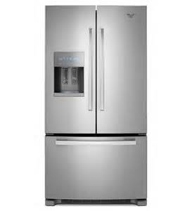
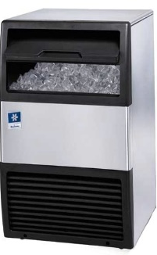
OVERVIEW OF THE EXAMINATION (Type 1)
Type I. Persons who maintain, service, repair, or dispose of small appliances must be certified as Type I technicians.
A small appliance is defined as a pre-assembled unit, hermetically sealed and factory charged with 5 lbs. or less of refrigerant.
Examples: water coolers, window units, refrigerators, freezers, de-humidifiers, ice machines, and package
terminal air conditioning.
Split-systems are not included in Type I.
Notes:
ESCO EPA Section 608 Preparatory Manual 9th Edition V2 Page 1
Type I.
Persons who maintain, service, repair, or dispose of small appliances must be certified as Type I technicians. A small appliance is defined as a pre-assembled unit, hermetically sealed and factory charged with 5 lbs. or less of refrigerant.
Examples include equipment such as water coolers, window units, refrigerators, freezers, de-humidifiers, residential ice machines, and package terminal air conditioning.
Split-systems are not included in Type I.

Slide 14
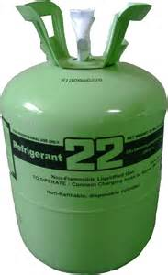
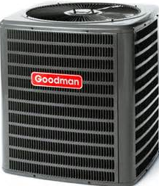
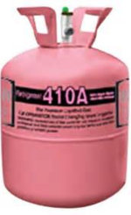
OVERVIEW OF THE EXAMINATION (Type 1I)
Type II. Persons who maintain, service, repair, or dispose of appliances, containing more than 5 lbs. of refrigerant, or if the installation of such equipment requires refrigerant charging, must be certified as Type II technicians.
Type II certification does not include small appliances or motor vehicle air-conditioning (MVAC) systems.
Notes:
ESCO EPA Section 608 Preparatory Manual 9th Edition V2 Page 1
Type II.
Persons who maintain, service, repair, or dispose of appliances, containing more than 5 lbs. of refrigerant, or if the installation of such equipment requires refrigerant charging, must be certified as Type II technicians. Type II certification does not include small appliances or motor vehicle air-conditioning (MVAC) systems.
It is important to understand the refrigerant pressure of each certification category. Type II certification includes medium-pressure, high-pressure, and very high-pressure appliances. If a system requires refrigerant line connections or charging in the field, even if it is less than 5 lbs., the technician must be certified as Type II.
High-pressure refrigerants have a pressure between 155 psig & 340 psig at a liquid-phase temperature of 104°F and medium-pressure refrigerants have a pressure between 30 psig & 155 psig at a liquid-phase temperature of 104°F.

Slide 15
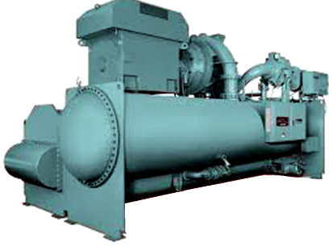
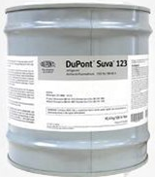
OVERVIEW OF THE EXAMINATION (Type III)
Type III. Persons who maintain, service, repair, or dispose of low-pressure appliances, such as centrifugal and chillers, must be certified as
Type III technicians.
Low-pressure appliances operate with low-pressure refrigerants, which have pressures of 30 psig, or lower, at a liquid-phase temperature of 104°F. HCFC-123 used in chillers is a “low-pressure refrigerant” under EPA’s Section 608 regulations to replace CFC-11.
Notes:
ESCO EPA Section 608 Preparatory Manual 9th EditionV2 Page 1
Type III.
Persons who maintain, service, repair, or dispose of low-pressure appliances, such as centrifugal and chillers, must be certified as Type III technicians. Low-pressure appliances operate with low-pressure refrigerants, which have pressures of 30 psig, or lower, at a liquid-phase temperature of 104°F. HCFC-123 used in chillers is a “low-pressure refrigerant” under EPA’s Section 608 regulations to replace CFC-11.

Slide 16
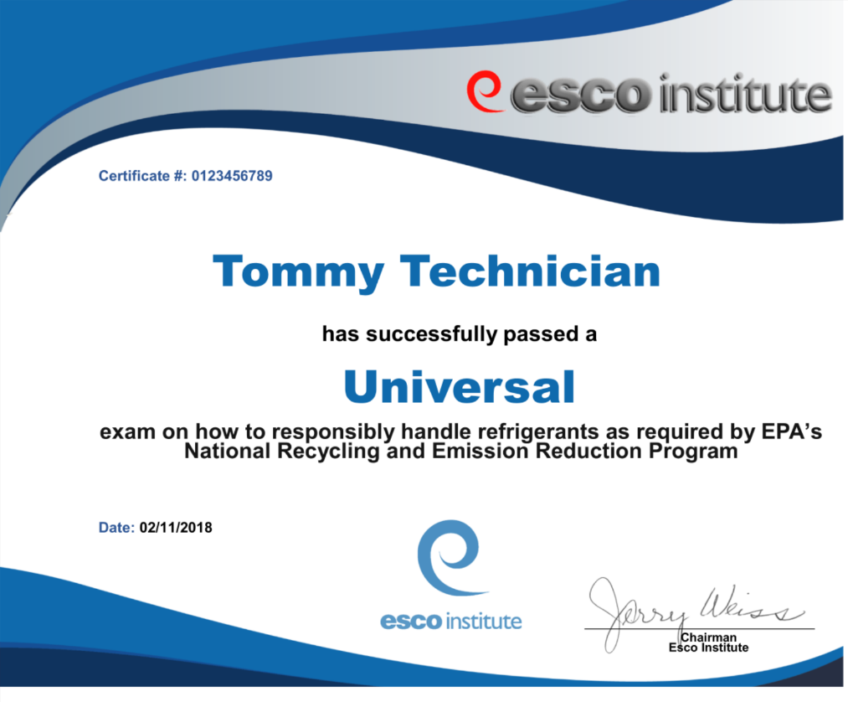
OVERVIEW OF THE EXAMINATION (Universal)
Universal. Persons, who maintain, service, or repair both low and high-pressure equipment, as well as small appliances, must be certified as Universal technicians.
Notes:
ESCO EPA Section 608 Preparatory Manual 9th Edition V2 Page 2
Universal.
Persons, who maintain, service, or repair both low and high‐pressure equipment, as well as small appliances, must be certified as Universal technicians.

Slide 17
TEST FORMAT
The test contains four sections: Core, and sections I, II, and III. Each section contains twenty-five (25) multiple-choice questions.
A technician MUST achieve a minimum passing score of 70 percent in each group/section in which they are to be certified. For example, a technician seeking Universal certification must achieve a minimum score of 70 percent, or 18 out of 25 correct, on each section of the test.
If a technician fails one or more of the sections, they may retake the failed section(s) without retaking the section(s) in which they earned a passing score. In the meantime, the technician will be certified in the Type(s) for which they received a passing score.
There is one exception; a technician MUST achieve a passing score on the Core plus any one Type to receive any certification.
Notes:
ESCO EPA Section 608 Preparatory Manual 9th Edition V2 Page 2
The test contains four sections: Core, and sections I, II, and III. Each section contains twenty-five (25) multiple-choice questions. A technician MUST achieve a minimum passing score of 70 percent in each group/section in which they are to be certified. For example, a technician seeking Universal certification must achieve a minimum score of 70 percent, or 18 out of 25 correct, on each section of the test. If a technician fails one or more of the sections, they may retake the failed section(s) without retaking the section(s) in which they earned a passing score. In the meantime, the technician will be certified in the Type(s) for which they received a passing score. There is one exception; a technician MUST achieve a passing score on the Core plus any one Type to receive any certification.

Slide 18
TEST FORMAT
The Core contains 25 general knowledge questions relating to stratospheric ozone depletion, rules and regulations of the Clean Air Act, the Montreal Protocol, refrigerant recovery, recycling and reclaiming, recovery devices, substitute refrigerants and oils, recovery techniques, dehydration, recovery cylinders, safety, and shipping.
Type I contains 25 sector-specific questions pertaining to small appliances.
Type II contains 25 sector-specific questions pertaining to medium and high-pressure appliances.
Type III contains 25 sector-specific questions pertaining to low-pressure appliances.
Notes:
ESCO EPA Section 608 Preparatory Manual 9th Edition V2 Page 2
The Core contains 25 general knowledge questions relating to stratospheric ozone depletion, rules and regulations of the Clean Air Act, the Montreal Protocol, refrigerant recovery, recycling and reclaiming, recovery devices, substitute refrigerants and oils, recovery techniques, dehydration, recovery cylinders, safety, and shipping.
Type I contains 25 sector-specific questions pertaining to small appliances.
Type II contains 25 sector-specific questions pertaining to medium and high-pressure appliances.
Type III contains 25 sector-specific questions pertaining to low-pressure appliances.

Slide 19

TEST FORMAT
Federal regulations require that this exam be conducted as a closed-book exam by an authorized test administrator (Proctor).
The only outside materials allowed during the test are a pressure-temperature chart and a calculator.
Phones are NOT allowed MUST be turned off and put away.
(Best to not allow phones in testing room.)
Notes:
ESCO EPA Section 608 Preparatory Manual 9th Edition V2 Page 2
Federal regulations require that this exam be conducted as a closed-book exam by an authorized test administrator (Proctor). The only outside materials allowed during the test are a pressure-temperature (PT) chart and a calculator. Phones are NOT allowed to be used during the examination and MUST be turned off and put away (not on the desktop) during the examination.

Slide 20


TEST FORMAT
Use of any other electronic communication device, or attempts to copy, distribute, post publicly, share photos of exam questions, etc., may result in revocation of certification and will be reported to the U.S. EPA.
Notes:
ESCO EPA Section 608 Preparatory Manual 9th Edition V2 Page 2
Use of any other electronic communication device, or attempts to copy, distribute, post publicly, share photos of exam questions, etc., may result in revocation of certification and will be reported to the U.S. EPA.

Slide 21
TEST FORMAT
Personal information required for the exam:
Picture Identification (Required)
Social security number (Used for identification purposes only.)
Home/mailing address
Date of Birth
Phone Number
Email address
Notes:
ESCO EPA Section 608 Preparatory Manual 9th Edition V2 Page 2
Certain personal information is requested on the exam. Technicians should be prepared to provide:
Picture Identification (Proctors will ask for this to verify your identity–this is required.)
Social security number (Used for identification purposes only.)
Home/mailing address
Date of Birth
Phone Number
Email address

Slide 22
TEST FORMAT
As required, all examination participants will be included in an online registry/lookup by name, city and state, as well as certification achieved.
No personal information will be included in the public registry.
Technicians will be able to opt out of this registry by logging into the ESCO website at www.escogroup.org or by contacting customer service at 800-726-9696.
Notes:
ESCO EPA Section 608 Preparatory Manual 9th Edition V2 Page 2
As required, all examination participants will be included in an online registry/lookup by name, city and state, as well as certification achieved. (No personal information will be included in the public registry.) Technicians will be able to opt out of this registry by logging into the ESCO website at www.escogroup.org or by contacting customer service at 800-726-9696.

Slide 23
TEST FORMAT
Technicians should carefully study the Core and section(s) related to the Type(s) of certification in which they are seeking to achieve a passing score.
Free EPA practice exams can be found online at: www.escogroup.org/practice
Practice exams are provided to give exam candidates a sample of the types of questions they can expect to encounter on the exam and are not intended to be a sole study source.
Notes:
ESCO EPA Section 608 Preparatory Manual 9th Edition V2 Page 2
Technicians should carefully study the Core and section(s) related to the Type(s) of certification in which they are seeking to achieve a passing score.
Free EPA practice exams can be found online at: www.escogroup.org.
Practice exams are provided to give exam candidates a sample of the types of questions they can expect to encounter on the exam and are not intended to be a sole study source.

Slide 24
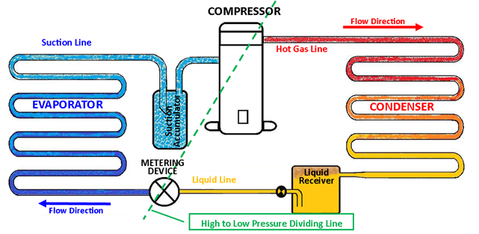
VAPOR - COMPRESSION REFRIGERATION CYCLE
Low
High
Notes:
ESCO EPA Section 608 Preparatory Manual 9th Edition V2 Page 3
Vapor- Compression Refrigeration Cycle
The compressor is the heart of the vapor-compression refrigeration cycle. Low-pressure, low-temperature, superheated refrigerant vapor enters the compressor and is compressed, changing it to a high-pressure, high-temperature, superheated vapor. It then moves to the condenser where some of the heat is removed, de-superheating and condensing it into a liquid. Before it leaves the condenser as a high-pressure liquid, the liquid refrigerant is subcooled to a point below the liquid saturation temperature. It then flows to the metering or expansion device as a high-pressure, subcooled liquid. As the refrigerant flows through the metering device, the pressure of the liquid is reduced, causing a small percentage of the liquid to flash to a vapor (flash-gas), lowering the temperature of the remaining refrigerant to its saturation temperature. The low-pressure, low-temperature refrigerant flows into the evaporator as a
low-temperature saturated refrigerant. As the refrigerant absorbs heat, it evaporates into a low-temperature vapor. This evaporation process is referred to as direct expansion. During this process, the refrigerant vapor is superheated above its saturation temperature and then enters the suction line. From the suction line, refrigerant enters the compressor as a low-pressure, low-temperature, superheated vapor to repeat the cycle. The compressor and the metering device are the dividing points between the low-pressure and high-pressure sides of the system.

Slide 25
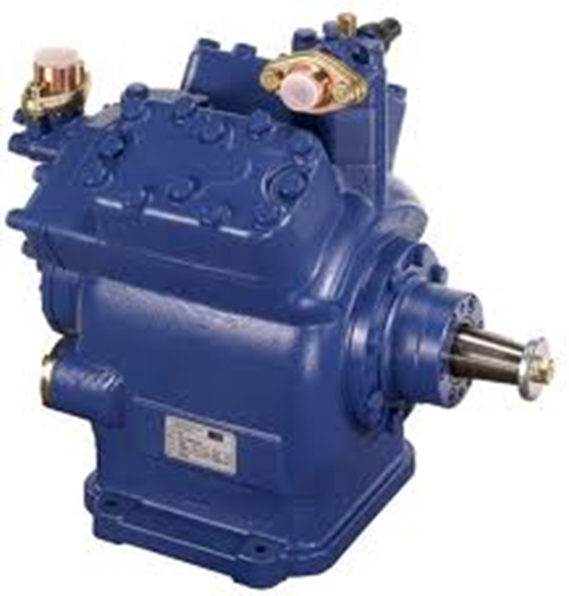
COMPRESSOR
Low-pressure and
low-temperature superheated vapor in
High-pressure & temperature, highly superheated vapor out
Notes:
ESCO EPA Section 608 Preparatory Manual 9th Edition V2 Page 3
The compressor is the heart of the vapor-compression refrigeration cycle. Low-pressure, low-temperature superheated refrigerant vapor entering the compressor is compressed, changing it to a high-pressure, high-temperature, superheated vapor.

Slide 26
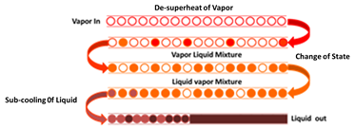
CONDENSER
Three stages of the condenser:
De-superheats
Change of state (Vapor to Liquid)
Subcools
Notes:
ESCO EPA Section 608 Preparatory Manual 9th Edition V2 Page 3
The refrigerant then moves to the condenser where the heat is removed, de-superheating and condensing it into a liquid. Before it leaves the condenser, the liquid refrigerant is subcooled to a point below the liquid saturation temperature.

Slide 27
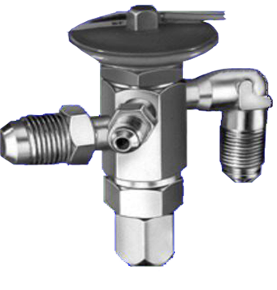
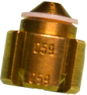
METERING DEVICE
Low-pressure liquid and
flash-gas out
High-pressure subcooled liquid in
TEV
Fixed Orifice
Notes:
ESCO EPA Section 608 Preparatory Manual 9th Edition V2 Page 3
The refrigerant then flows to the metering device as a high-pressure, subcooled liquid. As the refrigerant flows through the metering device, the liquid is reduced to a low-pressure causing a small percentage of the liquid to flash to a vapor (flash-gas) lowering the remaining refrigerant to its saturation temperature.

Slide 28
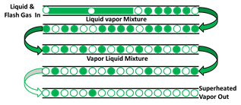
EVAPORATOR
Low-pressure & temperature superheated vapor leaves
Low-pressure & temperature liquid with some flash-gas enters
Notes:
ESCO EPA Section 608 Preparatory Manual 9th Edition V2 Page 3
The low-pressure, low-temperature refrigerant flows into the evaporator as a low-temperate liquid with some flash-gas. As the refrigerant absorbs heat, it evaporates into a low-temperature vapor. Before refrigerant vapor exits the evaporator and enters the suction line, additional heat superheats the vapor above its saturation temperature.

Slide 29
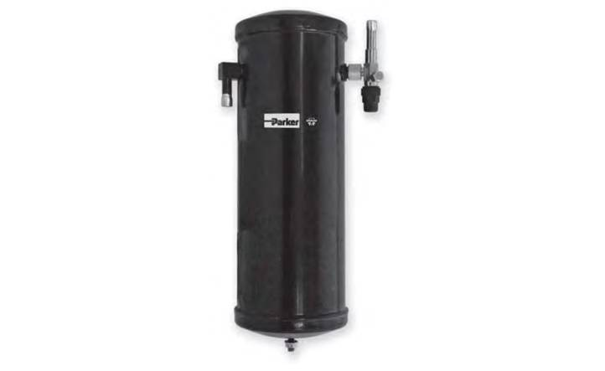
ACCESSORIES
A system that uses a thermostatic expansion valve (TEV) is usually equipped with a receiver located in the liquid line, directly following the condenser.
High-Pressure Liquid
Receiver
Notes:
ESCO EPA Section 608 Preparatory Manual 9th Edition V2 Page 3
A system that uses a thermostatic expansion valve (TEV) is usually equipped with a receiver located in the liquid line, directly following the condenser. The receiver should be used on systems with varying loads to ensure liquid to the expansion valve.

Slide 30
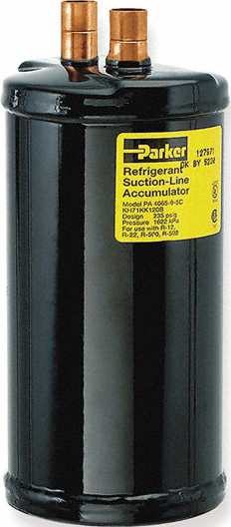
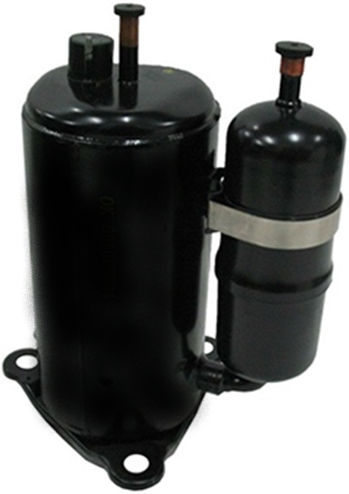
ACCESSORIES
An accumulator when used is located in the suction line.
Accumulators prevent any liquid refrigerant that may flow from the evaporator from flowing into the compressor.
Notes:
ESCO EPA Section 608 Preparatory Manual 9th Edition V2 Page 3
Accumulators are used to protect the compressor by preventing any liquid refrigerant from flowing into it.

Slide 31
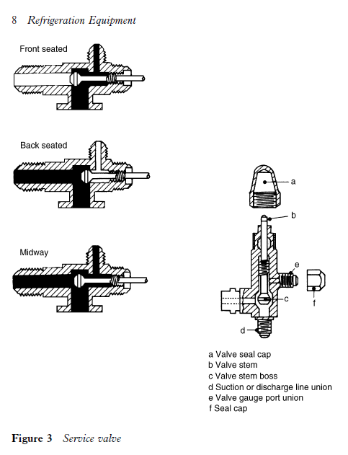
ACCESSORIES
Service valve in back-seated position.
Service Port
Back-Seated
Position
Line
Port
Line
Port
Compressor
Port
Notes:
ESCO EPA Section 608 Preparatory Manual 9th Edition V2 Page 3
A system may have service valves, access valves or process stubs to gain access for service. The valve must be back-seated (turn the valve stem counter-clockwise as far as possible) to close the service or gauge port before removing the service manifold hoses.

Slide 32
ACCESSORIES
Service valve in front-seated position.
Service
Port
Front- Seated
Position
Line Port
Compressor
Port
Notes:
ESCO EPA Section 608 Preparatory Manual 9th Edition V2 Page 3
Never front-seat (turn the valve stem clockwise as far as it will go) a service valve when the system is in operation.
The black solid color is where the refrigerant will flow in the front-seated position. The line port is closed, and compressor port is open to the service port.

Slide 33
ACCESSORIES
Service Valve in Mid-seated position.
Service
Port
Mid-Seated
Position
Line Port
Compressor
Port
Notes:
ESCO EPA Section 608 Preparatory Manual 9th Edition V2 Page 3
All three connections are open in the crack-seat position. The line port, compressor port, and service port are all open.
This position is for servicing and checking pressures.

Slide 34
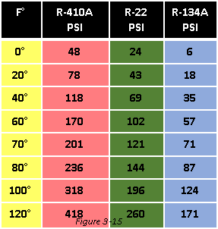
HOW TO USE THE PRESSURE -TEMPERATURE CHART
A pressure-temperature (PT) chart provides the pressure-temperature relationship of refrigerants.
At 70°F, the psi for 410A is 201 psi.
Notes:
ESCO EPA Section 608 Preparatory Manual 9th Edition V2 Page 4
A pressure-temperature (PT) chart provides the pressure-temperature relationship of refrigerants used in the HVACR industry. The charts are based on the saturation properties for which a refrigerant evaporates and condenses. Liquid must be present for the relationship to match. For example, a PT chart will indicate a cylinder at 70°F containing 1 ounce or 10 lbs of liquid R-410A will have a pressure of 201 psig. Likewise, the evaporator or condensing temperature can be found by comparing the operating suction or high-side pressure for the type of refrigerant to the corresponding temperature.

Slide 35
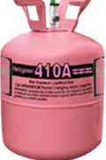
PRESSURE -TEMPERATURE RELATIONSHIP
Whether the tank is half full or has just a few ounces of liquid, the pressure will be the same if both tanks are at the same temperature.
80°F
236 Psig
80°F
236 Psig
410A
410A
Notes:
ESCO EPA Section 608 Preparatory Manual 9th Edition V2 Page 4
Whether the tank is half full or has just a few ounces of liquid, the pressure will be the same if both tanks are at the same temperature.

Slide 36
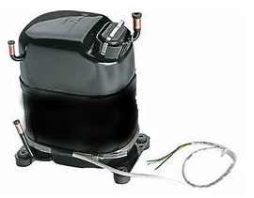
REFRIGERATION SERVICE
Refrigerant will migrate to a compressor's crankcase and mix with the oil when there is a difference between the oil pressure and refrigerant vapor pressure.
The compressor crankcase heater is used to help prevent this refrigerant migration.
Notes:
ESCO EPA Section 608 Preparatory Manual 9th Edition V2 Page 4
Refrigerant will migrate to a compressor's crankcase and mix with the oil when there is a difference between the oil pressure and refrigerant vapor pressure. The compressor crankcase heater is used to help prevent this refrigerant migration.

Slide 37
REFRIGERATION SERVICE
An oil sample should be taken when the unit has had a leak or a major component failure.
Refrigerant oil samples are also taken when moisture, acid, oil sludge formation, oil waxing, or residual acidic oil from a burn-out are suspected problems.
Notes:
ESCO EPA Section 608 Preparatory Manual 9th Edition V2 Page 4
An oil sample should be taken when unit has had a leak or a major component failure. Refrigerant oil samples are also taken when moisture, acid, oil sludge formation, oil waxing, or residual acidic oil from a burn-out are suspected problems.

Slide 38
REFRIGERATION SERVICE
Finding and repairing leaks in the system will conserve refrigerant when servicing an appliance.
Flushing field tubing with liquid refrigerant to clean the tubing after a burn-out is not recommended, and it is unlawful.
Notes:
ESCO EPA Section 608 Preparatory Manual 9th Edition V2 Page 4
Finding and repairing leaks in the system will conserve refrigerant when servicing an appliance. Flushing field tubing with liquid refrigerant to clean the tubing after a burn-out is not recommended, and it is unlawful.

Slide 39
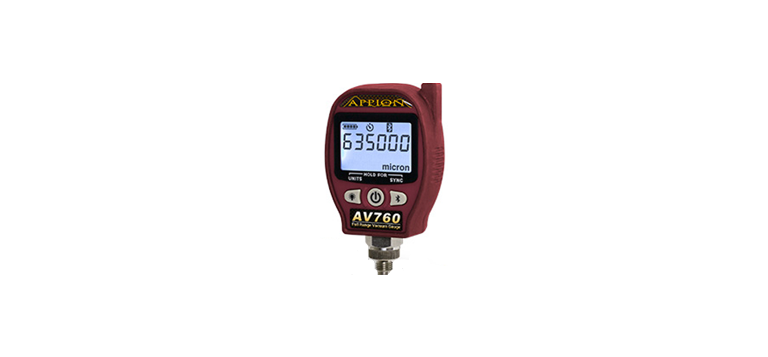
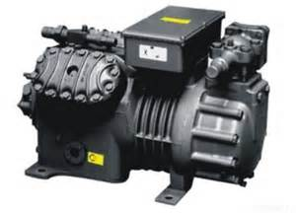
REFRIGERATION SERVICE
After making a major repair, the appliance should be dehydrated by evacuating the system to a minimum of 500 microns. This minimum level is required for HFC systems with POE oil.
Under no circumstance should a hermetic compressor be operated when there is a vacuum in the system; electrical arcing could burn the terminals inside the compressor.
500
Micron
Notes:
ESCO EPA Section 608 Preparatory Manual 9th Edition V2 Page 4
After making a major repair, the appliance should be dehydrated by evacuating the system to a minimum of 500 microns. This minimum level is required for HFC and all systems with POE oil. Under no circumstance should a hermetic compressor be operated when there is a vacuum in the system; electrical arcing could burn the terminals inside the compressor.

Slide 40
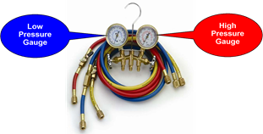
GAUGE MANIFOLD SET
One of the most important tools for an HVACR technician is the gauge manifold set.
The compound gauge measures low-pressure (psig) and vacuum (inches Hg).
Depending on the refrigerant, the high-pressure gauge may be rated at 500 or 800 psig.
Notes:
ESCO EPA Section 608 Preparatory Manual 9th Edition V2 Page 4
One of the most important tools for an HVACR technician is the gauge manifold set. The left side, compound gauge (blue) and the right side, high-pressure gauge (red), are attached to the manifold to measure system pressures. Hoses are used to connect the manifold to the refrigeration system’s access ports or service valves to gain access to system pressures. The compound gauge measures low-pressure (psig) and vacuum (inches Hg). The high-pressure gauge measures high-side (discharge) pressure. Depending on the refrigerant, the high-pressure gauge may be rated at 500 or 800 psig. The manifold is also equipped with a center port, (usually a yellow hose), that can be connected to a recovery device, evacuation vacuum pump, or charging device.

Slide 41
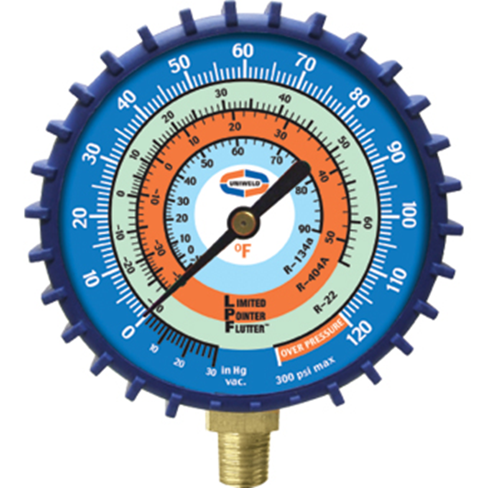
GAUGE MANIFOLD SET
The compound pressure gauge measures system pressure for the low side in pounds per square inch gauge (psig) and vacuum in inches of mercury (Hg).
Vacuum
Retard
Notes:
ESCO EPA Section 608 Preparatory Manual 9th Edition V2 Page 5
The compound pressure gauge measures system pressure for the low side in pounds per square inch gauge (psig) and vacuum in inches of mercury (Hg).

Slide 42
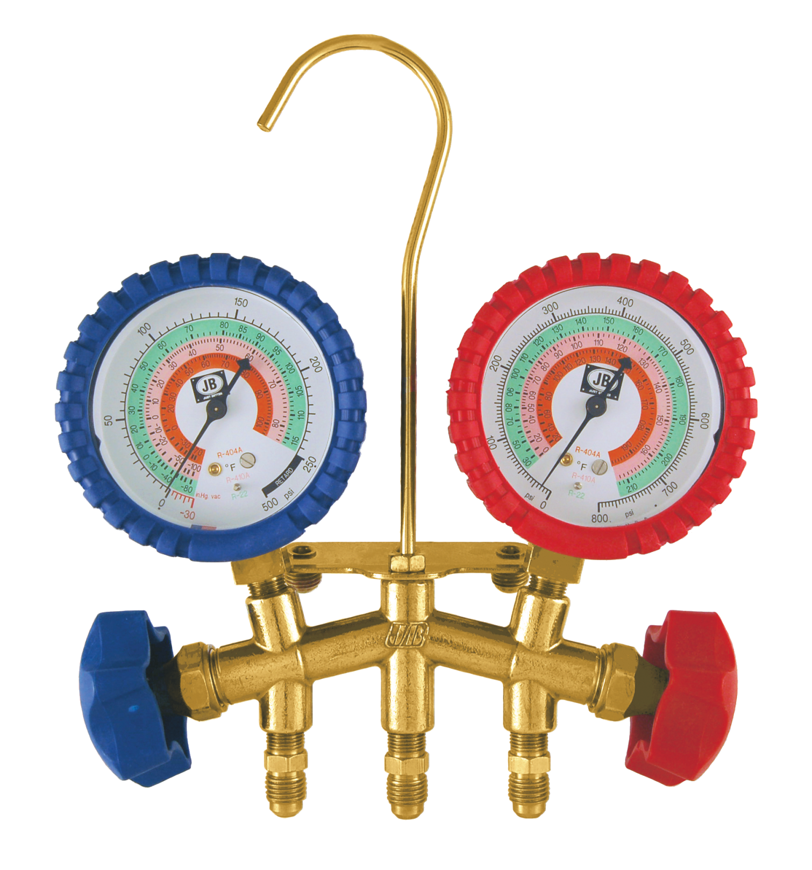
GAUGE MANIFOLD SET
High-Pressure Gauge
PSI
Refrigerant Saturation
Temperatures
Notes:
ESCO EPA Section 608 Preparatory Manual 9th Edition V2 Page 5
Most high-pressure gauges range from 0 to 800 psig.

Slide 43
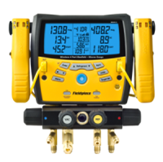
GAUGE MANIFOLD SET
An electronic manifold may have combined temperature probes to measure refrigerant line temperatures for calculating system superheat and subcooling.
Notes:
ESCO EPA Section 608 Preparatory Manual 9th Edition V2 Page 5
An electronic manifold or gauge may have combined temperature probes to measure refrigerant line temperatures for calculating system superheat and subcooling.

Slide 44
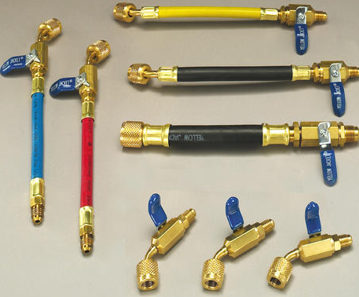
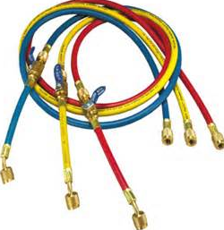
GAUGE MANIFOLD SET
EPA recommends that hoses be equipped with low-loss fittings or valves that manually close, or which close automatically, to minimize refrigerant loss when hoses are disconnected.
Notes:
ESCO EPA Section 608 Preparatory Manual 9th Edition V2 Page 5
EPA recommends that hoses be equipped with low-loss fittings or valves that manually close or which close automatically to minimize refrigerant loss when hoses are disconnected. The hoses used for service and with recovery equipment must be equipped with low-loss fittings.

Slide 45
DE-MINIMIS RELEASE
Minor releases when connecting or disconnecting hoses for service or recovery are considered a De-Minimis release.
This type of release is not considered unlawful.
Notes:
ESCO EPA Section 608 Preparatory Manual 9th Edition V2 Page 5
Minor releases when connecting or disconnecting hoses for service or recovery are considered a de-minimis release. A de-minimis release is not considered to be unlawful and is acceptable in normal service of equipment.

Slide 46
CAUTION
The gauge manifold and hoses must be pressure-rated to handle the refrigerant being used.
Notes:
ESCO EPA Section 608 Preparatory Manual 9th Edition V2 Page 5
Caution: The gauge manifold and hoses must be pressure-rated to handle the refrigerant being used.

Slide 47
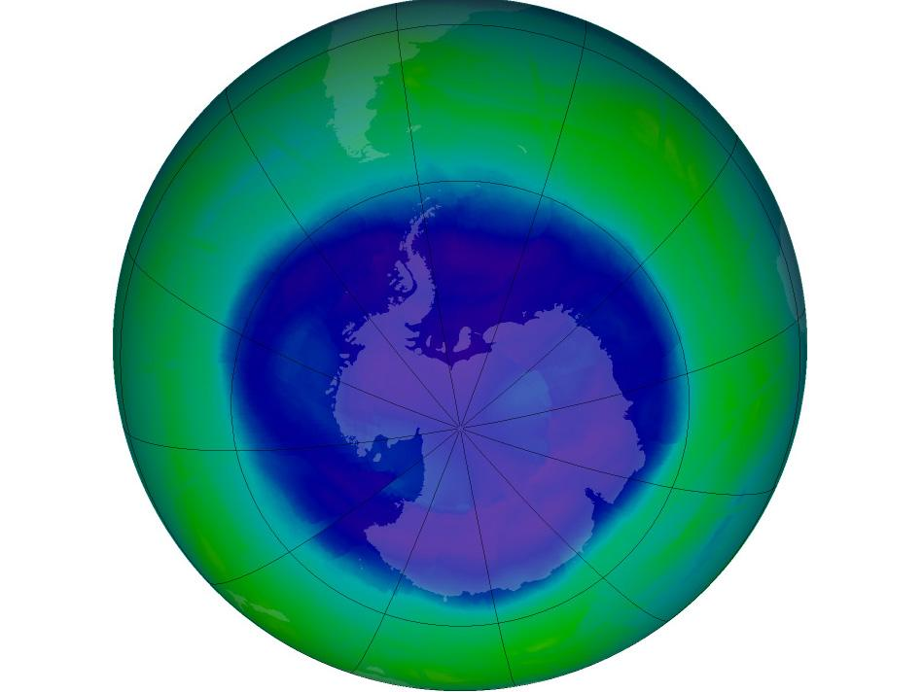
Stratospheric Ozone Depletion
Core
This Photo by Unknown Author is licensed under CC BY-SA
Notes:
ESCO EPA Section 608 Preparatory Manual 9th Edition V2 Page 6

Slide 48
Core Contents
Stratospheric Ozone Depletion
Global Warming Potential
Refrigerant Characteristics & Identification
Bubble And Dew Points
Low, Medium, High And Very High-pressure Refrigerants
Refrigerant Oils
Montreal Protocol / Clean Air Act
Recovery
Recovery Devices
Leak Detection
Dehydration
Safety / General
Safety / Cylinder
Shipping
Notes:
ESCO EPA Section 608 Preparatory Manual 9th Edition V2 Pages 6-15
There are 14 topics in the core section.

Slide 49

STRATOSPHERIC OZONE DEPLETION
Stratospheric ozone helps form the earth's protective shield.
The ozone layer protects the earth from ultraviolet radiation from the sun.
Notes:
ESCO EPA Section 608 Preparatory Manual 9th Edition V2 Page 6
Stratospheric ozone helps form the earth's protective shield. The ozone layer protects the earth from ultraviolet radiation from the sun.

Slide 50
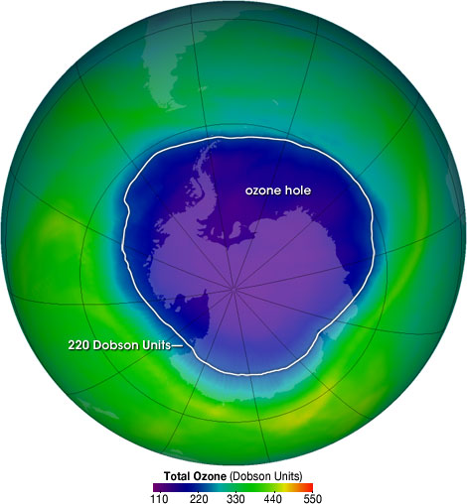
The Ozone Hole
Image Source: http://ozonewatch.gsfc.nasa.gov/facts/hole.html
Notes:
ESCO EPA Section 608 Preparatory Manual 9th Edition V2 Page 6
The ozone hole image shows the very low values (blue and purple colored area) centered over Antarctica on October 4, 2004.
The biggest hole recorded was in 2006.

Slide 51
STRATOSPHERIC OZONE DEPLETION
30 Miles
EARTH
Stratosphere
7 Miles
Notes:
ESCO EPA Section 608 Preparatory Manual 9th Edition V2 Page 6
Brief explanation of the Earth’s atmosphere layers.
Based on the vertical temperature distribution in the Earth's atmosphere, four semi-horizontal layers or spheres can be distinguished: the troposphere, stratosphere, mesosphere, and thermosphere. The stratosphere and mesosphere together are called the middle atmosphere, and their region also overlaps with the ionosphere, which is a region defined on the basis of the electric charges of the particles there.
The stratosphere is part of the earth's atmosphere which extends from the top of the troposphere from 7 miles to about 30 miles above the surface. This is the part of the atmosphere we are concerned about.

Slide 52
OZONE DEPLETION POTENTIAL
Ozone depletion potential (or ODP) measures the ability of a substance to destroy ozone in the stratosphere.
Notes:
ESCO EPA Section 608 Preparatory Manual 9th Edition V2 Page 6
Ozone depletion potential (or ODP) measures the ability of a substance to destroy ozone in the stratosphere.

Slide 53
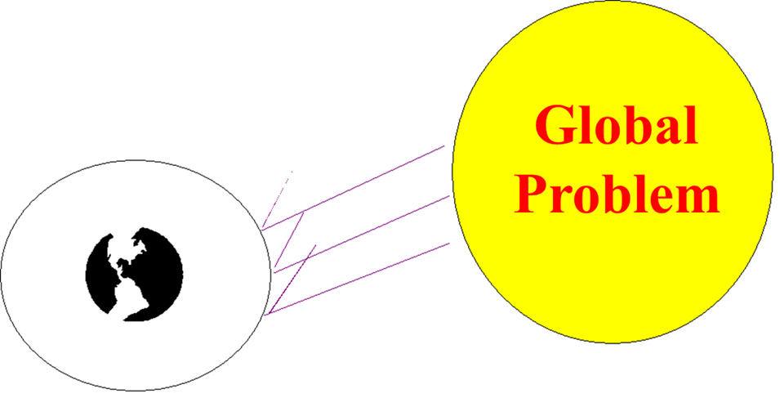
STRATOSPHERIC OZONE DEPLETION
Ozone depletion in the stratosphere is a global problem which affects everyone on the planet.
Notes:
ESCO EPA Section 608 Preparatory Manual 9th Edition V2 Page 6
Ozone depletion in the stratosphere is a global problem which affects everyone on the planet.

Slide 54
STRATOSPHERIC OZONE DEPLETION
One of the most serious results from the thinning and damaging of the stratospheric ozone layer is an increase in the rates of skin cancer in humans.
Notes:
ESCO EPA Section 608 Preparatory Manual 9th Edition V2 Page 6
One of the most serious results from the thinning and damaging of the stratospheric ozone layer is an increase in the rates of skin cancer in humans. Another human health effect that has increased from damage to the stratospheric ozone layer is the increase in cases of cataracts. Stratospheric ozone depletion can also have an effect on the environment, causing decreased crop yields and damage to marine organisms.

Slide 55
STRATOSPHERIC OZONE DEPLETION
Another human health effect that has increased from damage to the stratospheric ozone layer is the increase in cases of cataracts.
Notes:
ESCO EPA Section 608 Preparatory Manual 9th Edition V2 Page 6
Another human health effect that has increased from damage to the stratospheric ozone layer is the increase in cases of cataracts. Stratospheric ozone depletion can also have an effect on the environment, causing decreased crop yields and damage to marine organisms.

Slide 56
STRATOSPHERIC OZONE DEPLETION
Stratospheric ozone depletion can also have an effect on the environment, causing decreased crop yields and damage to marine organisms.
Notes:
ESCO EPA Section 608 Preparatory Manual 9th Edition V2 Page 6
Stratospheric ozone depletion can also have an effect on the environment, causing decreased crop yields and damage to marine organisms.

Slide 57
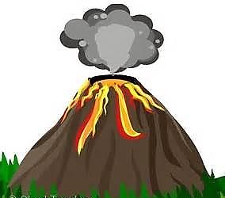
STRATOSPHERIC OZONE DEPLETION
Source of Chlorine in the Stratosphere
Air samples taken over erupting volcanoes show that volcanoes contribute only a small quantity of Chlorine as compared to CFCs and HCFCs.
Notes:
ESCO EPA Section 608 Preparatory Manual 9th Edition V2 Page 6
There has been some controversy over the subject of ozone depletion. Some believed that the chlorine found in the stratosphere comes from natural sources such as volcanic eruptions. However, air samples taken over erupting volcanoes show that volcanoes add only small quantities of chlorine to the atmosphere compared to the amount of chlorine added to the atmosphere from chlorine-containing refrigerants.

Slide 58
STRATOSPHERIC OZONE DEPLETION
The rise in Chlorine measured in the stratosphere matches the rise in the amount of Fluorine, which has different natural sources than Chlorine, over the past two decades.
The rise in the amount of Chlorine measured by NASA and other agencies in the stratosphere over the past twenty years matches the rise in CFC and HCFC emissions over the same period.
Notes:
ESCO EPA Section 608 Preparatory Manual 9th Edition V2 Page 6
In addition, the rise in the amount of chlorine measured in the stratosphere over the past four decades matches the rise in the amount of Fluorine, which has different natural sources than chlorine over the same period. Also, the rise in the amount of chlorine measured by NASA and other agencies in the stratosphere over the past twenty years matches the rise in CFC and HCFC emissions over the same period. The evidence is clear, chlorine containing refrigerants have changed the natural balance, thus depleting the ozone layer.

Slide 59
STRATOSPHERIC OZONE DEPLETION
The evidence is clear, chlorine containing refrigerants have changed the natural balance, thus depleting the ozone layer.
Chlorine is the Culprit
Notes:
ESCO EPA Section 608 Preparatory Manual 9th Edition V2 Page 6
The evidence is clear, chlorine containing refrigerants have changed the natural balance, thus depleting the ozone layer.

Slide 60

STRATOSPHERIC OZONE DEPLETION
An ozone molecule consists of three oxygen atoms (O₃).
Notes:
ESCO EPA Section 608 Preparatory Manual 9th Edition V2 Page 6
An ozone molecule, in the stratosphere consists of molecules containing 3 oxygen atoms. .

Slide 61

STRATOSPHERIC OZONE DEPLETION
Fluorine
Chlorine
CL
FL
CARBON
UV Radiation
CL
CL
CFC Molecule
Notes:
ESCO EPA Section 608 Preparatory Manual 9th Edition V2 Page 6
The ultraviolet radiation from the Sun sheers the chlorine atom from a CFC or HCFC molecule. This chlorine atom is then attracted to an ozone molecule.

Slide 62
STRATOSPHERIC OZONE DEPLETION
When CFCs and HCFCs reach the stratosphere, the sun’s UV radiation causes them to break apart.
O
O
O
O
Cl
O
Cl
O
Chlorine
Atom
Ozone Molecule
Made of up 3
Oxygen Atoms
Chlorine
Monoxide
Diatomic
Oxygen
Notes:
ESCO EPA Section 608 Preparatory Manual 9th Edition V2 Page 6
When a chlorine atom encounters an ozone molecule, it takes one of the ozone’s 3 oxygen atoms, forming a compound called chlorine monoxide (CIO), and leaves an oxygen O₂ molecule behind. Molecular Oxygen is composed of only one type of element: Oxygen. There are two atoms of oxygen, therefore 'diatomic.'

Slide 63
STRATOSPHERIC OZONE DEPLETION
The chlorine monoxide will collide with another ozone molecule, releasing its Oxygen atom, forming two O₂ molecules, leaving the chlorine free to attack another ozone molecule.
A single chlorine atom can last in the Stratosphere for 120 years destroying up to 100,000 ozone molecules.
CL
O
O
O
Notes:
ESCO EPA Section 608 Preparatory Manual 9th Edition V2 Page 6
The chlorine monoxide will collide with another ozone molecule, releasing its Oxygen atom, forming two O₂ molecules, leaving the chlorine free to attack another ozone molecule. A single chlorine atom can last in the Stratosphere for 120 years destroying up to 100,000 ozone molecules.

Slide 64
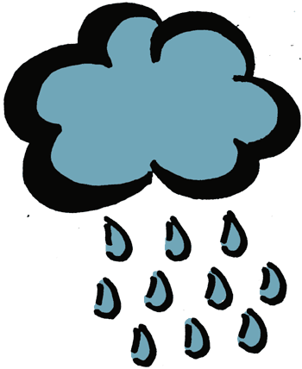
STRATOSPHERIC OZONE DEPLETION
The chlorine in CFCs & HCFCs will neither dissolve in water nor break down into compounds that dissolve in water, so it does not rain out of the atmosphere.
Naturally-occurring chlorine will dissolve in water and rain out of the atmosphere.
Notes:
ESCO EPA Section 608 Preparatory Manual 9th Edition V2 Page 6
Unlike other chlorine compounds and naturally-occurring chlorine, the chlorine in CFCs and HCFCs will neither dissolve in water nor break down into compounds that dissolve in water, so they do not rain out of the atmosphere.

Slide 65
HFCs
HFCs are made up of Hydrogen, Fluorine, and Carbon.
They do not contain chlorine that effects the ozone layer, but most HFCs have a high Global Warming Potential (GWP).
Notes:
ESCO EPA Section 608 Preparatory Manual 9th Edition V2 Page 6
HFCs are made up of Hydrogen, Fluorine and Carbon. They do not contain chlorine that effects the ozone layer, but most HFCs have a high Global Warming Potential (GWP).

Slide 66

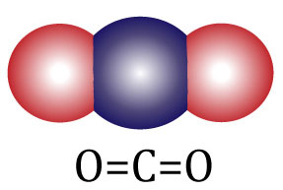
GLOBAL WARMING POTENTIAL
Global Warming Potential (GWP) was established to provide comparisons of the global warming impacts of different gases over a span of time.
Carbon Dioxide (CO₂) is used as the baseline measurement for global warming potential and has a value of 1.
Notes:
ESCO EPA Section 608 Preparatory Manual 9th Edition V2 Page 6
Global Warming Potential (GWP) was established to provide comparisons of the global warming impacts of different gases over a span of time. Carbon Dioxide (CO₂) is used as the baseline measurement for global warming potential and has a value of 1.

Slide 67
GLOBAL WARMING POTENTIAL
Most HFC refrigerants, such as R-410A, have global warming potentials thousands of times greater compared to carbon dioxide.
Hydrocarbon (HC) and Hydrofluoroolefins (HFO) refrigerants have the lowest global warming potential compared to CFCs, HCFCs, and HFCs.
Notes:
ESCO EPA Section 608 Preparatory Manual 9th Edition V2 Page 6
Most HFC refrigerants, such as R-410A, have global warming potentials thousands of times greater compared to carbon dioxide. Hydrocarbon (HC) and Hydrofluoroolefin (HFO) refrigerants have the lowest global warming potential compared to CFCs, HCFCs, and HFCs.

Slide 68

GLOBAL WARMING POTENTIAL
The global warming potential of isobutane (R-600a), propane (R-290), and R-441A are significantly lower when compared to the GWPs of HFCs such as R-134a, R-407C, R-404A, and R-410A.
Notes:
ESCO EPA Section 608 Preparatory Manual 9th Edition V2 Page 6
The global warming potential of isobutane (R-600a), propane (R-290), and R-441A are significantly lower when compared to the GWPs of HFCs such as R-134a, R-407C, R-404A, and R-410A.

Slide 69
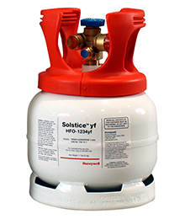
GLOBAL WARMING POTENTIAL
With non-ozone depleting and very low global warming potential characteristics, Hydrofluoroolefin (HFO) refrigerants are a good fit for HVACR equipment.
Most HFCs have very high global warming potentials; a characteristic that makes them damaging to the environment.
Notes:
ESCO EPA Section 608 Preparatory Manual 9th Edition V2 Page 6
With non-ozone depleting and very low global warming potential characteristics, hydrofluoroolefin (HFO) refrigerants are a good fit for HVACR equipment.
Most HFCs have very high global warming potentials; a characteristic that makes them damaging to the environment.

Slide 70
REFRIGERANT CHARACTERISTICS & IDENTIFICATION
Refrigerants may be identified by type (CFC, HCFC, HFC, HFO, HC) and American Society of Heating Refrigerating and Air-Conditioning Engineers (ASHRAE) number or with “R” plus the ASHRAE number such as HFC-134a or R-134a.
Notes:
ESCO EPA Section 608 Preparatory Manual 9th Edition V2 Page 7
Refrigerants may be identified by type (CFC, HCFC, HFC, HFO, HC) and American Society of Heating Refrigerating and Air-Conditioning Engineers (ASHRAE) number or with “R” plus the ASHRAE number such as HFC-134a or R-134a.

Slide 71



REFRIGERANT CHARACTERISTICS & IDENTIFICATION
ASHRAE Refrigerant Classification
A - Safest
B - Toxicity level to humans
L - Flammability
1 - no flammability
2L- slight flammability
2 - low flammability
3 - high flammability
Safety Group
High Flammability | A3 | B3
Low Flammability | A2 | B2
Slight Flammability | A2L | B2L
No Flammability | A1 | B1
Low
Low
Higher
Toxicity
Notes:
ESCO EPA Section 608 Preparatory Manual 9th Edition V2 Page 7
ASHRAE has grouped refrigerants by Class A (safest) or B, depending on their toxicity level to humans. Flammability is indicated by a 1 (no flammability), 2 (low flammability), or 3 (high flammability),

Slide 72
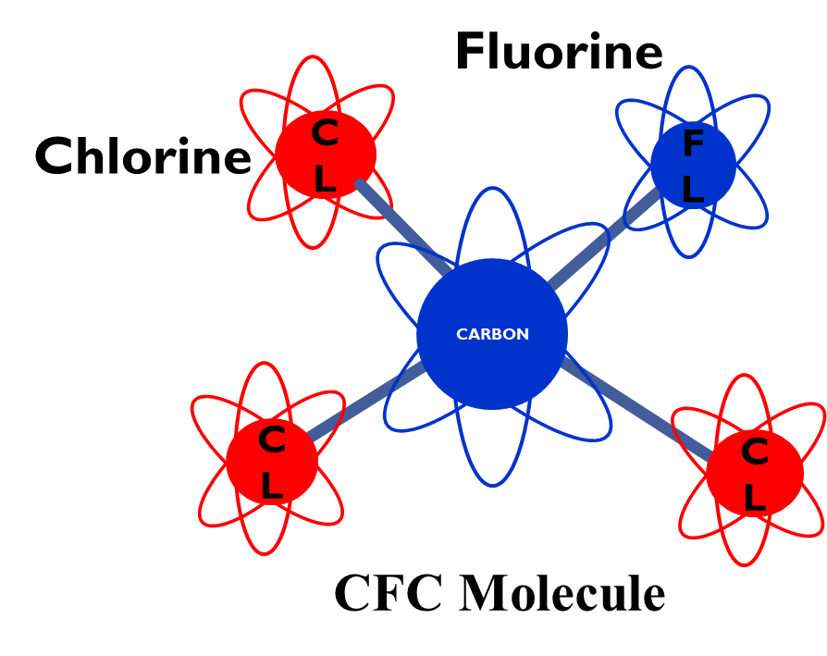
REFRIGERANT CHARACTERISTICS & IDENTIFICATION
Chlorofluorocarbon (CFC) refrigerants have the highest ozone depletion potential (ODP) and are the most harmful to stratospheric ozone.
CFC refrigerants contain chlorine, fluorine, and carbon.
Chlorine is the component that poses a threat to the stratospheric ozone.
Examples of CFC: R-11 and R-12.
Notes:
ESCO EPA Section 608 Preparatory Manual 9th Edition V2 Page 7
Chlorofluorocarbon (CFC) refrigerants have the highest ozone depletion potential (ODP) and are the most harmful to stratospheric ozone. CFC refrigerants contain chlorine, fluorine, and carbon. Chlorine is the component that poses a threat to the stratospheric ozone. Examples of CFC refrigerants include R-11 and R-12.

Slide 73
REFRIGERANT CHARACTERISTICS & IDENTIFICATION
Hydrochlorofluorocarbon (HCFC) refrigerants contain hydrogen, chlorine, fluorine, and carbon.
The hydrogen makes them a little less harmful to the stratospheric ozone when compared to CFCs.
HCFC refrigerants that have an ozone depletion potential of more than zero, ranging between zero and one.
Examples of HCFC: R-22 and R-123
H
F
C
F
Cl
HCFC Molecule
Notes:
ESCO EPA Section 608 Preparatory Manual 9th Edition V2 Page 7
Hydrochlorofluorocarbon (HCFC) refrigerants contain hydrogen, chlorine, fluorine, and carbon. The hydrogen makes them a little less harmful to the stratospheric ozone when compared to CFCs. R-22 and R-123 are examples of HCFC refrigerants that have an ozone depletion potential of more than zero, ranging between zero and one.

Slide 74
REFRIGERANT CHARACTERISTICS & IDENTIFICATION
Hydrofluorocarbon (HFC) refrigerants contain hydrogen, fluorine, and carbon atoms connected by single bonds between the atoms.
HFCs have the lowest/no ozone depletion potential but do have an effect on global warming. HFC refrigerants do not contain harmful chlorine.
Examples of HFCs
R-134a, R-410A, R-404A, R-407C, and R-422B.
F
F
F
C
C
H
F
H
HFC Molecule
Notes:
ESCO EPA Section 608 Preparatory Manual 9th Edition V2 Page 7
Hydrofluorocarbon (HFC) refrigerants contain hydrogen, fluorine, and carbon atoms connected by single bonds between the atoms.
HFCs have the lowest/no ozone depletion potential but do have an effect on global warming. HFC refrigerants do not contain harmful chlorine.
Examples of HFCs are R-134a, R-410A, R-404A, R-407C, and R-422B.

Slide 75
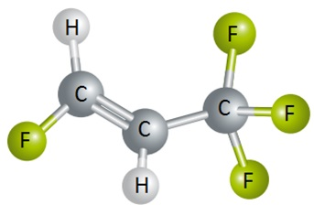
REFRIGERANT CHARACTERISTICS & IDENTIFICATION
Hydrofluoroolefins (HFO) refrigerants contain hydrogen, fluorine, and carbon atoms connected with at least one double bond between the carbon atoms.
HFOs have no ozone depletion potential but do have a very small effect on global warming.
HFO Molecule
Notes:
ESCO EPA Section 608 Preparatory Manual 9th Edition V2 Page 7
Hydrofluoroolefins (HFO) refrigerants contain hydrogen, fluorine, and carbon atoms connected with at least one double bond between the carbon atoms. HFOs have no ozone depletion potential but do have a very small effect on global warming.

Slide 76
REFRIGERANT CHARACTERISTICS & IDENTIFICATION
HFOs are less flammable than hydrocarbon refrigerants but most are still mildly flammable so are classified as A2L.
HFO refrigerants contain fluorine making them less flammable than hydrocarbon refrigerants.
HFO refrigerants are miscible in POE lubricants.
R-1234yf is an HFO refrigerant used in chillers.
Notes:
ESCO EPA Section 608 Preparatory Manual 9th Edition V2 Page 7
HFOs are less flammable than hydrocarbon refrigerants but most are still mildly flammable so are classified as A2L. HFO refrigerants contain fluorine making them less flammable than hydrocarbon refrigerants. HFO refrigerants are miscible in POE lubricants. R-1234yf is an HFO refrigerant used in low-pressure chillers.

Slide 77
REFRIGERANT CHARACTERISTICS & IDENTIFICATION
Hydrocarbon (HC) refrigerants are an elementary compound of hydrogen and carbon. Although flammable, these refrigerants pose the least amount of danger to the environment.
HCs have no ozone depletion potential and a very small effect on global warming, with GWP values less than 10. Isobutane (R-600a) and Propane (R-290) are examples of HCs.
Some HC refrigerants are considered natural refrigerants.
Notes:
ESCO EPA Section 608 Preparatory Manual 9th Edition V2 Page 7
Hydrocarbon (HC) refrigerants are an elementary compound of hydrogen and carbon. Although flammable, these refrigerants pose the least amount of danger to the environment. HCs have no ozone depletion potential and a very small effect on global warming, with GWP values less than 10. Isobutane (R-600a) and Propane (R-290) are examples of HCs. Some HC refrigerants are considered natural refrigerants.

Slide 78
REFRIGERANT CHARACTERISTICS & IDENTIFICATION
Propane cylinders for grilling should never be used as a refrigerant, as they contain impurities that can damage refrigeration equipment.
Notes:
ESCO EPA Section 608 Preparatory Manual 9th Edition V2 Page 7
Note: Propane cylinders for grilling should never be used as a refrigerant, as they contain impurities that can damage refrigeration equipment.

Slide 79
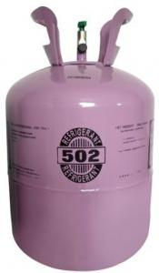
REFRIGERANT CHARACTERISTICS & IDENTIFICATION
Azeotropic refrigerant mixtures contains two or more refrigerants. At a certain pressure, an azeotropic mixture evaporates and condenses at a constant temperature.
It acts like a single component refrigerant over its entire range. Thus, azeotropic mixtures act as a pure compound.
500 Series
Notes:
ESCO EPA Section 608 Preparatory Manual 9th Edition V2 Page 7
Azeotropic refrigerant mixtures contains two or more refrigerants. At a certain pressure, an azeotropic mixture evaporates and condenses at a constant temperature. It acts like a single component refrigerant over its entire range. Thus, azeotropic mixtures act as a pure compound.

Slide 80
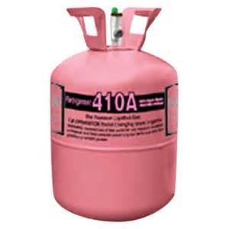
REFRIGERANT CHARACTERISTICS & IDENTIFICATION
Zeotropic or non-azeotropic refrigerant mixtures are mixtures of components that have different boiling points. This mixture is a blend of refrigerant.
The blend may be binary (two-part) or ternary (three-part).
Notes:
ESCO EPA Section 608 Preparatory Manual 9th Edition V2 Page 8
Zeotropic or non-azeotropic refrigerant mixtures are mixtures of components that have different boiling points. This mixture is a blend of refrigerant. The blend may be binary (two-part) or ternary (three-part).

Slide 81
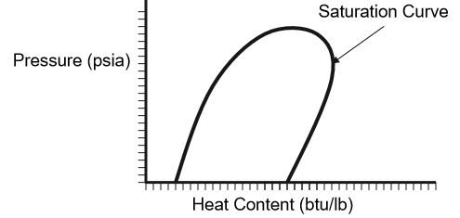


REFRIGERANT CHARACTERISTICS & IDENTIFICATION
Blended refrigerants are normally associated with having what is called “temperature glide”.
This is due to the blended parts having different pressures for the same saturation temperature.
Temperature glide can range a few tenths of a degree to 12 degrees or more.
Glide
Superheat Zone
Subcool
Zone
Saturation
Bubble Point
Dew Point
Notes:
ESCO EPA Section 608 Preparatory Manual 9th Edition V2 Page 8
Blended refrigerants are normally associated with having what is called “temperature glide”. This is due to the blended parts having different pressures for the same saturation temperature. Temperature glide can range a few tenths of a degree to 12 degrees or more.

Slide 82
BUBBLE AND DEW POINTS
Zeotropic and some near-azeotropic blends use bubble and dew points to indicate condensing and evaporation temperatures on a pressure-temperature chart.
Bubble point (Liquid) values are used when charging by condenser subcooling.
Dew point (Vapor) values are used for charging by suction or evaporator superheat.
Bubble Point
Dew Point
Notes:
ESCO EPA Section 608 Preparatory Manual 9th Edition V2 Page 8
Zeotropic and some near-azeotropic blends use bubble and dew points to indicate condensing and evaporation temperatures on a pressure-temperature chart. Bubble point is used when charging by condenser subcooling. Dew point is used for charging by suction or evaporator superheat. The relationship of pressures and temperatures are based on the refrigerant’s temperature glide.

Slide 83
BUBBLE AND DEW POINTS
Zeotropic and some near-azeotropic blends use bubble and dew points to indicate condensing and evaporation temperatures on a pressure-temperature chart.
Bubble point is used when charging by condenser subcooling.
Dew point is used for charging by suction or evaporator superheat.
Notes:
SAME INFO AS SLIDE 77
ESCO EPA Section 608 Preparatory Manual 9th Edition Page 11
Zeotropic and some near-azeotropic blends use bubble and dew points to indicate condensing and evaporation temperatures on a pressure-temperature chart.
Bubble point is used when charging by condenser subcooling.
Dew point is used for charging by suction or evaporator superheat.
The relationship of pressures and temperatures are based on the refrigerant’s temperature glide.

Slide 84
BUBBLE AND DEW POINTS
The R-400 series of refrigerants are near-azeotropic blends that can leak from a system at uneven rates due to different vapor pressures which can affect the percentage of each refrigerant remaining in the system.
The proper charging method for R-400 series blended refrigerants is to weigh the refrigerant into the high side of the system as a liquid. When adding refrigerant to an undercharged system, liquid refrigerant is throttled into the low side with the system operating.
Notes:
ESCO EPA Section 608 Preparatory Manual 9th Edition V2 Page 8
The R-400 series of refrigerants are near-azeotropic blends that can leak from a system at uneven rates due to different vapor pressures which can affect the percentage of each refrigerant remaining in the system. The proper charging method for R-400 series blended refrigerants is to weigh the refrigerant into the high side of the system as a liquid. When adding refrigerant to an undercharged system, liquid refrigerant is throttled into the low side with the system operating.

Slide 85
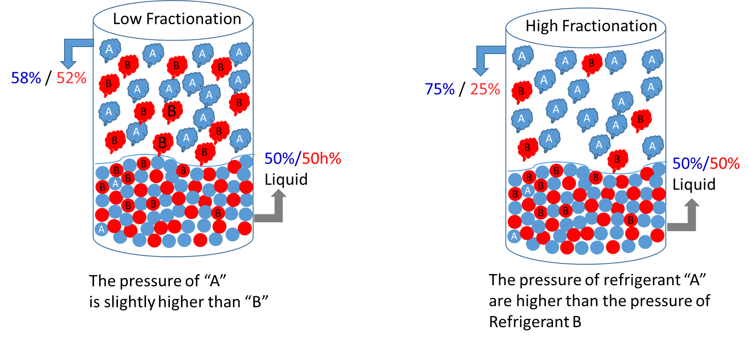
BUBBLE AND DEW POINTS
There is concern of using blended refrigerants in systems that develop a leak.
There may be fractionization of the refrigerant (refrigerant leaking at uneven rates due to different vapor pressures).
R-407C is one of the refrigerants that has a high temperature glide and may easily experience fractionation.
Notes:
ESCO EPA Section 608 Preparatory Manual 9th Edition V2 Page 8
There is concern of using blended refrigerants in systems that develop a leak.
There may be fractionization of the refrigerant (refrigerant leaking at uneven rates due to different vapor pressures).
R-407C is one of the refrigerants that has a high temperature glide and may easily experience fractionation.

Slide 86
BUBBLE AND DEW POINTS
Even though the pressure-temperature relationship and operating characteristics may be almost the same, the refrigerants cannot be interchanged.
Although the saturation pressure-temperature behavior of two refrigerants might be similar, potential of the refrigerants to oxidize copper tubing must also be considered.
Notes:
ESCO EPA Section 608 Preparatory Manual 9th Edition V2 Page 8
Even though the pressure-temperature relationship and operating characteristics may be almost the same, the refrigerants cannot be interchanged. Although the saturation pressure-temperature behavior of two refrigerants might be similar, potential of the refrigerants to oxidize copper tubing must also be considered.

Slide 87

BUBBLE AND DEW POINTS
Due to flammability of some HCs and HFOs, equipment must be designed to handle the refrigerant.
Therefore, EPA regulates the maximum amount of refrigerant that can be used in the new systems by their type and use.
Notes:
ESCO EPA Section 608 Preparatory Manual 9th Edition V2 Page 8
Due to flammability of some HCs and HFOs, equipment must be designed to handle the refrigerant. Therefore, EPA regulates the maximum amount of refrigerant that can be used in the new systems by their type and use.

Slide 88
BUBBLE AND DEW POINTS
When retrofitting or converting a system to use a different refrigerant, only EPA-approved substitutes can be used.
Remember, EPA does not approve any substitute refrigerants as direct drop-in replacements to service an R-22 or any other system.
Notes:
ESCO EPA Section 608 Preparatory Manual 9th Edition V2 Page 8
When retrofitting or converting a system to use a different refrigerant, only EPA-approved substitutes can be used. Remember, EPA does not approve any substitute refrigerants as direct drop-in replacements to service an R-22 or any other system.

Slide 89
LOW, MEDIUM, HIGH, AND VERY HIGH PRESSURE
To better define leak rates and service recovery levels the EPA lists refrigerants in four liquid-phase pressure ranges at 104°F condensing temperature.
Notes:
ESCO EPA Section 608 Preparatory Manual 9th Edition V2 Page 8
To better define leak rates and service recovery levels the EPA lists refrigerants in four liquid-phase pressure ranges at 104°F condensing temperature.

Slide 90
LOW, MEDIUM, HIGH, AND VERY HIGH PRESSURE
Low-pressure refrigerants have a pressure of 30 psig or lower at a liquid-phase temperature of 104°F.
Examples:
CFC-11, HCFC-123, HFC-245fa, HFO-1233zd
Notes:
ESCO EPA Section 608 Preparatory Manual 9th Edition V2 Page 8
To better define leak rates and service recovery levels the EPA lists refrigerants in four liquid-phase pressure ranges at 104°F condensing temperature.
Low-pressure refrigerants have a pressure of 30 psig or lower at a liquid-phase temperature of 104°F.
Examples: CFC-11, HCFC-123, HFC-245fa, HFO-1233zd

Slide 91
LOW, MEDIUM, HIGH, AND VERY HIGH PRESSURE
Medium-pressure refrigerants have a pressure between 30 psig & 155 psig at a liquid-phase temperature of 104°F.
Examples:
CFC-12, HCFC-124, HCFC-409A, HFC-134a, HC-600a,
HFO-1234yf, HFO-1234ze
Notes:
ESCO EPA Section 608 Preparatory Manual 9th Edition V2 Page 8
Medium-pressure refrigerants have a pressure between 30 psig & 155 psig at a liquid-phase temperature of 104°F.
Examples: CFC-12, HCFC-124, HCFC-409A, HFC-134a, HC-600a, HFO-1234yf, HFO-1234ze

Slide 92
LOW, MEDIUM, HIGH AND VERY HIGH PRESSURE
High-pressure refrigerants have a pressure between 155 psig & 340 psig at a liquid-phase temperature of 104°F.
Examples:
HCFC-22, HFC-404A, HFC-407C, HFC-422B, HFC-422D,
HFC-410A, HC-441A, R-717
Notes:
ESCO EPA Section 608 Preparatory Manual 9th Edition V2 Page 8
High-pressure refrigerants have a pressure between 155 psig & 340 psig at a liquid-phase temperature of 104°F.
Examples: HCFC-22, HFC-404A, HFC-407C, HFC-422B, HFC-422D, HFC-410A, HC-441A, R-717

Slide 93
LOW, MEDIUM, HIGH AND VERY HIGH PRESSURE
Very high-pressure refrigerants have a pressure over 340 psig at a liquid-phase temperature of 104°F.
Examples:
C0₂ (R-744)
Notes:
ESCO EPA Section 608 Preparatory Manual 9th Edition V2 Page 8
Very high-pressure refrigerants have a pressure over 340 psig at a liquid-phase temperature of 104°F.
Examples: CO₂ (R-744)

Slide 94

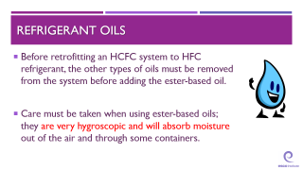
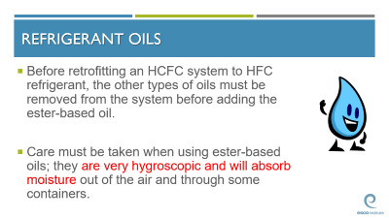
REFRIGERANT OILS
Most HCFC binary (two-part) and ternary (three- part) blends use a synthetic alkylbenzene lubricant.
When retrofitting HCFC equipment to HFC refrigerants or when working with newly manufactured systems, synthetic polyolester oil is most commonly used.
Ester-based oils cannot be mixed with any other type of oil.
Notes:
ESCO EPA Section 608 Preparatory Manual 9th Edition V2 Page 8
Most HCFC binary (two-part) and ternary (three-part) blends use a synthetic alkylbenzene lubricant. When retrofitting HCFC equipment to HFC refrigerants or when working with newly manufactured systems, synthetic polyolester oil is most commonly used. Ester-based oils cannot be mixed with any other type of oil.

Slide 95
REFRIGERANT OILS
Before retrofitting an HCFC system to HFC refrigerant, the other types of oils must be removed from the system before adding the ester-based oil.
Care must be taken when using ester-based oils; they are very hygroscopic and will absorb moisture out of the air and through some containers.
Notes:
ESCO EPA Section 608 Preparatory Manual 9th Edition V2 Page 8
Before retrofitting an HCFC system to HFC refrigerant, the other types of oils must be removed from the system before adding the ester-based oil. Care must be taken when using ester-based oils; they are very hygroscopic and will absorb moisture out of the air and through some containers.

Slide 96
MONTREAL PROTOCOL AND CLEAN AIR ACT
Notes:
ESCO EPA Section 608 Preparatory Manual 9th Edition V2 Page 9
The United States Environmental Protection Agency (EPA) regulates Section 608 of the Federal Clean Air Act which establishes the rules for regulating all Class I (Ozone-Depleting Substances such as CFCs), Class II (HCFCs), and substitute refrigerants. Failure to comply could cost you and your company.

Slide 97

MONTREAL PROTOCOL AND CLEAN AIR ACT
The United States is part of the Montreal Protocol which is an international treaty that addresses ozone-depleting substances and their alternatives.
Montreal Protocol
Treaty
Notes:
ESCO EPA Section 608 Preparatory Manual 9th Edition V2 Page 9
The United States is part of the Montreal Protocol which is an international treaty that addresses ozone-depleting substances and their alternatives.

Slide 98
MONTREAL PROTOCOL AND CLEAN AIR ACT
To stop damage to the stratospheric ozone layer, the U.S. is phasing out, or has already phased out, the use of chlorofluorocarbons (CFCs), hydrochlorofluorocarbons (HCFCs), and other refrigerants that are harmful to the environment.
Notes:
ESCO EPA Section 608 Preparatory Manual 9th Edition V2 Page 9
To stop damage to the stratospheric ozone layer, the U.S. is phasing out, or has already phased out, the use of chlorofluorocarbons (CFCs), hydrochlorofluorocarbons (HCFCs), and other refrigerants that are harmful to the environment.

Slide 99
MONTREAL PROTOCOL AND CLEAN AIR ACT
Section 608 of the Clean Air Act sets forth the rules and regulations for refrigerant handling in the HVACR industry.
Section 608 certification allows a technician to purchase or handle regulated refrigerants.
Distributors that sell HCFC, HFC, or another regulated refrigerant must verify the purchaser is, or employs, a Section 608 certified technician.
Notes:
ESCO EPA Section 608 Preparatory Manual 9th Edition V2 Page 9
Section 608 of the Clean Air Act sets forth the rules and regulations for refrigerant handling in the HVACR industry.
Section 608 certification allows a technician to purchase or handle regulated refrigerants.
Distributors that sell HCFC, HFC, or another regulated refrigerant must verify the purchaser is, or employs, a Section 608 certified technician.

Slide 100
MONTREAL PROTOCOL AND CLEAN AIR ACT
Anyone performing any activity that violates the refrigerant circuit, including removal of refrigerant or replacing a component containing a regulated refrigerant must be certified at the proper level and have the type of recovery equipment required.
Notes:
ESCO EPA Section 608 Preparatory Manual 9th Edition V2 Page 9
Anyone performing any activity that violates the refrigerant circuit, including removal of refrigerant or replacing a component containing a regulated refrigerant must be certified at the proper level and have the type of recovery equipment required.

Slide 101

MONTREAL PROTOCOL AND CLEAN AIR ACT
It is illegal to knowingly release CFC, HCFC, or HFC refrigerants during the service, maintenance, repair, or disposal of appliances.
A technician must have their Section 608 certification card in their possession when preforming an activity regulated by Section 608.
If your Section 608 certification card is lost, request a replacement from your certifying organization not the EPA.
Notes:
ESCO EPA Section 608 Preparatory Manual 9th Edition V2 Page 9
It is illegal to knowingly release CFC, HCFC, or HFC refrigerants during the service, maintenance, repair, or disposal of appliances. A technician must have their Section 608 certification card in their possession when preforming an activity regulated by Section 608.
If your Section 608 certification card is lost, request a replacement from your certifying organization not the EPA.

Slide 102
MONTREAL PROTOCOL AND CLEAN AIR ACT
A person is not required to be a Section 608 certified technician when servicing an external electric circuit or sections of the system that do not involve the refrigerant components of an HVACR appliance.
Notes:
ESCO EPA Section 608 Preparatory Manual 9th Edition V2 Page 9
A person is not required to be a Section 608 certified technician when servicing an external electric circuit or sections of the system that do not involve the refrigerant components of an HVACR appliance.

Slide 103
MONTREAL PROTOCOL AND CLEAN AIR ACT
The Clean Air Act (EPA’s regulations) allows for releasing an exempt refrigerant (e.g., ammonia and CO₂) or a small amount of refrigerant, mixed with nitrogen (a leak trace gas) for leak detection.
Notes:
ESCO EPA Section 608 Preparatory Manual 9th Edition V2 Page 9
The Clean Air Act (EPA’s regulations) allows for releasing an exempt refrigerant (e.g., ammonia and CO₂) or a small amount of refrigerant, mixed with nitrogen (a leak trace gas) for leak detection.

Slide 104
MONTREAL PROTOCOL AND CLEAN AIR ACT
As of 2017, a technician can be fined $44,539 per day, per violation, for violating the Clean Air Act, including knowingly releasing non-exempt refrigerant from appliances.
VIOLATORS will be FINED
Notes:
ESCO EPA Section 608 Preparatory Manual 9th Edition V2 Page 9
As of 2017, a technician can be fined $44,539 per day, per violation, for violating the Clean Air Act, including knowingly releasing non-exempt refrigerant from appliances.

Slide 105



MONTREAL PROTOCOL AND CLEAN AIR ACT
Service technicians who violate the Clean Air Act provisions may lose their certification in addition to paying fines and being required to appear in court.
Notes:
ESCO EPA Section 608 Preparatory Manual 9th Edition V2 Page 9
Service technicians who violate the Clean Air Act provisions may lose their certification in addition to paying fines and being required to appear in court.

Slide 106

MONTREAL PROTOCOL AND CLEAN AIR ACT
It is the technician's responsibility to comply with any future changes in the law or EPA regulations after a technician becomes certified.
2025
Notes:
ESCO EPA Section 608 Preparatory Manual 9th Edition V2 Page 9
It is the technician's responsibility to comply with any future changes in the law or EPA regulations after a technician becomes certified.

Slide 107
MONTREAL PROTOCOL AND CLEAN AIR ACT
State and local governments may establish laws that contain stricter requirements than the Clean Air Act/EPA regulations.
Notes:
ESCO EPA Section 608 Preparatory Manual 9th Edition V2 Page 9
State and local governments may establish laws that contain stricter requirements than the Clean Air Act/EPA regulations.

Slide 108
MONTREAL PROTOCOL AND CLEAN AIR ACT
The EPA’s Significant New Alternatives Policy (SNAP) Program identifies refrigerants with lower overall risks to human health and the environment.
Notes:
ESCO EPA Section 608 Preparatory Manual 9th Edition V2 Page 9
The EPA’s Significant New Alternatives Policy (SNAP) Program identifies refrigerants with lower overall risks to human health and the environment.

Slide 109
MONTREAL PROTOCOL AND CLEAN AIR ACT
The phase-out for the production and imports of newly manufactured R-22 and HCFC-142b in the U.S. will be in the year 2020.
After the phase-out of all HCFC refrigerants in 2030, supplies of those refrigerants for equipment servicing will come from recovered and reclaimed gas.
Notes:
ESCO EPA Section 608 Preparatory Manual 9th Edition V2 Page 9
The phase-out for the production and imports of newly manufactured R-22 and HCFC-142b in the U.S. will be in the year 2020. After the phase-out of all HCFC refrigerants in 2030, supplies of those refrigerants for equipment servicing will come from recovered and reclaimed gas.

Slide 110
MONTREAL PROTOCOL AND CLEAN AIR ACT
It is not a violation of the refrigerant management regulations under the Clean Air Act to service a system that uses CFCs or HCFCs after the phase-out of those refrigerants.
Notes:
ESCO EPA Section 608 Preparatory Manual 9th Edition V2 Page 9
It is not a violation of the refrigerant management regulations under the Clean Air Act to service a system that uses CFCs or HCFCs after the phase-out of those refrigerants.

Slide 111
MONTREAL PROTOCOL AND CLEAN AIR ACT
Reclaimed refrigerant must meet AHRI Standard 700 before it can be resold under EPA’s regulations.
Technicians can only charge used CFC, HCFC, or HFC refrigerants back into the same appliance or into another appliance owned by the same owner.
Used refrigerant may no longer meet the AHRI Standard for virgin refrigerant so it cannot change ownership without being reclaimed.
Notes:
ESCO EPA Section 608 Preparatory Manual 9th Edition V2 Page 9
Reclaimed refrigerant must meet AHRI Standard 700 before it can be resold under EPA’s regulations. Technicians can only charge used CFC, HCFC, or HFC refrigerants back into the same appliance or into another appliance owned by the same owner. Used refrigerant may no longer meet the AHRI Standard for virgin refrigerant so it cannot change ownership without being reclaimed.

Slide 112
MONTREAL PROTOCOL AND CLEAN AIR ACT
All CFC, HCFC, HFC, and HFO refrigerant recovery equipment must meet EPA standards.
Recovery equipment must be tested according to AHRI Standard 740.
Recovery machines may be able to recover one or multiple types of refrigerants.
Notes:
ESCO EPA Section 608 Preparatory Manual 9th Edition V2 Page 9
All CFC, HCFC, HFC, and HFO refrigerant recovery equipment must meet EPA standards.
Recovery equipment must be tested according to AHRI Standard 740.
Recovery machines may be able to recover one or multiple types of refrigerants.

Slide 113
MONTREAL PROTOCOL AND CLEAN AIR ACT
Desiccant dehumidifiers are NOT covered by EPA Section 608 regulations as they do not contain a refrigerant.
Notes:
ESCO EPA Section 608 Preparatory Manual 9th Edition V2 Page 9
Desiccant dehumidifiers are NOT covered by EPA Section 608 regulations as they do not contain a refrigerant.

Slide 114


MONTREAL PROTOCOL AND CLEAN AIR ACT
Self-contained recovery devices remove refrigerant from an appliance without the assistance of components in the appliance.
Recovery equipment that relies on the compressor in the appliance and/or the pressure of the refrigerant in the appliance is considered to be system-dependent.
Notes:
ESCO EPA Section 608 Preparatory Manual 9th Edition V2 Page 9
Self-contained recovery devices remove refrigerant from an appliance without the assistance of components in the appliance.
Recovery equipment that relies on the compressor in the appliance and/or the pressure of the refrigerant in the appliance is considered to be system-dependent.

Slide 115

MONTREAL PROTOCOL AND CLEAN AIR ACT
To make it easier to recover refrigerant, EPA regulations require appliances that do not have service valves to have a service aperture or process stub.
Notes:
ESCO EPA Section 608 Preparatory Manual 9th Edition V2 Page 9
To make it easier to recover refrigerant, EPA regulations require appliances that do not have service valves to have a service aperture or process stub.

Slide 116
MONTREAL PROTOCOL AND CLEAN AIR ACT
When disposing of appliances with 5-50 pounds of refrigerant, EPA does not require technicians (or the company employing the technician) to record the model and serial number of the appliance. However, records that must be kept include;
• type of refrigerant recovered
• quantity of refrigerant, by type
• quantity recovered from disposed appliances in each calendar month
• quantity of refrigerant, by type, sent for reclamation or destruction.
Notes:
ESCO EPA Section 608 Preparatory Manual 9th Edition V2 Page 10
When disposing of appliances with 5-50 pounds of refrigerant, EPA does not require technicians (or the company employing the technician) to record the model and serial number of the appliance. However, records that must be kept include;
type of refrigerant recovered
quantity of refrigerant, by type
quantity recovered from disposed appliances in each calendar month
quantity of refrigerant, by type, sent for reclamation or destruction.

Slide 117
MONTREAL PROTOCOL AND CLEAN AIR ACT
EPA’s refrigerant management regulations exempt certain refrigerants from the venting prohibition.
This can occur when and if the EPA determines that a certain refrigerant does not pose a threat to the environment if released.
Some natural refrigerants, such as carbon dioxide (CO₂), can be purchased by someone who is not Section 608 certified.
Notes:
ESCO EPA Section 608 Preparatory Manual 9th Edition V2 Page 10
EPA’s refrigerant management regulations exempt certain refrigerants from the venting prohibition.
This can occur when and if the EPA determines that a certain refrigerant does not pose a threat to the environment if released.
Some natural refrigerants, such as carbon dioxide (CO₂), can be purchased by someone who is not Section 608 certified.

Slide 118
MONTREAL PROTOCOL AND CLEAN AIR ACT
It is lawful to service existing R-22 systems and use existing supplies of R-22.
It is not legal to top off an R-22 charge with another refrigerant such as R-410A.
Topping off one type of refrigerant with another can void equipment warranty, ruin the refrigerant, damage the equipment, and cause severe personal injury, or death.
Notes:
ESCO EPA Section 608 Preparatory Manual 9th Edition V2 Page 10
It is lawful to service existing R-22 systems and use existing supplies of R-22.
It is not legal to top off an R-22 charge with another refrigerant such as R-410A.
Topping off one type of refrigerant with another can void equipment warranty, ruin the refrigerant, damage the equipment, and cause severe personal injury, or death.

Slide 119
MONTREAL PROTOCOL AND CLEAN AIR ACT
When discarding any disposable cylinders of CFCs, HCFCs, HFCs or HFOs, recover all remaining refrigerant, render the cylinder useless, and recycle the metal.
Notes:
ESCO EPA Section 608 Preparatory Manual 9th Edition V2 Page 10
When discarding any disposable cylinders of CFCs, HCFCs, HFCs or HFOs, recover all remaining refrigerant, render the cylinder useless, and recycle the metal.

Slide 120
MONTREAL PROTOCOL AND CLEAN AIR ACT
Before opening or disposing of any appliance containing a chlorofluorocarbon (CFC), hydrochlorofluorocarbon (HCFC), or hydrofluorocarbon (HFC) refrigerant, recover the refrigerant to the approved EPA recovery or evacuation levels.
Notes:
ESCO EPA Section 608 Preparatory Manual 9th Edition V2 Page 10
Before opening or disposing of any appliance containing a chlorofluorocarbon (CFC), hydrochlorofluorocarbon (HCFC), or hydrofluorocarbon (HFC) refrigerant, recover the refrigerant to the approved EPA recovery or evacuation levels.

Slide 121
MONTREAL PROTOCOL AND CLEAN AIR ACT
Under the Section 608 “Safe Disposal Requirements”, it is the final person in the disposal chain that is responsible for ensuring that any CFC, HCFC, or HFC refrigerant has been removed from household refrigerators or other appliances before they are disposed of.
Notes:
ESCO EPA Section 608 Preparatory Manual 9th Edition V2 Page 10
Under the Section 608 “Safe Disposal Requirements”, it is the final person in the disposal chain that is responsible for ensuring that any CFC, HCFC, or HFC refrigerant has been removed from household refrigerators or other appliances before they are disposed of.

Slide 122


MONTREAL PROTOCOL AND CLEAN AIR ACT
The knowingly release of a CFC, HCFC, HFC or HFO refrigerant during the service, maintenance, repair, vandalism, theft, or disposal of appliances is illegal.
Refrigerants emitted when cutting a line without properly evacuating the appliance violates the venting prohibition.
Notes:
ESCO EPA Section 608 Preparatory Manual 9th Edition V2 Page 10
The knowingly release of a CFC, HCFC, HFC or HFO refrigerant during the service, maintenance, repair, vandalism, theft, or disposal of appliances is illegal. Refrigerants emitted when cutting a line without properly evacuating the appliance violates the venting prohibition.

Slide 123


MONTREAL PROTOCOL AND CLEAN AIR ACT
Venting refrigerant from a recovery machine or recovery cylinder after use is also illegal.
Records of recovered refrigerant must be kept to ensure venting does not take place after recovery from an appliance.
Notes:
ESCO EPA Section 608 Preparatory Manual 9th Edition V2 Page 10
Venting refrigerant from a recovery machine or recovery cylinder after use is also illegal. Records of recovered refrigerant must be kept to ensure venting does not take place after recovery from an appliance.

Slide 124

MONTREAL PROTOCOL AND CLEAN AIR ACT
Small quantities of isobutane, used in household freezers, can be vented.
Releasing mixtures of nitrogen and refrigerant that result from adding nitrogen to a fully charged appliance to leak check the appliance is considered a violation of the prohibition on venting.
Only a few ounces of refrigerant mixed with nitrogen is considered a leak trace gas and may be released without recovery.
Notes:
ESCO EPA Section 608 Preparatory Manual 9th Edition V2 Page 10
Small quantities of isobutane, used in household freezers, can be vented.
Releasing mixtures of nitrogen and refrigerant that result from adding nitrogen to a fully charged appliance to leak check the appliance is considered a violation of the prohibition on venting.
Only a few ounces of refrigerant mixed with nitrogen is considered a leak trace gas and may be released without recovery.

Slide 125


RECOVER
Recover means to remove refrigerant, in any condition from a system and store it in an approved recovery cylinder or container.
Recovered refrigerant may be charged into the same system, another system with the same ownership, or shipped to an approved reclaimer.
Notes:
ESCO EPA Section 608 Preparatory Manual 9th Edition V2 Page 11
The processes of recovery, recycling, and reclaiming sound similar, but they are quite different.
Recover means to remove refrigerant, in any condition from a system and store it in an approved recovery cylinder or container.
Recovered refrigerant may be charged into the same system, another system with the same ownership, or shipped to an approved reclaimer.

Slide 126

RECYLE
Recycle means to extract refrigerant from an appliance (except motor vehicle air conditioners or MVACs) and clean the refrigerant for reuse in equipment of the same owner without meeting all of the requirements for reclamation.
Notes:
ESCO EPA Section 608 Preparatory Manual 9th Edition V2 Page 11
Recycle means to extract refrigerant from an appliance (except motor vehicle air conditioners or MVACs) and clean the refrigerant for reuse in equipment of the same owner without meeting all of the requirements for reclamation. In general, recycled refrigerant is refrigerant that is cleaned using oil separation and single or multiple passes through devices, such as replaceable core filter-driers, which reduce moisture, acidity, and particulate matter. Recycled refrigerant may be charged into the same system or another system with the same ownership.

Slide 127

RECLAIM
Reclaim means to process refrigerant to a level equal to new (virgin) product specifications as determined by chemical analysis. Reclaimed refrigerants must meet AHRI 700 Standards, before it can be sold.
Notes:
ESCO EPA Section 608 Preparatory Manual 9th Edition V2 Page 11
Reclaim means to process refrigerant to a level equal to new (virgin) product specifications as determined by chemical analysis. Reclaimed refrigerants must meet AHRI 700 Standards, before it can be sold.

Slide 128
RECOVERY DEVICES
Refrigerant recovery and/or recycling equipment manufactured after November 15, 1993 must be certified and labeled by an EPA-approved equipment testing organization to meet EPA standards.
An EPA-approved certification label is required on all new recovery equipment.
Notes:
ESCO EPA Section 608 Preparatory Manual 9th Edition V2 Page 11
Refrigerant recovery and/or recycling equipment manufactured after November 15, 1993 must be certified and labeled by an EPA-approved equipment testing organization to meet EPA standards. An EPA-approved certification label is required on all new recovery equipment.

Slide 129


RECOVERY DEVICES
There are two basic types of recovery devices:
“System-dependent” (passive) which captures refrigerant with the assistance of components in the appliance from which refrigerant is being recovered.
"Self-contained” (active) which has its own means to draw the refrigerant out of the appliance.
Notes:
ESCO EPA Section 608 Preparatory Manual 9th Edition V2 Page 11
There are two basic types of recovery devices: “System-dependent” (passive) which captures refrigerant with the assistance of components in the appliance from which refrigerant is being recovered, into non pressurized container. "Self-contained” (active) which has its own means to draw the refrigerant out of the appliance.

Slide 130


RECOVERY DEVICES
The recovery time will be increased if the appliance is located in:
Low ambient temperature condition
Long hoses are used between the unit and the recovery machine
Long and small diameter hoses between the unit and recovery machine should be avoided as they will cause excessive pressure drop and increase recovery time.
Notes:
ESCO EPA Section 608 Preparatory Manual 9th Edition V2 Page 11
The recovery time will be increased if the appliance is located in low ambient temperatures or long hoses are used between the unit and the recovery machine. Long and small diameter hoses between the unit and recovery machine should be avoided as they will cause excessive pressure drop and increase recovery time.

Slide 131
RECOVERY DEVICES
Upon completion of refrigerant liquid transfer between recovery unit and the refrigeration system, guard against trapping liquid refrigerant in the service hose between closed service valves.
Notes:
ESCO EPA Section 608 Preparatory Manual 9th Edition V2 Page 11
Upon completion of refrigerant liquid transfer between recovery unit and the refrigeration system, guard against trapping liquid refrigerant in the service hose between closed service valves.

Slide 132

RECOVERY DEVICES
The technician must have a separate refrigerant recovery cylinder for each type of refrigerant recovered and should have a separate cylinder for refrigerants known to be mixed.
If servicing systems that use HFC-134a, HFC-410A and HCFC-22, then three cylinders are required even though two are HFCs.
R-134a
R-410A
R-22
Notes:
ESCO EPA Section 608 Preparatory Manual 9th Edition V2 Page 11
The technician must have a separate refrigerant recovery cylinder for each type of refrigerant recovered and should have a separate cylinder for refrigerants known to be mixed. If servicing systems that use HFC-134a, HFC-410A and HCFC-22, then three cylinders are required even though two are HFCs.

Slide 133

RECOVERY DEVICES
It is important not to mix refrigerants in the same container when recovering as refrigerants that are mixed be may be impossible to reclaim and there may be an added cost to have them destroyed.
Do Not Mix
Notes:
ESCO EPA Section 608 Preparatory Manual 9th Edition V2 Page 11
It is important not to mix refrigerants in the same container when recovering as refrigerants that are mixed be may be impossible to reclaim and there may be an added cost to have them destroyed.

Slide 134
RECOVERY DEVICES
Technicians can only charge used CFC, HCFC, or HFC refrigerants back into the same appliance or into another appliance with the same owner.
Used refrigerant may no longer meet the AHRI standard for virgin refrigerant so it cannot change ownership without being reclaimed.
Notes:
ESCO EPA Section 608 Preparatory Manual 9th Edition V2 Page 11
Technicians can only charge used CFC, HCFC, or HFC refrigerants back into the same appliance or into another appliance with the same owner. Used refrigerant may no longer meet the AHRI standard for virgin refrigerant so it cannot change ownership without being reclaimed.

Slide 135
LEAK DETECTION
Leak detection methods and devices used must be approved by the manufacturer.
The wrong type of electronic leak detector used with a flammable refrigerant can cause an explosion and bodily injuries.
Notes:
ESCO EPA Section 608 Preparatory Manual 9th Edition V2 Page 12
To determine the general area of a small leak, the use of an electronic or ultrasonic leak detector is considered to be the most effective. To cause the least amount of damage to the environment, newly installed systems should be pressurized with dry nitrogen for leak detection purposes.

Slide 136

LEAK DETECTION
To determine the general area of a small leak, the use of an electronic or ultrasonic leak detector is considered to be the most effective.
To cause the least amount of damage to the environment, newly installed systems should be pressurized with dry nitrogen for leak detection purposes.
Notes:
ESCO EPA Section 608 Preparatory Manual 9th Edition V2 Page 12
To determine the general area of a small leak, the use of an electronic or ultrasonic leak detector is considered to be the most effective. To cause the least amount of damage to the environment, newly installed systems should be pressurized with dry nitrogen for leak detection purposes.

Slide 137

LEAK DETECTION
If an electronic leak detector is to be used, a trace of the system refrigerant can be added to the system along with the dry nitrogen.
A leak trace gas is not considered a refrigerant under the EPA’s refrigerant management regulations.
Notes:
ESCO EPA Section 608 Preparatory Manual 9th Edition V2 Page 12
If an electronic leak detector is to be used, a trace of the system refrigerant can be added to the system along with the dry nitrogen.
The trace gas should be the same as the refrigerant the appliance is going to be charged with.
A leak trace gas is not considered a refrigerant under the EPA’s refrigerant management regulations.

Slide 138

LEAK DETECTION
Once the general area of the leak is located, the use of soap bubbles will aid in pinpointing the leak.
Finding and repairing leaks in a system will conserve refrigerant for future use.
Notes:
ESCO EPA Section 608 Preparatory Manual 9th Edition V2 Page 12
Once the general area of the leak is located, the use of soap bubbles will aid in pinpointing the leak.
Finding and repairing leaks in a system will conserve refrigerant for future use.

Slide 139

LEAK DETECTION
Upon completion of a leak repair, and before recharging the system, install a new filter drier, and complete a standing-pressure leak check at the maximum system pressure.
For safety, any system designed to contain a flammable hydrocarbon (HC) or HFO refrigerant has to have a leak test before evacuating to 500 microns or lower.
Notes:
ESCO EPA Section 608 Preparatory Manual 9th Edition V2 Page 12
Upon completion of a leak repair, and before recharging the system, install a new filter drier, and complete a standing-pressure leak check at the maximum system pressure.
For safety, any system designed to contain a flammable hydrocarbon (HC) or HFO refrigerant has to have a leak test before evacuating to 500 microns or lower.

Slide 140

LEAK DETECTION
Unlike natural gas, flammable hydrocarbon or HFO refrigerants do not contain odorants to indicate their presence.
Odorants do not need to be added to systems containing flammable refrigerants.
Notes:
ESCO EPA Section 608 Preparatory Manual 9th Edition V2 Page 12
Unlike natural gas, flammable hydrocarbon or HFO refrigerants do not contain odorants to indicate their presence. Odorants do not need to be added to systems containing flammable refrigerants.

Slide 141


DEHYDRATION
The reason for dehydrating a refrigeration system is to remove water and water vapor, and it is important to follow proper dehydration procedures.
If moisture is allowed to remain in an operating refrigeration system, hydrochloric and hydrofluoric acids may form.
Notes:
ESCO EPA Section 608 Preparatory Manual 9th Edition V2 Page 12
The reason for dehydrating a refrigeration system is to remove water and water vapor, and it is important to follow proper dehydration procedures. If moisture is allowed to remain in an operating refrigeration system, hydrochloric and hydrofluoric acids may form.

Slide 142

DEHYDRATION
To dehydrate a system, it should be evacuated. It is not possible to over-evacuate a system.
Most manufacturers require system evacuation to 500 microns, or lower, which can be measured with a micron gauge.
500
Notes:
ESCO EPA Section 608 Preparatory Manual 9th Edition V2 Page 12
To dehydrate a system, it should be evacuated. It is not possible to over-evacuate a system. Most manufacturers require system evacuation to 500 microns, or lower, which can be measured with a micron gauge.

Slide 143

DEHYDRATION
Never evacuate a system to the ambient air without first following proper recovery procedures and attaining the mandated recovery level required by EPA regulations.
Notes:
ESCO EPA Section 608 Preparatory Manual 9th Edition V2 Page 12
Never evacuate a system to the ambient air without first following proper recovery procedures and attaining the mandated recovery level required by EPA regulations.

Slide 144


DEHYDRATION
The factors affecting the speed and efficiency of evacuation are:
Size of equipment being evacuated
Ambient temperature
Amount of moisture in the system
The size of the vacuum pump and suction hose
½ Hose
Notes:
ESCO EPA Section 608 Preparatory Manual 9th Edition V2 Page 12
The factors that affect the speed and efficiency of evacuation are; size of equipment being evacuated, ambient temperature, amount of moisture in the system, the size of the vacuum pump and vacuum lines.

Slide 145


DEHYDRATION
In addition, vacuum lines (hoses) should be equal to or larger than the pump intake connection.
The brand of a micron gauge does not usually affect the speed of evacuation, but the method used to connect it to the system may.
Notes:
ESCO EPA Section 608 Preparatory Manual 9th Edition V2 Page 12
In addition, vacuum lines (hoses) should be equal to or larger than the pump intake connection.
The brand of a micron gauge does not usually affect the speed of evacuation, but the method used to connect it to the system may.

Slide 146

DEHYDRATION
The piping connection to the vacuum pump should be as short a length as possible and as large in diameter as possible.
For accurate readings during evacuation, the system vacuum gauge should be connected as far away from the vacuum pump as possible.
Measuring a final system vacuum should be done with the system isolated and the vacuum pump turned off.
¼” Hose
Notes:
ESCO EPA Section 608 Preparatory Manual 9th Edition V2 Page 12
The piping connection to the vacuum pump should be as short a length as possible and as large in diameter as possible.
For accurate readings during evacuation, the system vacuum gauge should be connected as far away from the vacuum pump as possible.
Measuring a final system vacuum should be done with the system isolated and the vacuum pump turned off.

Slide 147


DEHYDRATION
A system that will not hold a vacuum after it has been evacuated probably has a leak.
During evacuation, you may wish to heat the refrigeration system to decrease dehydration time.
Tapping a compressor with a rubber mallet will aid in releasing trapped refrigerant from the oil.
Notes:
ESCO EPA Section 608 Preparatory Manual 9th Edition V2 Page 12
A system that will not hold a vacuum after it has been evacuated probably has a leak.
During evacuation, you may wish to heat the refrigeration system to decrease dehydration time.
Tapping a compressor with a rubber mallet will aid in releasing trapped refrigerant from the oil.

Slide 148


DEHYDRATION
Dehydration is complete when the vacuum gauge/indicator shows that you have reached and held the required vacuum of 500 microns or less.
If the pressure increases then stops for a few minutes then rises more, there is probably moisture left in the system.
If the pressure steadily rises, there is probably a leak.
Notes:
ESCO EPA Section 608 Preparatory Manual 9th Edition V2 Page 13
Dehydration is complete when the vacuum gauge/indicator shows that you have reached and held the required vacuum of 500 microns or less. If the pressure increases then stops for a few minutes then rises more, there is probably moisture left in the system. If the pressure steadily rises, there is probably a leak.

Slide 149





SAFETY/GENERAL
The EPA is concerned not only with the prevention of refrigerant venting, but with the technician’s overall safety.
When handling and filling refrigerant cylinders or operating recovery or recycling equipment, you should wear safety glasses, protective gloves, and follow all equipment manufacturer’s safety precautions.
Make sure your recovery machine is grounded when in use, especially when recovering a flammable refrigerant.
Notes:
ESCO EPA Section 608 Preparatory Manual 9th Edition V2 Page 13
The EPA is concerned not only with the prevention of refrigerant venting, but with the technician’s overall safety. When handling and filling refrigerant cylinders or operating recovery or recycling equipment, you should wear safety glasses, protective gloves, and follow all equipment manufacturer’s safety precautions. Make sure your recovery machine is grounded when in use, especially when recovering a flammable refrigerant.

Slide 150


SAFETY/GENERAL
When pressurizing a system with nitrogen, you should:
Charge through a regulator.
Insert a relief valve in the downstream line from the pressure regulator.
Relief valves MUST NOT be installed in series. If corrosion build-up is found within the body of a relief valve, the valve MUST be replaced.
Notes:
ESCO EPA Section 608 Preparatory Manual 9th Edition V2 Page 13
When pressurizing a system with nitrogen, you should always charge through a pressure regulator and a relief valve in the downstream line from the pressure regulator. Relief valves MUST NOT be installed in series. If corrosion build-up is found within the body of a relief valve, the valve MUST be replaced.

Slide 151


SAFETY/GENERAL
When leak checking a system, NEVER pressurize the system with oxygen or compressed air.
When mixed with some refrigerants or compressor oil, oxygen or compressed air can cause an explosion.
Oil, Oxygen
Notes:
ESCO EPA Section 608 Preparatory Manual 9th Edition V2 Page 13
When leak checking a system, NEVER pressurize the system with oxygen or compressed air. When mixed with some refrigerants or compressor oil, oxygen or compressed air can cause an explosion.

Slide 152




SAFETY/GENERAL
Never pressurize the system with oxygen or compressed air!
To determine the safe pressure for leak testing, check the equipment data plate.
No oxygen!
Notes:
ESCO EPA Section 608 Preparatory Manual 9th Edition V2 Page 13
When leak checking a system, NEVER pressurize the system with oxygen or compressed air. When mixed with some refrigerants or compressor oil, oxygen or compressed air can cause an explosion. To determine the safe pressure for leak testing, check the equipment data plate for the maximum low-side test pressure value.

Slide 153

SAFETY/GENERAL
To determine the safe pressure for leak testing, check the equipment data plate for the maximum low-side test pressure value.
Notes:
ESCO EPA Section 608 Preparatory Manual 9th Edition V2 Page 13
To determine the safe pressure for leak testing, check the equipment data plate for the maximum low-side test pressure value.

Slide 154

SAFETY/GENERAL
NEVER expose refrigerants to open flames or glowing hot metal surfaces.
Although reclaimers may accept visibly burned recovery tanks, at high temperatures, refrigerants decompose and form acids.
Notes:
ESCO EPA Section 608 Preparatory Manual 9th Edition V2 Page 13
NEVER expose refrigerants to open flames or glowing hot metal surfaces. Although reclaimers may accept visibly burned recovery tanks, at high temperatures, refrigerants decompose and form acids.

Slide 155

SAFETY/GENERAL
Hydrochloric acid is formed if the refrigerant contains chlorine.
Hydrofluoric acid is formed if the refrigerant contains fluorine
Notes:
ESCO EPA Section 608 Preparatory Manual 9th Edition V2 Page 13
Hydrochloric acid is formed if the refrigerant contains chlorine.
Hydrofluoric acid is formed if the refrigerant contains fluorine.
Heating a refrigerant cylinder can result in an explosion and cause serious injuries.

Slide 156


SAFETY/GENERAL
Heating a refrigerant cylinder can result in an explosion and cause serious injuries.
If oxygen is also present, it is possible to form carbon monoxide, carbon dioxide, and phosgene gas.
Notes:
ESCO EPA Section 608 Preparatory Manual 9th Edition V2 Page 13
Heating a refrigerant cylinder can result in an explosion and cause serious injuries. If oxygen is also present, it is possible to form carbon monoxide, carbon dioxide, and phosgene gas.

Slide 157
SAFETY/GENERAL
If a hydrocarbon (HC) refrigerant is released into a space, and an ignition source is provided an explosion can occur if the refrigerant concentration is above the Lower Flammability Limit (LFL) and below the Upper Flammability Limit (UFL) with an ignition source.
Notes:
ESCO EPA Section 608 Preparatory Manual 9th Edition V2 Page 13
If a hydrocarbon (HC) refrigerant is released into a space, and an ignition source is provided an explosion can occur if the refrigerant concentration is above the Lower Flammability Limit (LFL) and below the Upper Flammability Limit (UFL) with an ignition source.

Slide 158

SAFETY/GENERAL
When working with any solvents, chemicals, or refrigerants, Safety Data Sheets (SDS) should be reviewed by the technician to reference compatibility with other materials.
Silicone elastomers, for example, which are used in seals and gaskets, are not compatible with HFO refrigerants.
SDS
SHEETS
Notes:
ESCO EPA Section 608 Preparatory Manual 9th Edition V2 Page 13
When working with any solvents, chemicals, or refrigerants, Safety Data Sheets (SDS) should be reviewed by the technician to reference compatibility with other materials. Silicone elastomers, for example, which are used in seals and gaskets, are not compatible with HFO refrigerants.

Slide 159

SAFETY/GENERAL
Refrigerant vapors, or mist, in high concentrations, should not be inhaled; they may cause heart irregularities or unconsciousness.
In most refrigerant accidents where death occurs, oxygen deprivation is the major cause.
According to the ASHRAE refrigerant safety classification, A1 designations would be the safest.
Notes:
ESCO EPA Section 608 Preparatory Manual 9th Edition V2 Page 13
Refrigerant vapors, or mist, in high concentrations, should not be inhaled; they may cause heart irregularities or unconsciousness. In most refrigerant accidents where death occurs, oxygen deprivation is the major cause.
According to the ASHRAE refrigerant safety classification standard, A1 designations would be the safest.
R-410A is considered to be non-toxic but it, as any other refrigerant in high concentrations, can cause asphyxia.

Slide 160
SAFETY/GENERAL
Never apply an open flame or live steam to a flammable refrigerant cylinder, do not cut or weld any refrigerant line while refrigerant is in the unit, and do not use oxygen to purge lines or to pressurize the machine.
HFO-1234yf is classified A2L not as an A3 (higher flammability) refrigerant like Isobutane (R-600a), Propane (R-290) and R-441A (Hydrocarbon blend).
Notes:
ESCO EPA Section 608 Preparatory Manual 9th Edition V2 Page 13
Prior to recovery of any flammable refrigerant ensure that the refrigeration system and recovery unit is grounded. Never apply an open flame or live steam to a flammable refrigerant cylinder, do not cut or weld any refrigerant line while refrigerant is in the unit, and do not use oxygen to purge lines or to pressurize the machine. A sufficient concentration of the refrigerant in the space and an ignition source are most likely to lead to an explosion with refrigerants. HFO-1234yf is classified A2L not as an A3 (higher flammability) refrigerant like Isobutane (R-600a), Propane (R-290) and R-441A (Hydrocarbon blend).

Slide 161
SAFETY/GENERAL
A red color marking is required on all process tubes and other pipes through which a flammable refrigerant flows/passes and where a service connection is probable.
The red marking must extend a minimum of one inch in both directions from such locations.
Notes:
ESCO EPA Section 608 Preparatory Manual 9th Edition V2 Page 13
A red color marking is required on all process tubes and other pipes through which a flammable refrigerant flows/passes and where a service connection is probable.
The red marking must extend a minimum of one inch in both directions from such locations.

Slide 162

SAFETY/GENERAL
In the event of a large release of CFC, HCFC, HFC, HFO, HC, or any refrigerant in a contained area, a self-contained breathing apparatus (SCBA) is required.
IMMEDIATELY VACATE AND VENTILATE THE AREA.
Notes:
ESCO EPA Section 608 Preparatory Manual 9th Edition V2 Page 13
In the event of a large release of CFC, HCFC, HFC, HFO, HC, or any refrigerant in a contained area a self-contained breathing apparatus (SCBA) or leaving the area is required.
In large quantities, all refrigerants can cause suffocation because they can displace oxygen. Inhaling refrigerant vapors or mist may cause heart irregularities, unconsciousness, and oxygen deprivation leading to death (asphyxia).

Slide 163

SAFETY/GENERAL
An alcohol spray should be used to remove ice from sight glasses or viewing glasses.
Notes:
ESCO EPA Section 608 Preparatory Manual 9th Edition V2 Page 13
An alcohol spray should be used to remove ice from sight glasses or viewing glasses.

Slide 164


SAFETY/CYLINDER
A refrigerant recovery cylinder should be free of rust, damage, be labeled, secure, and filled to no more than 80% of its capacity by weight.
Liquid
Vapor
Care must be used to prevent overfilling refrigerant storage cylinders.
Notes:
ESCO EPA Section 608 Preparatory Manual 9th Edition V2 Page 14
A refrigerant recovery cylinder should be free of rust, damage, be labeled, secure, and filled to no more than 80% of its capacity by weight.

Slide 165

SAFETY/CYLINDER
Identified by their colors, yellow tops and grey bodies.
Notes:
ESCO EPA Section 608 Preparatory Manual 9th Edition V2 Page 14
Approved refrigerant recovery cylinders can be identified by having yellow colored tops and gray bodies.

Slide 166
SAFETY/CYLINDER
One should not heat a refrigerant storage or recovery tank with an open flame because refrigerant in the tank may decompose forming a toxic material, it can result in venting refrigerant to the atmosphere from the pressure safety valve or the tank may explode, causing serious injury.
Notes:
ESCO EPA Section 608 Preparatory Manual 9th Edition V2 Page 14
One should not heat a refrigerant storage or recovery tank with an open flame because refrigerant in the tank may decompose forming a toxic material, it can result in venting refrigerant to the atmosphere from the pressure safety valve or the tank may explode, causing serious injury.

Slide 167
SAFETY/CYLINDER
When using vapor or liquid recovery, the fill level of the recovery cylinder can be controlled by:
A mechanical float device
Electronic shut-off device
Measuring the gross cylinder weight
Notes:
ESCO EPA Section 608 Preparatory Manual 9th Edition V2 Page 14
When using vapor or liquid recovery, the fill level of the recovery cylinder can be controlled by a mechanical float device, electronic shut-off device, or measuring the gross cylinder weight.

Slide 168
SAFETY/CYLINDER
The pitch of the recovery device does not control the fill level of the recovery cylinder.
Care must be used to prevent overfilling refrigerant storage cylinders.
Notes:
ESCO EPA Section 608 Preparatory Manual 9th Edition V2 Page 14
The pitch of the recovery device does not control the fill level of the recovery cylinder.
Care must be used to prevent overfilling refrigerant storage cylinders.

Slide 169
SAFETY/CYLINDER
A reusable container for refrigerant that is under high pressure (above 15 psig), at normal ambient temperature, must be hydrostatically tested every 5 years.
Notes:
ESCO EPA Section 608 Preparatory Manual 9th Edition V2 Page 14
The pitch of the recovery device does not control the fill level of the recovery cylinder.
Care must be used to prevent overfilling refrigerant storage cylinders.

Slide 170

SAFETY/CYLINDER
A disposable refrigerant cylinder may never be used to recover refrigerant.
When empty, the vapor should be recovered, reducing the pressure in a disposable cylinder to 0 psig before scrapping.
Notes:
ESCO EPA Section 608 Preparatory Manual 9th Edition V2 Page 14
A disposable refrigerant cylinder may never be used to recover refrigerant. When empty, the vapor should be recovered, reducing the pressure in a disposable cylinder to 0 psig before scrapping.

Slide 171
SHIPPING
When transporting cylinders containing used refrigerant, a Department of Transportation (DOT) classification tag and label must be attached to the cylinders.
Portable, refillable tanks or containers used to ship CFC, HCFC, or other refrigerants obtained with recovery equipment must meet DOT standards.
Notes:
ESCO EPA Section 608 Preparatory Manual 9th Edition V2 Page 14
When transporting cylinders containing used refrigerant, a Department of Transportation (DOT) classification tag and label must be attached to the cylinders. Portable, refillable tanks or containers used to ship CFC, HCFC, or other refrigerants obtained with recovery equipment must meet DOT standards.

Slide 172
SHIPPING
DOT regulations require that the number of cylinders of each gas be recorded on the shipping paper for hazard class 2.2 Nonflammable Compressed Gases.
Refrigerant cylinders must be positioned upright when they are shipped.
Notes:
ESCO EPA Section 608 Preparatory Manual 9th Edition V2 Page 14
DOT regulations require that the number of cylinders of each gas be recorded on the shipping paper for hazard class 2.2 Nonflammable Compressed Gases. Refrigerant cylinders must be positioned upright when they are shipped.

Slide 173
SHIPPING
Before shipping any used refrigerant in a cylinder, a refrigerant label to identify the type of refrigerant recovered is placed on a recovery cylinder to avoid accidental mixing of recovered refrigerants, allow the recycler to identify the contents, and allow the technician’s company to determine the amount of refrigerant recovered for recordkeeping purposes.
Notes:
ESCO EPA Section 608 Preparatory Manual 9th Edition V2 Page 14
Before shipping any used refrigerant in a cylinder, a refrigerant label to identify the type of refrigerant recovered is placed on a recovery cylinder to avoid accidental mixing of recovered refrigerants, allow the recycler to identify the contents, and allow the technician’s company to determine the amount of refrigerant recovered for recordkeeping purposes.

Slide 174

Notes:
ESCO EPA Section 608 Preparatory Manual 9th Edition V2 Page 15
The chart depicts old and new refrigerants, types of refrigerant CFC, HCFC, HFC, HC, and HFO, the Ozone Depletion Potential (ODP), the Global Warming Potential (GWP), common use, EPA pressure range, and ASHRAE class.

Slide 175

Type I
Notes:
ESCO EPA Section 608 Preparatory Manual 9th Edition V2 Page 16

Slide 176
TYPE I CERTIFICATION CONTENTS
Recovery Equipment
Recovery Requirements
Recovery Techniques
Safety
Notes:
ESCO EPA Section 608 Preparatory Manual 9th Edition V2 Page 16

Slide 177


TYPE I
Persons handling refrigerant during the maintenance, service, or repair of small appliances must be certified as either a Type I Technician or as a Universal Technician, with the exception of motor vehicle air conditioning (MVAC).
Notes:
ESCO EPA Section 608 Preparatory Manual 9th Edition V2 Page 16
Persons handling refrigerant during the maintenance, service, or repair of small appliances must be certified as either a Type I Technician or as a Universal Technician, with the exception of motor vehicle air conditioning (MVAC).

Slide 178
TYPE I
The EPA definition of a small appliance includes; products manufactured, fully charged, and hermetically sealed in a factory containing five pounds or less of refrigerant.
Split-systems may not be serviced by Type I technicians.
Notes:
ESCO EPA Section 608 Preparatory Manual 9th Edition V2 Page 16
The EPA definition of a small appliance includes; products manufactured, fully charged, and hermetically sealed in a factory containing five pounds or less of refrigerant. Split-systems may not be serviced by Type I technicians.

Slide 179
TYPE I
The sale of CFC, HCFC, HFC, and HFO refrigerants to service or install refrigeration and air-conditioning equipment is restricted to technicians who are EPA certified in refrigerant recovery.
SALE
RESTRICTIONS
Notes:
ESCO EPA Section 608 Preparatory Manual 9th Edition V2 Page 16
The sale of CFC, HCFC, HFC, and HFO refrigerants to service or install refrigeration and air-conditioning equipment is restricted to technicians who are EPA certified in refrigerant recovery.

Slide 180

TYPE I
MVAC-like systems do not meet the criteria for Type I appliance certification no matter the type or quantity of refrigerant.
HCFCs and HFCs such as R-404A cannot be used for new Type I appliances.
Notes:
ESCO EPA Section 608 Preparatory Manual 9th Edition V2 Page 16
MVAC-like systems do not meet the criteria for Type I appliance certification no matter the type or quantity of refrigerant.
HCFCs and HFCs such as R-404A cannot be used for new Type I appliances.

Slide 181

TYPE I
When retrofitting or converting a system to use a different refrigerant, only EPA-approved substitutes can be used.
Remember, there is no such thing as a “drop-in” substitute; EPA does not approve any substitute refrigerants as a direct drop-in replacement to service an R-22 or other system.
Notes:
ESCO EPA Section 608 Preparatory Manual 9th Edition V2 Page 16
When retrofitting or converting a system to use a different refrigerant, only EPA-approved substitutes can be used. Remember, there is no such thing as a “drop-in” substitute; EPA does not approve any substitute refrigerants as a direct drop-in replacement to service an R-22 or other system.

Slide 182




RECOVERY EQUIPMENT
Recovery equipment used during the maintenance, service, or repair of small appliances that use CFCs, HCFCs, and HFCs must be certified by an EPA-approved laboratory.
Notes:
ESCO EPA Section 608 Preparatory Manual 9th Edition V2 Page 16
Recovery equipment used during the maintenance, service, or repair of small appliances that use CFCs, HCFCs, and HFCs must be certified by an EPA-approved laboratory.

Slide 183

RECOVERY EQUIPMENT
Persons who open or perform maintenance, service, or repair of Type I appliances containing a CFC, HCFC, or HFC, can use either self-contained (active) or passive recovery equipment.
Notes:
ESCO EPA Section 608 Preparatory Manual 9th Edition V2 Page 16
Persons who open or perform maintenance, service, or repair of Type I appliances containing a CFC, HCFC, or HFC, can use either self-contained (active) or passive recovery equipment.

Slide 184

RECOVERY EQUIPMENT
A domestic refrigerator is an example of an appliance on which it would be permissible to use a passive recovery device.
System-dependent or passive recovery equipment use for an appliance containing HCFCs or HFCs is limited to a maximum charge of 15 pounds.
Notes:
ESCO EPA Section 608 Preparatory Manual 9th Edition V2 Page 16
A domestic refrigerator is an example of an appliance on which it would be permissible to use a passive recovery device. System-dependent or passive recovery equipment use for an appliance containing HCFCs or HFCs is limited to a maximum charge of 15 pounds.

Slide 185

RECOVERY EQUIPMENT
Maintenance practices for recovery equipment should include checking for refrigerant leaks and oil levels on a regular basis.
A refrigerant scale or tank internal float device are acceptable methods for monitoring that the fill level in a recovery tank does not exceed 80%.
Notes:
ESCO EPA Section 608 Preparatory Manual 9th Edition V2 Page 16
Maintenance practices for recovery equipment should include checking for refrigerant leaks and oil levels on a regular basis. A refrigerant scale or tank internal float device are acceptable methods for monitoring that the fill level in a recovery tank does not exceed 80%.

Slide 186

RECOVERY EQUIPMENT
Self-Contained (Active)Equipment
Self-contained recovery devices for use with small appliances containing CFCs, HCFCs, and HFCs must be able to recover 90% of the refrigerant when the compressor is operating or achieve a 4-inch vacuum under the conditions of AHRI 740.
With an inoperative compressor, the equipment used to recover CFC, HCFC, and HFC refrigerants from small appliances, for the purpose of disposal, must be able to recover 80% of the refrigerant or achieve a 4-inch vacuum.
Notes:
ESCO EPA Section 608 Preparatory Manual 9th Edition V2 Page 16
Self-contained recovery devices for use with small appliances containing CFCs, HCFCs, HFCs and HFOs must be able to recover 90% of the refrigerant when the compressor is operating or achieve a 4-inch vacuum under the conditions of AHRI 740. With an inoperative compressor, the equipment used to recover CFC, HCFC, and HFC refrigerants from small appliances, for the purpose of disposal, must be able to recover 80% of the refrigerant or achieve 4 inches of vacuum.

Slide 187
RECOVERY EQUIPMENT
Refrigerant recovery devices used to recover CFCs, HCFCs, and HFCs can be either manually closed or automatically closed when disconnected to prevent loss of refrigerant from hoses.
Notes:
ESCO EPA Section 608 Preparatory Manual 9th Edition V2 Page 16
Refrigerant recovery devices used to recover CFCs, HCFCs, HFCs and HFOs can be either manually closed or automatically closed when disconnected to prevent loss of refrigerant from hoses.

Slide 188
RECOVERY EQUIPMENT
When attaching a gauge set to check system pressures, hoses with a manual or self-sealing valve on the ends should be used to minimize release of refrigerant.
Notes:
ESCO EPA Section 608 Preparatory Manual 9th Edition V2 Page 16
When attaching a gauge set to check system pressures, hoses with a manual or self-sealing valve on the ends should be used to minimize release of refrigerant.

Slide 189

RECOVERY EQUIPMENT
When filling a charging cylinder with a CFC, HCFC, or HFC refrigerant, the refrigerant that is vented off the top must be recovered.
Notes:
ESCO EPA Section 608 Preparatory Manual 9th Edition V2 Page 16
When filling a charging cylinder with a CFC, HCFC, or HFC refrigerant, the refrigerant that is vented off the top must be recovered.

Slide 190

RECOVERY EQUIPMENT
A vacuum pump made for system dehydration may be used to evacuate a recovery cylinder to be used as a recovery device, however it cannot directly recover refrigerant.
Notes:
ESCO EPA Section 608 Preparatory Manual 9th Edition V2 Page 16
A vacuum pump made for system dehydration may be used to evacuate a recovery cylinder to be used as a recovery device, however it cannot be used in combination with a pressurized recovery cylinder or vessel for recovery.

Slide 191
RECOVERY REQUIREMENTS
Hydrocarbon R-600a is an approved refrigerant for new household refrigerators, freezers, and combination refrigeration/freezers.
Hydrocarbon refrigerants are not approved for retrofit into existing household refrigerators.
Notes:
ESCO EPA Section 608 Preparatory Manual 9th Edition V2 Page 16-17
Hydrocarbon (HC) R-600a is an approved refrigerant for new household refrigerators, freezers, and combination refrigeration/freezers. Hydrocarbon refrigerants are not approved for retrofit into existing household refrigerators designed for refrigerants other than hydrocarbons.

Slide 192


RECOVERY REQUIREMENTS
New SNAP regulations have approved R-290, R-450A, and R-600a refrigerants for newly manufactured household refrigerators.
Notes:
ESCO EPA Section 608 Preparatory Manual 9th Edition V2 Page 17
New SNAP regulations have approved R-290, R-450A, and R-600a refrigerants for newly manufactured household refrigerators.

Slide 193
RECOVERY TECHNIQUES
When servicing a small appliance found to be leaking, it is not mandatory to repair the leak, but it is recommended to do so whenever possible.
Notes:
ESCO EPA Section 608 Preparatory Manual 9th Edition V2 Page 17
The EPA does not require leak repair for small appliances, but leaks should be repaired whenever possible to conserve refrigerant . Make sure the valve cores are tight and the caps are on the Schrader ports to prevent accidental depression and leaking from the valve cores.

Slide 194




RECOVERY TECHNIQUES
Before beginning a refrigerant recovery procedure, it is always necessary to know the type of refrigerant that is in the system to prevent the mixing of refrigerant in the recovery cylinder.
Notes:
ESCO EPA Section 608 Preparatory Manual 9th Edition V2 Page 17
Before beginning a refrigerant recovery procedure, it is always necessary to know the type of refrigerant that is in the system to prevent the mixing of refrigerant in the recovery cylinder.

Slide 195

RECOVERY TECHNIQUES
It is unacceptable to mix any refrigerants in an appliance or recovery cylinder.
Notes:
ESCO EPA Section 608 Preparatory Manual 9th Edition V2 Page 17
It is unacceptable to mix any refrigerants in an appliance or recovery cylinder.

Slide 196
RECOVERY TECHNIQUES
R-744, carbon dioxide, is a very high-pressure refrigerant and generally does not need to be recovered.
Notes:
ESCO EPA Section 608 Preparatory Manual 9th Edition V2 Page 17
R-744, carbon dioxide CO₂, is a very high-pressure refrigerant and generally does not need to be recovered.

Slide 197


RECOVERY TECHNIQUES
When R-410A or any other refrigerant is recovered from an appliance, it should be recovered into a recovery vessel that is clearly marked to ensure that mixing of refrigerants does not occur.
Notes:
ESCO EPA Section 608 Preparatory Manual 9th Edition V2 Page 17
When R-410A or any other refrigerant is recovered from an appliance, it should be recovered into a recovery vessel that is clearly marked as to its content, to ensure that mixing of refrigerants does not occur.

Slide 198
RECOVERY TECHNIQUES
Comparisons to a pressure-temperature chart are only valid to check for contaminated refrigerant if both the pressure and temperature of the refrigerant are stable and known.
When checking for non-condensables inside a recovery cylinder containing one refrigerant, the technician must allow the temperature of the cylinder to stabilize to room temperature before taking a pressure reading for comparison using the pressure-temperature chart.
Notes:
ESCO EPA Section 608 Preparatory Manual 9th Edition V2 Page 17
Comparisons to a pressure-temperature chart are only valid to check for contaminated refrigerant if both the pressure and temperature of the refrigerant are stable and known. When checking for non-condensables inside a recovery cylinder containing one refrigerant, the technician must allow the temperature of the cylinder to stabilize to room temperature before taking a pressure reading for comparison using the pressure-temperature (PT) chart.

Slide 199
RECOVERY TECHNIQUES
If a technician suspects that the refrigerant in a recovery cylinder to be contaminated, a pressure measurement should be taken and compared to a pressure-temperature chart.
If the pressure-temperature relationship does not match, the refrigerant should be turned in to a reclamation facility.
Notes:
ESCO EPA Section 608 Preparatory Manual 9th Edition V2 Page 17
If a technician suspects that the refrigerant in a recovery cylinder to be contaminated, a pressure measurement should be taken and compared to a pressure-temperature chart. If the pressure-temperature relationship does not match, the refrigerant should be turned in to a reclamation facility.

Slide 200

RECOVERY TECHNIQUES
Some reclamation facilities may refuse to accept mixed refrigerants or charge extra for processing or destroying it.
Notes:
ESCO EPA Section 608 Preparatory Manual 9th Edition V2 Page 17
Some reclamation facilities may refuse to accept mixed refrigerants or charge extra for processing or destroying it.

Slide 201
RECOVERY TECHNIQUES
The service aperture or process stub typically used on small appliances is a straight piece of tubing that is entered using a piercing access valve to add or remove refrigerant from a small appliance.
Process Stub
Notes:
ESCO EPA Section 608 Preparatory Manual 9th Edition V2 Page 17
The service aperture or process stub typically used on small appliances is a straight piece of tubing that is entered using a piercing access valve to add or remove refrigerant from a small appliance.

Slide 202



RECOVERY TECHNIQUES
When installing any type of access fitting onto a sealed system the fitting should be leak tested before proceeding with recovery.
Because solderless type piercing valves tend to leak over time, they should not remain on the refrigeration systems after completion of the repair.
Notes:
ESCO EPA Section 608 Preparatory Manual 9th Edition V2 Page 17
When installing any type of access fitting onto a sealed system the fitting should be leak tested before proceeding with recovery. Because solderless type piercing valves tend to leak over time, they should not remain on the refrigeration systems after completion of the repair.

Slide 203


RECOVERY TECHNIQUES
A passive, system-dependent, recovery process for small appliances can capture refrigerant in a non-pressurized container.
Notes:
ESCO EPA Section 608 Preparatory Manual 9th Edition V2 Page 17
A passive, system-dependent, recovery process for small appliances can capture refrigerant in a non-pressurized container.

Slide 204
RECOVERY TECHNIQUES
System-Dependent (Passive) Equipment
When using passive recovery devices on small appliances with non-operating compressors it is essential to take measures to help release trapped regulated refrigerant from the compressor oil during refrigerant recovery.
Notes:
ESCO EPA Section 608 Preparatory Manual 9th Edition V2 Page 17
When using passive recovery devices on small appliances with non-operating compressors it essential to take measures to help release trapped regulated refrigerant from the compressor oil during refrigerant recovery.

Slide 205

RECOVERY TECHNIQUES
System-Dependent (Passive) Equipment
It is helpful to heat with a heat gun and strike the compressor with a rubber mallet when recovering refrigerants into a non-pressurized container from a small appliance, such as a household refrigerator, with an inoperative compressor.
Doing so will help free refrigerant that might be trapped under the oil in the compressor crankcase.
Notes:
ESCO EPA Section 608 Preparatory Manual 9th Edition V2 Page 17
It is helpful to heat with a heat gun and strike the compressor with a rubber mallet when recovering refrigerants into a non-pressurized container from a small appliance, such as a household refrigerator, with an inoperative compressor. Doing so will help free refrigerant that might be trapped under the oil in the compressor crankcase.

Slide 206
RECOVERY TECHNIQUES
System-Dependent (Passive) Equipment
When using the system-dependent (passive) recovery process and the compressor does not run, both the high and low side of the system must be accessed for refrigerant recovery.
Notes:
ESCO EPA Section 608 Preparatory Manual 9th Edition V2 Page 17
When using the system-dependent (passive) recovery process and the compressor does not run, both the high and low side of the system must be accessed for refrigerant recovery.

Slide 207
RECOVERY TECHNIQUES
System-Dependent (Passive) Equipment
Both low and high-side access valves should be installed when recovering refrigerant from a household refrigerator or any other appliance to improve the speed of recovery.
Notes:
ESCO EPA Section 608 Preparatory Manual 9th Edition V2 Page 17
Both low and high-side access valves should be installed when recovering refrigerant from a household refrigerator or any other appliance to improve the speed of recovery.

Slide 208

RECOVERY TECHNIQUES
System-Dependent (Passive) Equipment
To ensure that all CFC, HCFC, or HFC refrigerant has been removed from a frost-free refrigerator, the defrost heater can be energized to increase the refrigerant’s temperature and vaporize any liquid.
Notes:
ESCO EPA Section 608 Preparatory Manual 9th Edition V2 Page 17
To ensure that all CFC, HCFC, or HFC refrigerant has been removed from a frost-free refrigerator, the defrost heater can be energized to increase the refrigerant’s temperature and vaporize any liquid.

Slide 209

RECOVERY TECHNIQUES
System-Dependent (Passive) Equipment
An appliance with an operating compressor and completely restricted capillary tube or metering device requires only one access valve on the high side of the system.
Notes:
ESCO EPA Section 608 Preparatory Manual 9th Edition V2 Page 17-18
An appliance with an operating compressor and completely restricted capillary tube or metering device requires only one access valve on the high side of the system.

Slide 210
RECOVERY TECHNIQUES
System-Dependent (Passive) Equipment
If the pressure in an appliance is 0 psig after installing and opening a piercing access valve, the recovery procedure cannot begin.
Notes:
ESCO EPA Section 608 Preparatory Manual 9th Edition V2 Page 18
If the pressure in an appliance is 0 psig after installing and opening a piercing access valve, the recovery procedure cannot begin.

Slide 211
RECOVERY TECHNIQUES
Self-Contained (Active) Equipment Operation
When using a self-contained (active) recovery device and there is a large volume of non-condensable gas in the refrigerant being recovered, excessive pressure can occur on the high side of the recovery machine and in the recovery cylinder.
Notes:
ESCO EPA Section 608 Preparatory Manual 9th Edition V2 Page 18
When using a self-contained (active) recovery device and there is a large volume of non-condensable gas in the refrigerant being recovered, excessive pressure can occur on the high side of the recovery machine and in the recovery cylinder.

Slide 212
RECOVERY TECHNIQUES
Self-Contained (Active) Equipment Operation
When using a self-contained (active) recovery device and there is a large volume of non-condensable gas in the refrigerant being recovered, excessive pressure can occur on the high side of the recovery machine and in the recovery cylinder.
Non-condensable gas in the refrigerant can be checked for by using a pressure-temperature (PT) chart.
Notes:
ESCO EPA Section 608 Preparatory Manual 9th Edition V2 Page 18
When using a self-contained (active) recovery device and there is a large volume of non-condensable gas in the refrigerant being recovered, excessive pressure can occur on the high side of the recovery machine and in the recovery cylinder.
Non-condensable gas in the refrigerant can be checked for by using a pressure-temperature (PT) chart.

Slide 213
RECOVERY TECHNIQUES
Self-Contained (Active) Equipment Operation
The approximate pressure of an R-134a cylinder that does not contain any non-condensable impurities and is stored in a room at 80°F is equal to a pressure of 87 psig.
As long as there is liquid refrigerant present and no impurities in the cylinder, the pressure and temperature should match what is shown on the PT chart.
Notes:
ESCO EPA Section 608 Preparatory Manual 9th Edition V2 Page 18
The approximate pressure of an R-134a cylinder that does not contain any non-condensable impurities and is stored in a room at 80°F is equal to a pressure of 87 psig. As long as there is liquid refrigerant present and no impurities in the cylinder, the pressure and temperature should match what is shown on the PT chart.

Slide 214

RECOVERY TECHNIQUES
During system recovery and/or repair a pungent odor detected from the refrigerant normally indicates a compressor burn-out.
The technician should watch for signs of oil contamination when recovering refrigerant from a system that experienced a compressor burn-out as the system will have to be flushed if contaminants are present.
Notes:
ESCO EPA Section 608 Preparatory Manual 9th Edition V2 Page 18
During system recovery and/or repair a pungent odor detected from the refrigerant normally indicates a compressor burn-out.
The technician should watch for signs of oil contamination when recovering refrigerant from a system that experienced a compressor burn-out as the system will have to be flushed if contaminants are present.

Slide 215

RECOVERY TECHNIQUES
When nitrogen is used to pressurize or blow debris out of the system, the nitrogen may be vented to the ambient air.
Notes:
ESCO EPA Section 608 Preparatory Manual 9th Edition V2 Page 18
When nitrogen is used to pressurize or blow debris out of the system, the nitrogen may be vented to the ambient air.

Slide 216
SAFETY
Household appliances charged with HC refrigerants require permanent safety markings on or near any evaporators, exposed refrigerant tubing, the machine compartment, and exterior of the refrigerator.
Notes:
ESCO EPA Section 608 Preparatory Manual 9th Edition V2 Page 18
Household appliances charged with HC refrigerants require permanent safety markings on or near any evaporators, exposed refrigerant tubing, the machine compartment, and exterior of the refrigerator.

Slide 217

SAFETY
When recovering refrigerants, safe work practices include wearing safety eyewear and butyl-lined gloves when connecting/disconnecting hoses.
Notes:
ESCO EPA Section 608 Preparatory Manual 9th Edition V2 Page 18
When recovering refrigerants, safe work practices include wearing safety eyewear and butyl-lined gloves when connecting/disconnecting hoses.

Slide 218
SAFETY
When using nitrogen to service, leak test, or purge a refrigeration system, the nitrogen tank should be equipped with a regulator.
Notes:
ESCO EPA Section 608 Preparatory Manual 9th Edition V2 Page 18
When nitrogen is used to pressurize or blow debris out of the system, the nitrogen may be vented to the ambient air.

Slide 219
SAFETY
Because refrigerants are heavier than air and displace oxygen, a very large refrigerant leak can cause suffocation.
If a large leak of refrigerant occurs, such as from a filled cylinder in an enclosed area, and no self-contained breathing apparatus is available, vacate and naturally ventilate the area.
Notes:
ESCO EPA Section 608 Preparatory Manual 9th Edition V2 Page 18
Because refrigerants are heavier than air and displace oxygen, a very large refrigerant leak can cause suffocation.
If a large leak of refrigerant occurs, such as from a filled cylinder in an enclosed area, and no self-contained breathing apparatus is available, vacate and naturally ventilate the area.

Slide 220
SAFETY
At high temperatures, CFC and HCFC refrigerants can decompose into phosgene gas, hydrochloric, and/or hydrofluoric acids.
Notes:
ESCO EPA Section 608 Preparatory Manual 9th Edition V2 Page 18
At high temperatures, CFC and HCFC refrigerants can decompose into phosgene gas, hydrochloric, and/or hydrofluoric acids.

Slide 221
Type II
Notes:
ESCO EPA Section 608 Preparatory Manual 9th Edition V2 Page 19
Technicians maintaining, servicing, repairing or disposing of high-pressure or very high-pressure appliances, except small appliances and motor vehicle air-conditioning systems (MVAC), must be certified as a Type II Technician or a Universal Technician.

Slide 222

TYPE II CERTIFICATION CONTENTS
System Classifications
Determining System Charge
Leak Repair Requirements
Leak Repair Time Frames
Section 608 Leak Repair Regulations
Record Keeping
Leak Detection
Recovery Techniques : Before You Recover
Recovery Techniques : Enhancing the Process
Recovery Techniques : Required Evacuation Levels During Recovery
Refrigeration System Liquid Line Accessories
Refrigeration System Suction Line and Compressor Accessories
System Evacuation
Notes:
ESCO EPA Section 608 Preparatory Manual 9th Edition V2 Page 19
System Classifications
Determining System Charge
Leak Repair Requirements
Leak Repair Time Frames
Section 608 Leak Repair Regulations
Record Keeping
Leak Detection
Recovery Techniques : Before You Recover
Recovery Techniques : Enhancing the Process
Recovery Techniques : Required Evacuation Levels During Recovery
Refrigeration System Liquid Line Accessories
Refrigeration System Suction Line and Compressor Accessories
System Evacuation

Slide 223
TYPE II
Technicians maintaining, servicing, repairing or disposing of medium, high, or very high-pressure appliances, except small appliances and motor vehicle air-conditioning systems, must be certified as a Type II or a Universal Technician.
Notes:
ESCO EPA Section 608 Preparatory Manual 9th Edition V2 Page 19
Technicians maintaining, servicing, repairing or disposing of medium, high, or very high-pressure appliances, except small appliances and motor vehicle air-conditioning systems (MVAC), must be certified as a Type II Technician or a Universal Technician.

Slide 224
SYSTEM CLASSIFICATIONS
Air-conditioning appliances used to supply cooling in order to control heat and/or humidity in occupied facilities is defined by EPA as Comfort Cooling for the leak repair category.
Residential, office, and commercial buildings are included in this category.
Notes:
ESCO EPA Section 608 Preparatory Manual 9th Edition V2 Page 19
Air-conditioning appliances used to supply cooling in order to control heat and/or humidity in occupied facilities is defined by EPA as Comfort Cooling for the leak repair category.
Residential, office, and commercial buildings are included in this category.
Appliances (equipment) used to preserve products, as in the retail food and cold storage warehouse sectors are classified by EPA as Commercial Refrigeration.

Slide 225

SYSTEM CLASSIFICATIONS
Commercial Refrigeration
Appliances (equipment) used to preserve products, as in the retail food and cold storage warehouse sectors are classified by EPA as Commercial Refrigeration.
Notes:
ESCO EPA Section 608 Preparatory Manual 9th Edition V2 Page 19
Appliances (equipment) used to preserve products, as in the retail food and cold storage warehouse sectors are classified by EPA as Commercial Refrigeration.

Slide 226

SYSTEM CLASSIFICATIONS
When an appliance has a dual use, the applicable maximum leak rate is determined by the highest percentage of use.
Example;
If a company uses 55% of its systems cooling capacity to one of its manufacturing lines or refrigeration and 45% of its cooling capacity to air condition the office spaces, it is considered Industrial Process Refrigeration (IPR) for the leak rate category.
Notes:
ESCO EPA Section 608 Preparatory Manual 9th Edition V2 Page 19
When an appliance has a dual use, the applicable maximum leak rate is determined by the highest percentage of use. For example; If a company uses 55% of its systems cooling capacity to one of its manufacturing lines or refrigeration and 45% of its cooling capacity to air condition the office spaces, it is considered Industrial Process Refrigeration (IPR) for the leak rate category.

Slide 227

DETERMINING SYSTEM CHARGE
Use the charge stated on the equipment nameplate to determine normal charge for leak rate calculations when the system is a packaged system charged at the factory.
Notes:
ESCO EPA Section 608 Preparatory Manual 9th Edition V2 Page 19
Use the charge stated on the equipment nameplate to determine normal charge for leak rate calculations when the system is a packaged system charged at the factory.

Slide 228
DETERMINING SYSTEM CHARGE
The charge in field-piped split-systems can be calculated using the factory charge plus the charge added for piping and accessories.
The leak rate of an appliance can be calculated when topping off or recharging a system due to a loss of charge.
Notes:
ESCO EPA Section 608 Preparatory Manual 9th Edition V2 Page 19
The charge in field-piped split-systems can be calculated using the factory charge plus the charge added for piping and accessories. The leak rate of an appliance can be calculated when topping off or recharging a system due to a loss of charge.

Slide 229
DETERMINING SYSTEM CHARGE
The unit nameplate is the easiest way to check the type of refrigerant used in a packaged rooftop unit. In addition, the unit’s nameplate will indicate the system’s total charge.
The best method to charge a system that has both an air-cooled condenser and evaporator with a nameplate charge of 80 pounds is a liquid charge by weight through the liquid-line service valve.
Notes:
ESCO EPA Section 608 Preparatory Manual 9th Edition V2 Page 19
The unit nameplate is the easiest way to check the type of refrigerant used in a packaged rooftop unit. In addition, the unit’s nameplate will indicate the system’s total charge.

Slide 230
LEAK REPAIR REQUIREMENTS
The EPA’s leak repair requirements apply to all appliances using a regulated refrigerant.
Once the threshold leak rate has been exceeded on any system using an ozone-depleting refrigerant with a charge size of 50 pounds or greater the owner must repair the appliance enough to bring the leak rate below the threshold, retrofit, or retire the appliance.
Notes:
ESCO EPA Section 608 Preparatory Manual 9th Edition V2 Page 19
The EPA’s leak repair requirements apply to all appliances using a regulated refrigerant. Once the threshold leak rate has been exceeded on any system using an ozone-depleting refrigerant with a charge size of 50 pounds or greater the owner must repair the appliance enough to bring the leak rate below the threshold, retrofit, or retire the appliance.
(Note: leak repair requirements are the same for Type II & III)
This is a must know!!!

Slide 231
LEAK REPAIR REQUIREMENTS
As of January 1, 2019 the maximum leak rates are:
10% of the charge per year when used for comfort cooling.
20% of the charge per year when used for commercial refrigeration.
30% of the charge per year when used for industrial process refrigeration.
Notes:
ESCO EPA Section 608 Preparatory Manual 9th Edition V2 Page 19
As of January 1, 2019 the maximum leak rates are:
•10% of the charge per year when used for comfort cooling.
•20% of the charge per year when used for commercial refrigeration.
•30% of the charge per year when used for industrial process refrigeration.

Slide 232
LEAK REPAIR TIME FRAMES
If an appliance with 50 or more pounds of a regulated refrigerant has exceeded the threshold leak rate, the equipment owner or operator has 30 days to repair the appliance so that it leaks below the threshold limit and conduct the initial verification test, unless EPA grants additional time.
Notes:
ESCO EPA Section 608 Preparatory Manual 9th Edition V2 Page 19
If an appliance with 50 or more pounds of a regulated refrigerant has exceeded the threshold leak rate, the equipment owner or operator has 30 days to repair the appliance so that it leaks below the threshold limit and conduct the initial verification test, unless EPA grants additional time.

Slide 233
LEAK REPAIR TIME FRAMES
If an appliance with a charge of 200 pounds or more of a regulated refrigerant passes the initial verification leak test, a follow-up verification test must be conducted within 10 days.
Not having certified service technician available for service cannot be used as a reason to extend the appliance leak repair deadline.
Notes:
ESCO EPA Section 608 Preparatory Manual 9th Edition V2 Page 19
If an appliance with a charge of 200 pounds or more of a regulated refrigerant passes the initial verification leak test, a follow-up verification test must be conducted within 10 days.
Not having certified service technician available for service cannot be used as a reason to extend the appliance leak repair deadline.

Slide 234

LEAK REPAIR TIME FRAMES
If, after repairing a leak in an HCFC rack refrigeration system used in a supermarket, the system fails the initial leak verification test, the technician has a 30-day window to make additional repairs or develop a retrofit plan.
Notes:
ESCO EPA Section 608 Preparatory Manual 9th Edition V2 Page 20
If, after repairing a leak in an HCFC rack refrigeration system used in a supermarket, the system fails the initial leak verification test, the technician has a 30-day window to make additional repairs or develop a retrofit plan.

Slide 235
LEAK REPAIR TIME FRAMES
Assuming no extensions apply, a cold storage warehouse operating an appliance charged with R-22 or any other regulated substance leaking above the threshold rate, can continue to operate the appliance without repair for 12 months before it must be retrofitted or retired.
Notes:
ESCO EPA Section 608 Preparatory Manual 9th Edition V2 Page 20
Assuming no extensions apply, a cold storage warehouse operating an appliance charged with R-22 or any other regulated substance leaking above the threshold rate, can continue to operate the appliance without repair for 12 months before it must be retrofitted or retired.

Slide 236

LEAK REPAIR TIME FRAMES
If that system leak rate exceeds 125% of its full charge in a calendar year, then a report must be submitted to EPA describing the efforts to identify and repair system leaks.
Further action must be taken by repairing, retiring, mothballing, or retrofitting the appliance.
Notes:
ESCO EPA Section 608 Preparatory Manual 9th Edition V2 Page 20
Use the charge stated on the equipment nameplate to determine normal charge for leak rate calculations when the system is a packaged system charged from the factory.
Field-piped systems can be calculated using the factory charge plus the charge added for piping and accessories.

Slide 237
LEAK REPAIR TIME FRAMES
An appliance using an ozone-depleting refrigerant does not need to be removed or mothballed by storing in a warehouse at the facility to extend the leak repair deadline.
The repair deadline can be extended by temporarily shutting down the appliance, recovering the refrigerant from an isolated section or the entire system to at least atmospheric pressure.
Notes:
ESCO EPA Section 608 Preparatory Manual 9th Edition V2 Page 20
Note: An appliance using an ozone-depleting refrigerant does not need to be removed or mothballed by storing in a warehouse at the facility to extend the leak repair deadline. The repair deadline can be extended by temporarily shutting down the appliance, recovering the refrigerant from an isolated section or the entire system to at least atmospheric pressure.

Slide 238

LEAK REPAIR TIME FRAMES
The owner or operator has 18 months to retrofit or retire a leaking appliance if the replacement appliance will use a refrigerant exempt from the venting prohibition.
Notes:
ESCO EPA Section 608 Preparatory Manual 9th Edition V2 Page 20
A Type II appliance that will not be repaired must be retrofitted or retired within 12 months. If the appliance is using an exempt refrigerant, then the owner has 18 months to retire the leaking system.

Slide 239

SECTION 608 LEAK REPAIR REGULATIONS
Notes:
ESCO EPA Section 608 Preparatory Manual 9th Edition V2 Page 20
The following chart summarizes the repair regulations as outlined above. (Note: Leak repair requirements are the same for Type II & III.)

Slide 240
SECTION 608 LEAK REPAIR REGULATIONS
Commercial refrigeration appliances and IPR with a full charge of 500 or more pounds of an ODS or substitute refrigerant will require a leak inspection to be conducted every three months unless a refrigerant leak monitoring system is installed.
Notes:
ESCO EPA Section 608 Preparatory Manual 9th Edition V2 Page 20
Commercial refrigeration appliances and IPR with a full charge of 500 pounds or more of an ODS or substitute refrigerant will require a leak inspection to be conducted every three months unless a refrigerant leak monitoring system is installed, or it has not exceeded the leak rate for four quarters.

Slide 241

SECTION 608 LEAK REPAIR REGULATIONS
Industrial Process Refrigeration
Based on the Section 608 Leak Repair Regulations chart, an industrial process refrigeration system containing 1000 lbs. or more of R-22, that has exceeded the applicable leak rate threshold, must be inspected for leaks every 3 months until verification that leak rate has not been exceeded for one year after repair.
Notes:
ESCO EPA Section 608 Preparatory Manual 9th Edition V2 Page 20
Based on the Section 608 Leak Repair Regulations chart, an industrial process refrigeration system containing 1000 lbs. or more of R-22, that has exceeded the applicable leak rate threshold, must be inspected for leaks every 3 months until verification that leak rate has not been exceeded for one year after repair.

Slide 242
RECORD KEEPING
The records of leak inspections, initial leak verification, and follow-up verification tests must be kept on file for three (3) years.
The owner and/or operator of the equipment is responsible for keeping the records.
Notes:
ESCO EPA Section 608 Preparatory Manual 9th Edition V2 Page 21
The records of leak inspections, initial leak verification, and follow-up verification tests must be kept on file for three (3) years. The owner and/or operator of the equipment is responsible for keeping the records.

Slide 243

LEAK DETECTION
After assembly and installation of a split- system, the unit should first be pressurized with an inert gas, such as nitrogen (may also be referred to as dry-nitrogen), and leak checked.
Notes:
ESCO EPA Section 608 Preparatory Manual 9th Edition V2 Page 21
After assembly and installation of a split-system, the unit should first be pressurized with an inert gas, such as nitrogen (may also be referred to as dry-nitrogen), and leak checked.

Slide 244

LEAK DETECTION
When absolutely necessary, dry-nitrogen with a trace amount of the system’s design refrigerant should be used for leak detection.
For example, an R-407C system should be leak checked with pressurized dry-nitrogen and a trace amount of R-407C.
Notes:
ESCO EPA Section 608 Preparatory Manual 9th Edition V2 Page 21
When absolutely necessary, dry-nitrogen with a trace amount of the system’s design refrigerant should be used for leak detection. For example, an R-407C system should be leak checked with pressurized dry-nitrogen and a trace amount of R-407C.

Slide 245

LEAK DETECTION
Visual leak inspection
When first inspecting a hermetic system known to be leaking, you should look for traces of oil.
Notes:
ESCO EPA Section 608 Preparatory Manual 9th Edition V2 Page 21
When first inspecting an operating hermetic system known to be leaking, you should look for traces of oil.

Slide 246

LEAK DETECTION
Oil traces on the rotating shaft seal of a belt-driven compressor is an indication of a leak, especially if the compressor has not been used for several months.
Notes:
ESCO EPA Section 608 Preparatory Manual 9th Edition V2 Page 21
The rotating shaft seal on a belt-driven compressor is most likely to leak if the compressor has not been used for several months and may have traces of oil.

Slide 247

LEAK DETECTION
To pinpoint refrigerant leaks, testing with soap bubbles is best.
Notes:
ESCO EPA Section 608 Preparatory Manual 9th Edition V2 Page 21
To determine the general area of a leak use an electronic or ultrasonic leak detector. Once the general area of the leak is located the use of soap bubbles will pinpoint the leak.

Slide 248



LEAK DETECTION
Excessive superheat in a high-pressure capillary tube system is an indication of a leak.
118 PSIG
48°F
Suction Pressure 118 psig
Measured Temperature 48°F
Saturation Temperature 40°F
Actual Superheat 8°F
Notes:
ESCO EPA Section 608 Preparatory Manual 9th Edition V2 Page 21
Excessive superheat in a high-pressure capillary tube system is an indication of a leak.

Slide 249

RECOVERY TECHNIQUES: BEFORE YOU RECOVER
Although those who service Type II, stationary refrigeration appliances must own active recycling and recovery equipment, it is no longer required that the purchase of the equipment be reported to the EPA.
Notes:
ESCO EPA Section 608 Preparatory Manual 9th Edition V2 Page 21
Although those who service Type II, stationary refrigeration appliances must own active recycling and recovery equipment, it is no longer required that the purchase of the equipment be reported to the EPA.

Slide 250
RECOVERY TECHNIQUES: BEFORE YOU RECOVER
Before you recover refrigerant, determine the maximum amount of refrigerant that is contained in the system.
This will be the system’s total charge.
Notes:
ESCO EPA Section 608 Preparatory Manual 9th Edition V2 Page 21
Before you recover refrigerant, determine the maximum amount of refrigerant that is contained in the system.
This will be the system’s total charge.

Slide 251

RECOVERY TECHNIQUES: BEFORE YOU RECOVER
If the total charge is greater than 15 pounds, system-dependent, or passive, recovery techniques cannot be used as EPA regulations prohibit their use when the appliance contains over 15 pounds of refrigerant.
Notes:
ESCO EPA Section 608 Preparatory Manual 9th Edition V2 Page 21
If the total charge is greater than 15 pounds, system-dependent, or passive, recovery techniques cannot be used as EPA regulations prohibit their use when the appliance contains over 15 pounds of refrigerant.

Slide 252

RECOVERY TECHNIQUES: BEFORE YOU RECOVER
Before using a recovery unit, you should always:
Check the service valve positions.
Check the recovery unit’s oil level.
Evacuate and recover any remaining
refrigerant from the unit’s receiver.
Fronted Seated
Service Port
Line Port
Compressor Port
Notes:
ESCO EPA Section 608 Preparatory Manual 9th Edition V2 Page 21
Before using a recovery unit you should always check the service valve positions, check the recovery unit’s oil level, evacuate and recover any remaining refrigerant from the unit’s receiver.

Slide 253



RECOVERY TECHNIQUES: BEFORE YOU RECOVER
The recovered refrigerant may have contained impurities of acids, moisture, and oil.
Burn-out
Notes:
ESCO EPA Section 608 Preparatory Manual 9th Edition V2 Page 21
The recovered refrigerant may have contained impurities of acids, moisture, and oil.

Slide 254

RECOVERY TECHNIQUES: BEFORE YOU RECOVER
The gauge hoses used to connect the recovery unit to the tank (and for all field service work) are required to have self-sealing connectors or hand valves to minimize refrigerant release when the hoses are connected or disconnected.
Notes:
ESCO EPA Section 608 Preparatory Manual 9th Edition V2 Page 21
Low-loss fittings, quick couplers, self-sealing hoses, or hand valves should be used to minimize refrigerant release when hoses are connected and disconnected from a system.

Slide 255
RECOVERY TECHNIQUES: BEFORE YOU RECOVER
Before transferring refrigerant to an empty cylinder, the cylinder should be evacuated to reduce the pressure and remove non-condensables.
Notes:
ESCO EPA Section 608 Preparatory Manual 9th Edition V2 Page 21
The technician should always evacuate an empty recovery cylinder before transferring refrigerant to the cylinder. Low-loss fittings, quick couplers, self-sealing hoses, or hand valves should be used to minimize refrigerant release when hoses are connected and disconnected from a system.

Slide 256


RECOVERY TECHNIQUES: BEFORE YOU RECOVER
Before recovering refrigerant in a parallel piped compressor system, make certain that the equalization connections between compressors are closed.
Notes:
ESCO EPA Section 608 Preparatory Manual 9th Edition V2 Page 21
Before recovering refrigerant in a parallel piped compressor system, make certain that the equalization connections between compressors are closed.

Slide 257

RECOVERY TECHNIQUES: BEFORE YOU RECOVER
Recovery machines that utilize a water-cooled condenser are generally connected to the municipal water supply.
Notes:
ESCO EPA Section 608 Preparatory Manual 9th Edition V2 Page 21
Low-loss fittings, quick couplers, self-sealing hoses, or hand valves should be used to minimize refrigerant release when hoses are connected and disconnected from a system.

Slide 258
RECOVERY TECHNIQUES: ENHANCING THE PROCESS
To reduce recovery time, connect one of the service hoses to the liquid line and recover refrigerant in the liquid phase; or remove the refrigerant from the condenser outlet when the condenser is below the receiver.
Notes:
ESCO EPA Section 608 Preparatory Manual 9th Edition V2 Page 21
To reduce recovery time, connect one of the service hoses to the liquid line and recover refrigerant in the liquid phase or remove the refrigerant from the condenser outlet when the condenser is below the receiver.

Slide 259

RECOVERY TECHNIQUES: ENHANCING THE PROCESS
After the liquid refrigerant has been recovered, the remaining vapor is removed by the recovery system.
Notes:
ESCO EPA Section 608 Preparatory Manual 9th Edition V2 Page 21
After the liquid refrigerant has been recovered, the remaining vapor is removed by the recovery system.

Slide 260
RECOVERY TECHNIQUES: ENHANCING THE PROCESS
Recovering refrigerant in the vapor phase, although slower than liquid recovery, will minimize oil loss from the appliance.
Notes:
ESCO EPA Section 608 Preparatory Manual 9th Edition V2 Page 21
Recovering refrigerant in the vapor phase, although slower than liquid recovery, will minimize oil loss from the appliance.

Slide 261

RECOVERY TECHNIQUES: ENHANCING THE PROCESS
Refrigerant that has been recovered from an air-conditioning system and held in a refillable cylinder may be charged back into the system after the repair.
Notes:
ESCO EPA Section 608 Preparatory Manual 9th Edition V2 Page 21
After recovery, refrigerant may be returned to the appliance from which it was removed or to another appliance owned by the same person without being recycled or reclaimed.

Slide 262

RECOVERY TECHNIQUES: ENHANCING THE PROCESS
If, however, the appliance is being disposed of, it is important to know that all HVAC service companies must keep records for three (3) years for each appliance disposed of if the system’s refrigerant charge is between 5 and 50 pounds.
Notes:
ESCO EPA Section 608 Preparatory Manual 9th Edition V2 Page 21
If, however, the appliance is being disposed of, it is important to know that all HVAC service companies must keep records for three (3) years for each appliance disposed of if the system’s refrigerant charge is between 5 and 50 pounds.

Slide 263


RECOVERY TECHNIQUES: ENHANCING THE PROCESS
Cooling the recovery cylinder will lower its pressure and speed up the recovery process or removal of refrigerant charge from a system.
Notes:
ESCO EPA Section 608 Preparatory Manual 9th Edition V2 Page 22
Cooling the recovery cylinder will lower its pressure and speed up the recovery process or removal of refrigerant charge from a system.

Slide 264
RECOVERY TECHNIQUES: ENHANCING THE PROCESS
In addition, heating the system will also speed up the recovery process as this will increase the pressure differential between the tank and the system.
Notes:
ESCO EPA Section 608 Preparatory Manual 9th Edition V2 Page 22
Cooling the recovery cylinder will lower its pressure and speed up the recovery process or removal of refrigerant charge from a system.

Slide 265

RECOVERY TECHNIQUES: ENHANCING THE PROCESS
As the amount of refrigerant in the appliance drops, be careful to closely monitor the temperature of the recovery unit’s compressor.
This is because the hermetic compressor motors on recycling or recovery machines rely on the flow of refrigerant through the compressor for cooling and may overheat when drawing deep vacuums.
Notes:
ESCO EPA Section 608 Preparatory Manual 9th Edition V2 Page 22
As the amount of refrigerant in the appliance drops, be careful to closely monitor the temperature of the recovery unit’s compressor. This is because the hermetic compressor motors on recycling or recovery machines rely on the flow of refrigerant through the compressor for cooling and may overheat when drawing deep vacuums.

Slide 266
RECOVERY TECHNIQUES: ENHANCING THE PROCESS
In addition, the motor winding of a hermetic refrigeration compressor could be damaged if energized under a deep vacuum, so care should be taken to avoid energizing these compressors when refrigerant is being recovered.
Notes:
ESCO EPA Section 608 Preparatory Manual 9th Edition V2 Page 22
In addition, the motor winding of a hermetic refrigeration compressor could be damaged if energized under a deep vacuum, so care should be taken to avoid energizing these compressors when refrigerant is being recovered.

Slide 267
RECOVERY TECHNIQUES: REQUIRED EVACUATION LEVELS DURING RECOVERY
Recovery Techniques: Required Evacuation Levels During Recovery.
Notes:
ESCO EPA Section 608 Preparatory Manual 9th Edition V2 Page 22
Very large capacity recovery machines may have a water-cooled condenser to aid in faster recovery. The water-cooled condenser requires connection to a potable or municipal water supply.

Slide 268

Notes:
ESCO EPA Section 608 Preparatory Manual 9th Edition V2 Page 22
The required levels of evacuation during recovery are summarized in the following chart:

Slide 269
RECOVERY TECHNIQUES: REQUIRED EVACUATION LEVELS DURING RECOVERY
Example 1:
Before making a major repair to an R-410A (a high-pressure refrigerant) system that contains more than 200 pounds of refrigerant, the technician must evacuate the appliance (or component thereof) to a vacuum level of at least 10 inches of Hg vacuum.
Notes:
ESCO EPA Section 608 Preparatory Manual 9th Edition V2 Page 22
Example 1:
Before making a major repair to an R-410A (a high-pressure refrigerant) system that contains more than 200 pounds of refrigerant, the technician must evacuate the appliance (or component thereof) to a vacuum level of at least 10 inches of Hg vacuum.

Slide 270

RECOVERY TECHNIQUES: REQUIRED EVACUATION LEVELS DURING RECOVERY
Example 2:
After reaching the required recovery vacuum level on an appliance, wait for a few minutes to see if the system pressure rises indicating moisture or a leak.
For example, when changing out the compressor of a system containing 40 pounds of R-404A (a high-pressure refrigerant), evacuate the isolated section of the system to 0 psig and if system pressure does not rise after a few minutes, remove the compressor.
Notes:
ESCO EPA Section 608 Preparatory Manual 9th Edition V2 Page 22
Example 2:
After reaching the required recovery vacuum level on an appliance, wait for a few minutes to see if the system pressure rises indicating moisture or a leak.
For example, when changing out the compressor of a system containing 40 pounds of R-404A (a high-pressure refrigerant), evacuate the isolated section of the system to 0 psig and if system pressure does not rise after a few minutes, remove the compressor.

Slide 271

RECOVERY TECHNIQUES: REQUIRED EVACUATION LEVELS DURING RECOVERY
Example 3:
If leaks in an appliance containing a regulated refrigerant make recovery to the prescribed level unattainable, the evacuation levels in the chart can be ignored, as the system refrigerant only needs to be recovered until the system’s internal pressure reaches atmospheric pressure.
Notes:
ESCO EPA Section 608 Preparatory Manual 9th Edition V2 Page 22
Example 3:
If leaks in an appliance containing a regulated refrigerant make recovery to the prescribed level unattainable, the evacuation levels in the chart can be ignored, as the system refrigerant only needs to be recovered until the system’s internal pressure reaches atmospheric pressure.

Slide 272


REFRIGERATION SYSTEM LIQUID-LINE ACCESSORIES
The refrigerant receiver will typically be found in the liquid line, at the outlet of the condenser, when the system uses a thermostatic expansion valve as its metering device.
Receiver
TEV
Notes:
ESCO EPA Section 608 Preparatory Manual 9th Edition V2 Page 22
The refrigerant receiver will typically be found In the liquid line, at the outlet of the condenser, when the system uses a thermostatic expansion valve as its metering device.

Slide 273
REFRIGERATION SYSTEM LIQUID-LINE ACCESSORIES
When the system is operating, the state of refrigerant leaving the receiver is a high-pressure liquid.
High-Pressure Liquid
Receiver
Notes:
ESCO EPA Section 608 Preparatory Manual 9th Edition V2 Page 22
The refrigerant receiver will typically be found In the liquid line, at the outlet of the condenser, when the system uses a thermostatic expansion valve as its metering device.
When the system is operating, the state of refrigerant leaving the receiver is a high-pressure liquid.

Slide 274

REFRIGERATION SYSTEM LIQUID-LINE ACCESSORIES
Prior to opening a system with a liquid-line receiver for repair, the system’s refrigerant should be pumped down and isolated in the receiver whenever possible to eliminate the need to recover the refrigerant from the system.
Notes:
ESCO EPA Section 608 Preparatory Manual 9th Edition V2 Page 22
The refrigerant receiver will typically be found In the liquid line, at the outlet of the condenser, when the system uses a thermostatic expansion valve as its metering device.

Slide 275

REFRIGERATION SYSTEM LIQUID-LINE ACCESSORIES
A moisture indicating sight glass is used for checking refrigerant for moisture.
The sight glass is located in the liquid line, immediately down stream, after, the liquid-line filter drier.
Notes:
ESCO EPA Section 608 Preparatory Manual 9th Edition V2 Page 23
Some systems are equipped with a moisture-indicating sight glass. When the sight glass changes color, the system contains excessive moisture and will need to be evacuated and the filter drier must be replaced. Use alcohol to remove or clean ice from a sight glass.

Slide 276

REFRIGERATION SYSTEM LIQUID-LINE ACCESSORIES
Anytime a system is opened for service, the liquid-line filter drier should be replaced.
The filter drier is used to remove moisture from the refrigerant in a system.
Notes:
ESCO EPA Section 608 Preparatory Manual 9th Edition V2 Page 23
The filter drier should be replaced any time a system is opened for servicing. Filter driers will remove moisture from the refrigerant and oil in a system, but there is a limit to their capacity.

Slide 277
REFRIGERATION SYSTEM LIQUID-LINE ACCESSORIES
An alcohol spray should be used to remove ice from a sight glass or viewing glass.
Notes:
ESCO EPA Section 608 Preparatory Manual 9th Edition V2 Page 23
Note: Isopropyl alcohol should be used to remove ice from sight glasses or viewing glasses.

Slide 278

REFRIGERATION SYSTEM SUCTION LINE AND COMPRESSOR ACCESSORIES
In the suction line, at the outlet of the evaporator, suction line accumulators can be found.
They are located between the evaporator and the compressor.
Notes:
ESCO EPA Section 608 Preparatory Manual 9th Edition V2 Page 23
In the suction line, at the outlet of the evaporator, suction line accumulators can be found.
They are located between the evaporator and the compressor.

Slide 279
REFRIGERATION SYSTEM SUCTION LINE AND COMPRESSOR ACCESSORIES
Accumulators prevent any liquid refrigerant that may flow from the evaporator from flowing into the compressor.
Notes:
ESCO EPA Section 608 Preparatory Manual 9th Edition V2 Page 23
Accumulators prevent any liquid refrigerant that may flow from the evaporator from flowing into the compressor.

Slide 280


REFRIGERATION SYSTEM SUCTION LINE AND COMPRESSOR ACCESSORIES
The normal position of the suction service/shutoff valve is
back-seated.
In the back-seated position, the gauge port is closed off so the manifold hose can be removed from the valve without releasing refrigerant.
Service Port
Service
Port
Back-Seated
Position
Service
Port
Line Port
Line
Port
Inlet
Port
Compressor
Port
Inlet
Port
Line Port
Notes:
ESCO EPA Section 608 Preparatory Manual 9th Edition V2 Page 23
The normal position of the suction service/shutoff valve is back-seated. In the back-seated position, the gauge port is closed off so the manifold hose can be removed from the valve without releasing refrigerant.

Slide 281
REFRIGERATION SYSTEM SUCTION LINE AND COMPRESSOR ACCESSORIES
On the high side of the compressor, the discharge valve can be found. As with the suction service valve, the normal operating position is back-seated.
Under no circumstances should the discharge service valve be closed on an operating reciprocating compressor.
Doing so can result in compressor damage as well as severe personal injury.
Discharge Valve
Notes:
ESCO EPA Section 608 Preparatory Manual 9th Edition V2 Page 23
On the high side of the compressor, the discharge valve can be found. As with the suction service valve, the normal operating position is back-seated.
Under no circumstances should the discharge service valve be closed on an operating reciprocating compressor.
Doing so can result in compressor damage as well as severe personal injury.

Slide 282

REFRIGERATION SYSTEM SUCTION LINE AND COMPRESSOR ACCESSORIES
To help prevent compressor damage, refrigerant systems must be protected by a high-pressure relief device which may be in the compressor or external relief valve.
When using multiple pressure relief valves they can only be installed in parallel.
Notes:
ESCO EPA Section 608 Preparatory Manual 9th Edition V2 Page 23
To help prevent compressor damage, refrigerant systems must be protected by a high-pressure relief device which may be in the compressor or external relief valve. When using multiple pressure relief valves they can only be installed in parallel.

Slide 283


REFRIGERATION SYSTEM SUCTION LINE AND COMPRESSOR ACCESSORIES
Crankcase heaters are used on refrigeration and air-conditioning compressors to reduce the amount of refrigerant in the oil and to reduce oil foaming which usually occurs in the compressor crankcase.
Notes:
ESCO EPA Section 608 Preparatory Manual 9th Edition V2 Page 23
Crankcase heaters are used on refrigeration and air-conditioning compressors to reduce the amount of refrigerant in the oil and to reduce oil foaming which usually occurs in the compressor crankcase.

Slide 284
REFRIGERATION SYSTEM SUCTION LINE AND COMPRESSOR ACCESSORIES
If a strong odor is detected during the recovery process, a compressor burn-out may have occurred.
Should the compressor burn-out, an oil sample should be taken to test for the presence of acid in the system.
Notes:
ESCO EPA Section 608 Preparatory Manual 9th Edition V2 Page 23
If a strong odor is detected during the recovery process, a compressor burn-out may have occurred. When recovering refrigerant from a system that experienced a compressor burn-out, watch for signs of and test for contamination of the oil.

Slide 285
REFRIGERATION SYSTEM SUCTION LINE AND COMPRESSOR ACCESSORIES
Compressor replacement, as well as the replacement of an evaporator coil, condenser coil, or other system heat exchanger, is considered to be a “major” repair as defined by EPA regulations.
Notes:
ESCO EPA Section 608 Preparatory Manual 9th Edition V2 Page 23
A “major repair,” according to EPA regulations, is defined as any maintenance, service or repair involving the removal of any or all of the following components: the compressor, the condenser, the evaporator, or an auxiliary heat exchanger coil.

Slide 286

SYSTEM EVACUATION
A deep vacuum is measured in microns. A vacuum level of 500 microns should be achieved to ensure all moisture and non-condensables have been removed from a refrigeration system.
Notes:
ESCO EPA Section 608 Preparatory Manual 9th Edition V2 Page 23
A deep vacuum is measured in microns. A vacuum level of 500 microns should be achieved to ensure all moisture and non-condensables have been removed from a refrigeration system.

Slide 287
SYSTEM EVACUATION
When evacuating a system with large amounts of moisture it may be necessary to break the vacuum by increasing the pressure with nitrogen to counteract freezing of the moisture.
Water in the system can freeze when using too large of a vacuum pump to evacuate a system.
Notes:
ESCO EPA Section 608 Preparatory Manual 9th Edition V2 Page 23
When evacuating a system with large amounts of moisture it may be necessary to break the vacuum by increasing the pressure with nitrogen to counteract freezing of the moisture.

Slide 288

SYSTEM EVACUATION
If non-condensables, such as air or dry-nitrogen, remain in a refrigeration system, the discharge pressure of the system will be high.
Notes:
ESCO EPA Section 608 Preparatory Manual 9th Edition V2 Page 23
The source of most non-condensables in a system is air. Non-condensables will cause higher discharge pressures. All refrigeration systems must be protected by an internal or external pressure relief valve(s).

Slide 289

SYSTEM EVACUATION
Notes:
Nitrogen tanks are under high pressures, so the nitrogen cylinders require a pressure regulator to reduce the pressure to a safe level.
Notes:
ESCO EPA Section 608 Preparatory Manual 9th Edition V2 Page 23
Notes: Nitrogen tanks are under high pressures, so the nitrogen cylinders require a pressure regulator to reduce the pressure to a safe level.

Slide 290



SYSTEM EVACUATION
On a refrigeration system, never install multiple pressure relief valves in series.
Notes:
ESCO EPA Section 608 Preparatory Manual 9th Edition V2 Page 23
On a refrigeration system, never install multiple pressure relief valves in series.

Slide 291

SYSTEM CHARGING AND THE PRESSURE-TEMPERATURE CHART
In an R-410A chilled-water system, vapor is charged from a vacuum level to a pressure of approximately 110 psig, which corresponds to a temperature of 36°F, to prevent water freezing.
Similarly, the saturation pressure of an R-410A machine at (80°F) room temperature, while the machine is idle, is 238 psig when referring to a PT chart.
Notes:
ESCO EPA Section 608 Preparatory Manual 9th Edition V2 Page 23
In an R-410A chilled-water system, vapor is charged from a vacuum level to a pressure of approximately 110 psig, which corresponds to a temperature of 36°F, to prevent water freezing.
Similarly, the saturation pressure of an R-410A machine at (80°F) room temperature, while the machine is idle, is 238 psig when referring to a PT chart.

Slide 292
SYSTEM CHARGING AND THE PRESSURE-TEMPERATURE CHART
An R-134a chiller should be initially charged with vapor to a pressure of approximately 30 psig, which corresponds to a temperature of 35°F.
The evaporation temperature of R-134a at 0 psig is -15°F.
For R-123, a low-pressure refrigerant that is used in low-pressure appliances, the saturation pressure at 35°F is 19.5”Hg vacuum.
Notes:
ESCO EPA Section 608 Preparatory Manual 9th Edition V2 Page 23
An R-134a chiller should be initially charged with vapor to a pressure of approximately 30 psig, which corresponds to a temperature of 35°F.
The evaporation temperature of R-134a at 0 psig is -15°F.
For R-123, a low-pressure refrigerant that is used in low-pressure appliances, the saturation pressure at 35°F is 19.5”Hg vacuum.

Slide 293
SYSTEM CHARGING AND THE PRESSURE-TEMPERATURE CHART
ASHRAE Standard 15
ASHRAE Standard 15 requires the use of sensors to detect the presence of refrigerant with few exceptions.
ASHRAE Standard 15, for example, does not require an equipment room refrigerant detector for R-717 provided the mechanical ventilation system in the machinery room is run continuously.
Notes:
ESCO EPA Section 608 Preparatory Manual 9th Edition V2 Page 23
ASHRAE Standard 15 requires a refrigerant sensor that will sound an alarm and automatically start a ventilation system in occupied equipment rooms where refrigerant from a leak will concentrate. Equipment rooms with ammonia, R-717 refrigerant, do not require a leak sensor if the room’s mechanical ventilation system is continuously operated.

Slide 294



Type III
Notes:
ESCO EPA Section 608 Preparatory Manual 9th Edition V2 Page 24
Technicians maintaining, servicing, repairing or disposing of low‐pressure appliances must be certified as a Type III Technician or a Universal Technician.

Slide 295
Type III Certification Contents
Leak Detection
Leak Repair Requirements
Recovery Techniques
Recovery Requirements
Recharging Techniques
Safety
Notes:
ESCO EPA Section 608 Preparatory Manual 9th Edition V2 Page 24

Slide 296


Type III
Technicians maintaining, servicing, repairing, or disposing of low-pressure appliances must be certified as a Type III Technician or a Universal Technician. Most low-pressure appliances are used for comfort cooling and are subject to a lower allowable leak rate.
Notes:
ESCO EPA Section 608 Preparatory Manual 9th Edition V2 Page 24
Most low-pressure appliances are used for comfort cooling and are subject to a lower allowable leak rate.

Slide 297
LEAK DETECTION
Because a low-pressure system operates below atmospheric pressure (in a vacuum), leaks in the gaskets or fittings will cause air and moisture to enter the system.
Notes:
ESCO EPA Section 608 Preparatory Manual 9th Edition V2 Page 24
Because a low-pressure system operates below atmospheric pressure (in a vacuum), leaks in the gaskets or fittings will cause air and moisture to enter the system.

Slide 298

LEAK DETECTION
Low-pressure chillers require purge units because they operate below atmospheric pressure.
The primary purpose of a purge unit is to remove non-condensables that leak into a low-pressure chiller system.
Notes:
ESCO EPA Section 608 Preparatory Manual 9th Edition V2 Page 24
The purge unit gets its suction from a connection on top of the condenser where most non-condensables accumulate.
After separating the air from the refrigerant, the purge unit sends the refrigerant back to the evaporator.

Slide 299
LEAK DETECTION
The purge unit gets its suction from a connection on top of the condenser where most non-condensables accumulate.
After separating the air from the refrigerant, the purge unit sends the refrigerant back to the evaporator.
Notes:
ESCO EPA Section 608 Preparatory Manual 9th Edition V2 Page 24
The purge unit gets its suction from a connection on top of the condenser where most non-condensables accumulate. After separating the air from the refrigerant, the purge unit sends the refrigerant back to the evaporator.

Slide 300
LEAK DETECTION
High head pressure indicates air in a low-pressure system and that the purge unit may not be operating properly.
Excessive running of a purge system on a low-pressure chiller generally indicates a leaking system.
High-efficiency purge units will discharge a low percentage of refrigerant with the air they remove.
Notes:
ESCO EPA Section 608 Preparatory Manual 9th Edition V2 Page 24
High head pressure indicates air in a low-pressure system and that the purge unit may not be operating properly. Excessive running of a purge system on a low-pressure chiller generally indicates a leaking system. High-efficiency purge units will discharge a low percentage of refrigerant with the air they remove.

Slide 301

LEAK DETECTION
A hydrostatic tube test kit is used to determine if a tube is leaking.
Leak testing a low-pressure refrigeration system with nitrogen in excess of 10 psig could cause the rupture disc to fail.
Notes:
ESCO EPA Section 608 Preparatory Manual 9th Edition V2 Page 24
A hydrostatic tube test kit is used to determine if a tube is leaking.
When leak testing a low-pressure centrifugal chiller with nitrogen, the maximum test pressure is 10 psig.

Slide 302
LEAK DETECTION
Charged low-pressure refrigeration machines may be most efficiently leak checked by adding heat with circulated hot water or heating blankets.
Notes:
ESCO EPA Section 608 Preparatory Manual 9th Edition V2 Page 24
Charged low-pressure refrigeration machines may be most efficiently leak checked by adding heat with circulated hot water or heating blankets.

Slide 303
LEAK DETECTION
To reduce refrigerant loss from the purge unit on an R-123 chiller, always leak test and repair the chiller.
A low-pressure refrigeration system could have a leak in the condenser or chiller barrel tubes if excessive moisture continuously collects in the purge unit.
Notes:
ESCO EPA Section 608 Preparatory Manual 9th Edition V2 Page 24
To reduce refrigerant loss from the purge unit on an R-123 chiller, always leak test and repair the chiller. Excessive running of a purge system on a low-pressure chiller generally indicates a leaking system. A low-pressure refrigeration system could have a leak in the condenser or chiller barrel tubes if excessive moisture continuously collects in the purge unit.

Slide 304
LEAK DETECTION
To prevent air accumulation into an idled low-pressure refrigeration system, maintain system pressure slightly above atmospheric pressure.
Notes:
ESCO EPA Section 608 Preparatory Manual 9th Edition V2 Page 24
To prevent air accumulation into an idled low-pressure refrigeration system, maintain system pressure slightly above atmospheric pressure.

Slide 305
LEAK DETECTION
Moisture most frequently enters the refrigerant system in low-pressure chillers through leaks from areas with gaskets or fittings.
Notes:
ESCO EPA Section 608 Preparatory Manual 9th Edition V2 Page 24
Moisture most frequently enters the refrigerant system in low-pressure chillers through leaks from areas with gaskets or fittings.

Slide 306

LEAK DETECTION
To check for a refrigerant leak to the water side of a chiller, place a leak detector probe in the drain valve opening of the water box with the water removed.
Drain the water sides of the evaporator and condenser prior to recovering refrigerant from a chiller suspected of having tube leaks.
Notes:
ESCO EPA Section 608 Preparatory Manual 9th Edition V2 Page 24
To check for a refrigerant leak to the water side of a chiller, place a leak detector probe in the drain valve opening of the water box with the water removed. Drain the water sides of the evaporator and condenser prior to recovering refrigerant from a chiller suspected of having tube leaks.

Slide 307

LEAK DETECTION
Low-pressure refrigeration systems with open-drive type compressors are particularly susceptible to leaks from the shaft seal.
According to ASHRAE Guideline 3, the system should be checked for leaks if, during a standard vacuum test, the pressure in a system rises from 1 mm Hg to a level above 2.5 mm Hg.
Notes:
ESCO EPA Section 608 Preparatory Manual 9th Edition V2 Page 24
Low-pressure refrigeration systems with open-drive type compressors are particularly susceptible to leaks from the shaft seal. According to ASHRAE Guideline 3, the system should be checked for leaks if, during a standard vacuum test, the pressure in a system rises from 1 mm Hg to a level above 2.5 mm Hg.

Slide 308
LEAK REPAIR REQUIREMENTS
The EPA’s leak repair requirements apply to all appliances using a regulated refrigerant.
Once the threshold leak rate has been exceeded on any system using an ozone-depleting refrigerant with a charge of 50 pounds or greater, the owner must repair the appliance to bring the leak rate below the threshold, retrofit, or retire the appliance.
Notes:
ESCO EPA Section 608 Preparatory Manual 9th Edition V2 Page 24
The EPA’s leak repair requirements apply to all appliances using a regulated refrigerant. Once the threshold leak rate has been exceeded on any system using an ozone-depleting refrigerant with a charge of 50 pounds or greater, the owner must repair the appliance to bring the leak rate below the threshold, retrofit, or retire the appliance.

Slide 309
LEAK REPAIR REQUIREMENTS
As of January 1, 2019, the applicable maximum leak rates are:
10% of the charge per year when used for comfort cooling.
20% of the charge per year when used for commercial refrigeration.
30% of the charge per year when used for industrial process refrigeration.
Notes:
ESCO EPA Section 608 Preparatory Manual 9th Edition V2 Page 25
As of January 1,2019, the applicable maximum leak rates are:
• 10% of the charge per year when used for comfort cooling.
• 20% of the charge per year when used for commercial refrigeration.
• 30% of the charge per year when used for industrial process refrigeration.

Slide 310
LEAK REPAIR REQUIREMENTS
Chillers generally belong to the EPA leak repair category for comfort cooling.
When used in multiple categories, the applicable maximum leak rate is determined by the highest percentage of use.
Example:
If a company diverts 55% of its chiller’s cooling capacity to one of its manufacturing lines and 45% of its cooling capacity to air condition the office spaces, the chiller is considered in the industrial process refrigeration leak rate category.
Notes:
ESCO EPA Section 608 Preparatory Manual 9th Edition V2 Page 25
Chillers generally belong to the EPA leak repair category for comfort cooling. When used in multiple categories, the applicable maximum leak rate is determined by the highest percentage of use.
Example: If a company diverts 55% of its chiller’s cooling capacity to one of its manufacturing lines and 45% of its cooling capacity to air condition the office spaces, the chiller is considered in the industrial process refrigeration (IPR) leak rate category.

Slide 311
LEAK REPAIR REQUIREMENTS
Use the charge stated on the equipment nameplate to determine a chiller’s normal charge for leak rate calculations.
The leak rate of an appliance using an ozone-depleting refrigerant must be calculated when topping off or recharging a system due to a loss of charge.
Notes:
ESCO EPA Section 608 Preparatory Manual 9th Edition V2 Page 25
Use the charge stated on the equipment nameplate to determine a chiller’s normal charge for leak rate calculations.
The leak rate of an appliance using an ozone-depleting refrigerant must be calculated when topping off or recharging a system due to a loss of charge.

Slide 312
LEAK REPAIR REQUIREMENTS
If an appliance with 50 or more pounds of a regulated refrigerant charge has exceeded the threshold leak rate, the owner or operator has 18 months to retrofit or retire the appliance, if the replacement appliance will use a refrigerant exempt from the venting prohibition.
Notes:
ESCO EPA Section 608 Preparatory Manual 9th Edition V2 Page 25
If an appliance with 50 or more pounds of a regulated refrigerant charge has exceeded the threshold leak rate, the owner or operator has 18 months to retrofit or retire the appliance, if the replacement appliance will use a refrigerant exempt from the venting prohibition.

Slide 313
LEAK REPAIR REQUIREMENTS
Not having a certified service technician available for service cannot be used as a reason to extend the appliance leak repair deadline.
System mothballing does not require removing the appliance and storing it in a warehouse at the facility.
Notes:
ESCO EPA Section 608 Preparatory Manual 9th Edition V2 Page 25
Not having a certified service technician available for service cannot be used as a reason to extend the appliance leak repair deadline.
System mothballing does not require removing the appliance and storing it in a warehouse at the facility.

Slide 314
LEAK REPAIR REQUIREMENTS
If an appliance containing 50 or more pounds of an ozone-depleting refrigerant has exceeded the threshold leak rate, the owner or operator has 30 days to repair the appliance so that it leaks below the threshold and conduct the initial verification test.
Notes:
ESCO EPA Section 608 Preparatory Manual 9th Edition V2 Page 25
If an appliance containing 50 or more pounds of an ozone-depleting refrigerant has exceeded the threshold leak rate, the owner or operator has 30 days to repair the appliance so that it leaks below the threshold and conduct the initial verification test.

Slide 315
LEAK REPAIR REQUIREMENTS
If a chiller with a charge of 200 pounds of an ozone-depleting refrigerant has passed the initial verification leak test, a follow-up verification test must be conducted within 10 days.
Notes:
ESCO EPA Section 608 Preparatory Manual 9th Edition V2 Page 25
If a chiller with a charge of 200 pounds of an ozone-depleting refrigerant has passed the initial verification leak test, a follow-up verification test must be conducted within 10 days.

Slide 316
LEAK REPAIR REQUIREMENTS
The owner and/or operator of the equipment is responsible for and must keep records of all leak inspections, initial verification, and any completed leak repair follow-up verification tests for three (3) years.
Notes:
ESCO EPA Section 608 Preparatory Manual 9th Edition V2 Page 25
The owner and/or operator of the equipment is responsible for and must keep records of all leak inspections, initial verification, and any completed leak repair follow-up verification tests for three (3) years.

Slide 317

RECOVERY TECHNIQUES
Notes:
ESCO EPA Section 608 Preparatory Manual 9th Edition V2 Page 25

Slide 318
RECOVERY TECHNIQUES
The high-pressure cut-out control on a recovery unit used for evacuating the refrigerant from a low-pressure chiller is typically set for 10 psig.
Notes:
ESCO EPA Section 608 Preparatory Manual 9th Edition V2 Page 25
The high-pressure cut-out control on a recovery unit used for evacuating/recovering the refrigerant from a low-pressure chiller is typically set for 10 psig.

Slide 319
RECOVERY TECHNIQUES
Due to the volume of liquid refrigerant in large systems, refrigerant removal from a low-pressure system starts with liquid removal followed by recovery of the vapor refrigerant.
After all the liquid has been removed, an average 350-ton, R-123 chiller, at 0 psig, would still have approximately 100 pounds of refrigerant in the vapor state.
Notes:
ESCO EPA Section 608 Preparatory Manual 9th Edition V2 Page 25
Due to the volume of liquid refrigerant in large systems, refrigerant removal from a low-pressure system starts with liquid removal followed by recovery of the vapor refrigerant. After all the liquid has been removed, an average 350-ton, R-123 chiller, at 0 psig, would still have approximately 100 pounds of refrigerant in the vapor state.

Slide 320
RECOVERY TECHNIQUES
The use of a severely oversized vacuum pump could cause trapped water to freeze when evacuating a system.
During evacuation/dehydration of a system containing large amounts of moisture, it may be necessary to break the vacuum using nitrogen.
Increasing the pressure with nitrogen prevents the moisture from freezing and increases the speed of dehydration.
Notes:
ESCO EPA Section 608 Preparatory Manual 9th Edition V2 Page 25
The use of a severely oversized vacuum pump could cause trapped water to freeze when evacuating/dehydrating a system. During evacuation/dehydration of a system containing large amounts of moisture, it may be necessary to break the vacuum using nitrogen. Increasing the pressure with nitrogen prevents the moisture from freezing and increases the speed of dehydration.

Slide 321
RECOVERY TECHNIQUES
A water-cooled recovery unit will allow for faster recovery of large quantities of refrigerant.
Water is circulated through a chiller during refrigerant evacuation/recovery to prevent freezing of water in the appliance.
Notes:
ESCO EPA Section 608 Preparatory Manual 9th Edition V2 Page 26
A water-cooled recovery unit will allow for faster recovery of large quantities of refrigerant.
Water is circulated through a chiller during refrigerant evacuation/recovery to prevent freezing of water in the appliance.

Slide 322
RECOVERY TECHNIQUES
The system’s water pumps, recovery compressor, and recovery condenser water should all be on during vapor or liquid removal from a low-pressure refrigeration system.
Raising the temperature of the room in which a low-pressure chiller is located will help speed up recovery.
Notes:
ESCO EPA Section 608 Preparatory Manual 9th Edition V2 Page 26
The system’s water pumps, recovery compressor, and recovery condenser water should all be on during vapor or liquid removal from a low-pressure refrigeration system. Raising the temperature of the room in which a low-pressure chiller is located will help speed up recovery as long as the recovery cylinder is not being heated also.

Slide 323


RECOVERY TECHNIQUES
When removing refrigerant oil, it should be heated to 130°F as less refrigerant will be contained in the oil at the higher temperature.
Be careful when heating the system, the rupture disc on a recovery vessel for low-pressure refrigerants relieves at 15 psig.
Notes:
ESCO EPA Section 608 Preparatory Manual 9th Edition V2 Page 26
When removing refrigerant oil, it should be heated to 130°F as less refrigerant will be contained in the oil at the higher temperature. Be careful when heating the system, the rupture disc on a recovery vessel for low-pressure refrigerants relieves at 15 psig.

Slide 324
RECOVERY REQUIREMENTS
After reaching the required recovery vacuum on a low-pressure appliance wait a few minutes to see if the system pressure rises before charging.
When leaks in the appliance make evacuation/recovery to the prescribed level unattainable, do not proceed with the recovery.
Recovery and recycling equipment must be labeled as certified to meet EPA’s requirements.
Notes:
ESCO EPA Section 608 Preparatory Manual 9th Edition V2 Page 26
After reaching the required recovery vacuum on a low-pressure appliance wait a few minutes to see if the system pressure rises before charging.
When leaks in the appliance make evacuation/recovery to the prescribed level unattainable, do not proceed with the recovery.
Recovery and recycling equipment must be labeled as certified to meet EPA’s requirements.

Slide 325
RECOVERY REQUIREMENTS
Replacing or repairing a compressor, condenser, or evaporator is considered a major repair.
When making a non-major repair, warming the liquid refrigerant in the system with hot water or warming blankets will bring the system pressure out of a vacuum.
Notes:
ESCO EPA Section 608 Preparatory Manual 9th Edition V2 Page 26
Replacing or repairing a compressor, condenser, or evaporator is considered a major repair.
When making a non-major repair, warming the liquid refrigerant in the system with hot water or warming blankets will bring the system pressure out of a vacuum.

Slide 326
RECOVERY REQUIREMENTS
Before disposing of a low-pressure appliance, the refrigerant must be recovered or evacuated to 25 mm of Hg absolute.
Recovery records for disposed appliances with 5 – 50 lbs. of refrigerant must be kept for three (3) years.
Notes:
ESCO EPA Section 608 Preparatory Manual 9th Edition V2 Page 26
Before disposing of a low-pressure appliance, the refrigerant must be recovered or evacuated to 25 mm of Hg absolute.
Recovery records for disposed appliances with 5 – 50 lbs. of refrigerant must be kept for three (3) years.

Slide 327

RECHARGING TECHNIQUES
Before evacuation/recovery or dehydration, an oil sample should be taken if the unit has had a compressor burn-out.
Also, when evacuating/dehydrating a system that contains a large amount of moisture, triple evacuate/dehydrate the system using dry-nitrogen to break the vacuum.
Increasing the pressure with nitrogen will prevent the moisture from freezing.
Notes:
ESCO EPA Section 608 Preparatory Manual 9th Edition V2 Page 26
Before evacuation/recovery or dehydration, an oil sample should be taken if the unit has had a compressor burn-out. Also, when evacuating/dehydrating a system that contains a large amount of moisture, triple evacuate/dehydrate the system using dry-nitrogen to break the vacuum. Increasing the pressure with nitrogen will prevent the moisture from freezing.

Slide 328
RECHARGING TECHNIQUES
After servicing and evacuating/dehydrating a chiller, refrigerant vapor is re-introduced into the chiller to a pressure which corresponds to its saturation temperature above freezing.
This will prevent liquid refrigerant charged into the system from freezing water in the heat exchanger tube bundle.
Example:
Charging liquid R-245fa into a low-pressure refrigeration system in a vacuum greater than 18 inches Hg vacuum will cause the system water to freeze.
Notes:
ESCO EPA Section 608 Preparatory Manual 9th Edition V2 Page 26
After servicing and evacuating a chiller, refrigerant vapor is re-introduced into the chiller to a pressure which corresponds to its saturation temperature above freezing.
This will prevent liquid refrigerant charged into the system from freezing water in the heat exchanger tube bundle.
Example:
Charging liquid R-245fa into a low-pressure refrigeration system in a vacuum greater than 18 inches Hg vacuum will cause the system water to freeze.
At 18 inches Hg vacuum, R-245fa has a saturation temperature well below -40°F. When reviewing the saturated conditions on a PT chart, an evacuated/dehydrated water-cooled chiller system with R-123 should have a vapor pressure above 20 inches Hg vacuum before adding liquid refrigerant. The liquid refrigerant is charged into the system using the evaporator charging valve, which is the lowest access point on a low-pressure appliance.

Slide 329
RECHARGING TECHNIQUES
When reviewing the saturated conditions on a PT chart, an evacuated/dehydrated water-cooled chiller system with R-123 should have a vapor pressure above 20 in Hg vacuum before adding liquid refrigerant.
Notes:
ESCO EPA Section 608 Preparatory Manual 9th Edition V2 Page 26
When reviewing the saturated conditions on a PT chart, an evacuated/ dehydrated water-cooled chiller system with R-123 should have a vapor pressure above 20 in Hg vacuum before adding liquid refrigerant.

Slide 330

RECHARGING TECHNIQUES
The liquid refrigerant is charged into the system using the evaporator charging valve, which is the lowest access point on a low-pressure appliance.
Notes:
ESCO EPA Section 608 Preparatory Manual 9th Edition V2 Page 26
The liquid refrigerant is charged into the system using the evaporator charging valve, which is the lowest access point on a low-pressure appliance.

Slide 331
RECHARGING TECHNIQUES
The relationships found on pressure-temperature charts will vary slightly from one manufacturer or publisher to the next.
The pressures are normally indicated in psig. To convert from absolute pressure (psia) to gauge pressure (psig) subtract 14.7 from the absolute pressure.
Notes:
ESCO EPA Section 608 Preparatory Manual 9th Edition V2 Page 26
Note: The relationships found on pressure-temperature charts will vary slightly from one manufacturer or publisher to the next. The pressures are normally indicated in psig. To convert from absolute pressure (psia) to gauge pressure (psig) subtract 14.7 from the absolute pressure. Therefore, 14.7 psia equals 0 psig.

Slide 332

SAFETY
When the TLV-TWA (Threshold Limit Value - Time Weighted Average) is exceeded, ASHRAE Standard 15-2013 requires that each machinery room activate an alarm and a mechanical ventilation system.
Notes:
ESCO EPA Section 608 Preparatory Manual 9th Edition V2 Page 26
When the TLV-TWA (Threshold Limit Value - Time Weighted Average) is exceeded, ASHRAE Standard 15-2013 requires that each machinery room activate an alarm and a mechanical ventilation system.

Slide 333
SAFETY
ASHRAE Standard 15-2013 also requires the use of room sensors and alarms to detect refrigerant leaks in all refrigerant safety groups. R-123 refrigerant is classified as B1 (non-flammable, high toxicity).
Refrigerant R-1233zd is classified A1(non-flammable, low toxicity) under Standard 34 code group.
Notes:
ESCO EPA Section 608 Preparatory Manual 9th Edition V2 Page 27
ASHRAE Standard 15-2013 also requires the use of room sensors and alarms to detect refrigerant leaks in all refrigerant safety groups. R-123 refrigerant is classified as B1 (non-flammable, high toxicity), and refrigerant R-1233zd is classified A1 under Standard 34 code group.

Slide 334
SAFETY
The use of room sensors and alarms to detect refrigerant leaks in all refrigerant safety groups is required not only because of refrigerant characteristics, but because refrigerants are heavier than air and can displace oxygen.
Notes:
ESCO EPA Section 608 Preparatory Manual 9th Edition V2 Page 27
The use of room sensors and alarms to detect refrigerant leaks in all refrigerant safety groups is required not only because of refrigerant characteristics, but because refrigerants are heavier than air and can displace oxygen.

Slide 335

SAFETY
Gloves and safety goggles should be worn when working with liquid refrigerant for low-pressure systems.
Notes:
ESCO EPA Section 608 Preparatory Manual 9th Edition V2 Page 27
Gloves and safety goggles should be worn when working with liquid refrigerant for low-pressure systems.

Slide 336

SAFETY
The discharge from a rupture disc or pressure relief valves should be piped outdoors to prevent venting into the machine room.
Notes:
ESCO EPA Section 608 Preparatory Manual 9th Edition V2 Page 27
The discharge from a rupture disc or pressure relief valves should be piped outdoors to prevent venting into the machine room.

Slide 337


SAFETY
All pressure relief valves should be piped or installed in parallel, never in series.
Notes:
ESCO EPA Section 608 Preparatory Manual 9th Edition V2 Page 27
All refrigeration systems must be protected by a pressure relief valve. If more than one relief valve is required, they must be piped in parallel not series. Another safety device is the rupture disc located on the evaporator of a low-pressure chiller. The rupture disc should be piped to the outdoors in case of rupture to prevent the equipment room from filling with refrigerant.

Slide 338

SAFETY
A 15 psig rated rupture disc is located on the evaporator of a centrifugal chiller.
When charging, refrigerant is introduced through the evaporator charging valve make sure not to over-pressurize the system.
Notes:
ESCO EPA Section 608 Preparatory Manual 9th Edition V2 Page 27
A 15 psig rated rupture disc is located on the evaporator of a centrifugal chiller.
When charging, refrigerant is introduced through the evaporator charging valve make sure not to over-pressurize the system.
Isopropyl alcohol should be used to remove ice from sight glasses or viewing glasses.

Slide 339

SAFETY
Isopropyl alcohol should be used to remove ice from sight glasses or viewing glasses.
Notes:
ESCO EPA Section 608 Preparatory Manual 9th Edition V2 Page 27
Isopropyl alcohol should be used to remove ice from sight glasses or viewing glasses.

Slide 340

Any Questions?

